Slide 1
Improved database performance for internet of things devices
iinq
+
By Dana Klamut
B.A. Major in Mathematics, Honours in Computer Science
Supervisor: dr. ramon lawrence
Notes:
Welcome everyone, my name is Dana Klamut and I am presenting my honours thesis in computer science on improved database performance for internet of things devices as supervised by Dr. Ramon Lawrence

Slide 2
Overview
Motivations
Background
Implementation
Experimental Results
Conclusions and Future Work
2
Notes:
My presentation will include the project motivations and background information followed by the implementation of my work, the experimental results that followed, as well as conclusions and future work

Slide 3
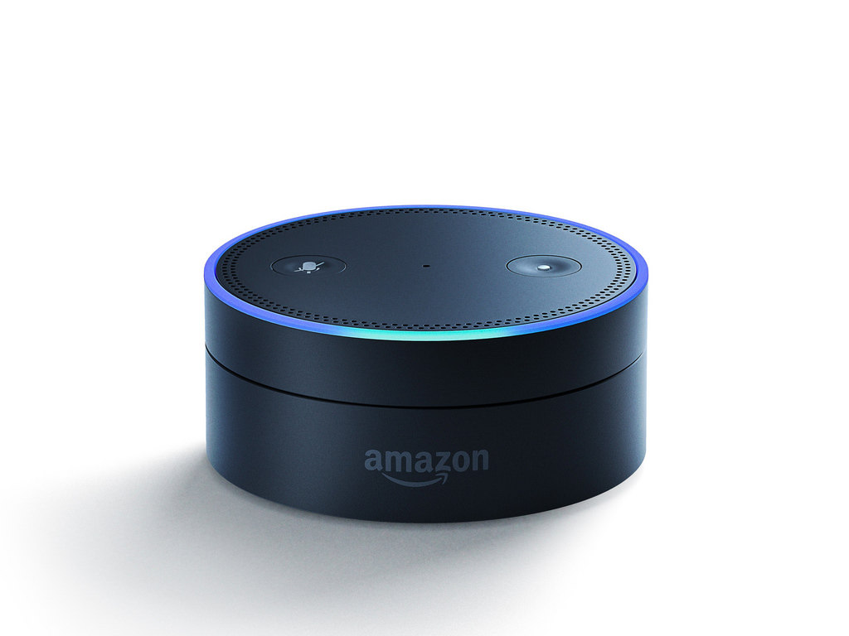
What is the Internet of Things (IoT)?
Devices interconnected on a network
Designed to improve and aid society
Data from these devices is collected and analyzed
Examples of IoT devices:
Apple Watch
Google Home
Amazon Alexa
Source: https://blog.v-comply.com/internet-of-things-iot/
Source: G. Fernandes/Flickr
Notes:
Embedded devices or microprocessors are often utilized as internet of things devices. The Internet of Things includes all of the “smart” technology constantly being developed from home appliances to fitness trackers. One thing these devices share in common is that they are connected to the internet. These devices are a major contributor to the massive amounts of data, in particular on embedded devices, generated and subsequently stored to be analyzed each day.

Slide 4
Motivations
Due to the prevalence of the Internet of Things, massive amounts of data are generated each day
IonDB^{[1][2]} was created to manage data on IoT devices
The query capabilities of IonDB are limited
Equality, range, and all records cursor queries are supported
IonDB is not compatible with SQL commands
IonDB syntax is unfamiliar to general users
4
Notes:
We live in a society where we are surrounded by these embedded devices constantly collecting and storing data. As this data rapidly accumulates, the question of where and how it is being stored and accessed is raised. IonDB was created to allow these microprocessors to contain a local database even within their memory constrained environments. However, IonDB is limited in the types of queries it supports and it is also limited in its appeal to unfamiliar users as the user code necessary to perform these database commands is complicated and unlike other query languages more commonly used.

Slide 5
Databases & SQL
Databases are used for the storage and manipulation of data
SQL is the standard query language for relational database management systems ^{[3]}
Many professions require SQL skills ^{[4]}
Most in-demand data language of 2017 ^{[5]}
Notes:
To manage the storage and access of the data generated by internet of things devices, databases are required. They control where and how the data is stored, accessed, and manipulated. To derive meaning from the data stored within a database, query languages, such as SQL, have been developed. SQL, or structured query language, is the query language most familiar to general users. Due to its popularity, it is required in many professions and remained the most in-demand data language of 2017 as determined by the number of job postings with SQL as a required programing language. As SQL is universally well-known as a standard query language, it can be extended to new areas while maintaining its familiarity to users, even as database technology evolves.

Slide 6
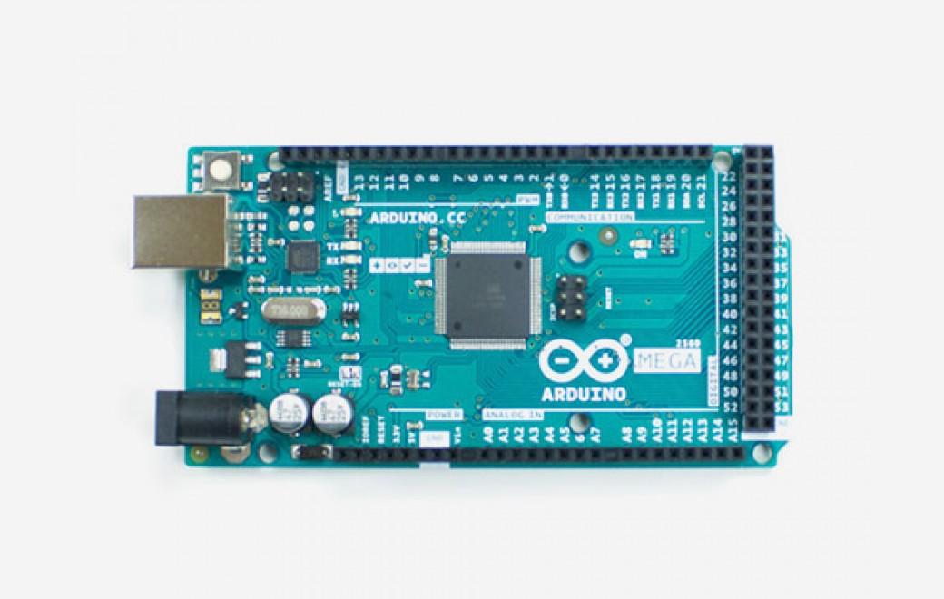
IonDB
Key value database designed for embedded devices
Performance competitive
Six data structure implementations:
Skiplist
Open Address Hash
Open Address File Hash
B+ Tree
Flat File
Linear Hash
Source: Arduino.cc
Notes:
Embedded devices, such as the Arduino shown, are often used as internet of things devices. IonDB was created as a memory efficient database to manage the data on these memory and resource constrained devices. Through its different data structure implementations to be utilized by users, IonDB is performance competitive in a microprocessor environment while remaining memory efficient. IonDB has grown a substantial following, as a comprehensive database in the area of embedded devices did not previously exist.

Slide 7
IINQ
Ion Integrated Query (IINQ)
A query language supporting IonDB queries using an SQL interface
Why IINQ?
To make IonDB more accessible to general users
Conceals complex C code from user
Optimizes code space
Notes:
Since embedded devices have insufficient memory and CPU resources to process SQL queries on device, the key contribution of this project, known as IINQ, is a compile-time optimization and automatic code generation that translates user-specified SQL queries into optimized C code for execution on the device. Through its development, IINQ allows IonDB to be SQL-enabled, therefore extending it to more general users while remaining performance competitive in a resource-limited environment.

Slide 8
IINQ
SQL Commands supported by IINQ
CREATE TABLE
INSERT
Prepared Statement INSERT
UPDATE
DELETE
SELECT
SELECT field_list FROM WHERE
DROP TABLE
Notes:
IINQ supports basic SQL commands such as create table, insert, including insertions using prepared statements, update, delete, basic selects such as select fieldlist from where, and drop table. These commands have been implemented to mimic SQL syntax as closely as possible.

Slide 9
IINQ Architecture
Notes:
IINQ’s intuitive SQL interface uses an SQL translator that converts user code into executable code on the device during compilation and building.

Slide 10
IINQ Architecture
SQL_execute(
"CREATE TABLE Dogs (id INT, name VARCHAR(30), age INT, PRIMARY KEY(id)); ");
Notes:
To perform an SQL command, the only code the user is responsible for writing is the command itself, in IINQ SQL format. This is demonstrated through a sample create table statement.

Slide 11
IINQ Architecture
Notes:
Once the user code is written, an SQL translator is run to generate the C code necessary to run the SQL command on IonDB.

Slide 12
IINQ Architecture
create_table("Dogs.inq", key_type_numeric_unsigned,
sizeof(int), (sizeof(int) * 3)+(sizeof(char) * 70));
Notes:
This is accomplished through Java code parsing the user code and writing back to another C file in the user’s directory only the C code for their current commands. Therefore, the file with the generated code supporting the functionality of IINQ is re-generated depending on the user’s commands as to limit the space it uses and increase IINQ’s performance speed. The user commands are also updated by the Java code to follow the function signatures of IINQ, as demonstrated by the translated created table statement.

Slide 13
IINQ Architecture
Notes:
Following the C code generation by the Java SQL translator, the code is now executable and can be compiled and run on device.

Slide 14
INSERT Statement
SQL
INSERT INTO Dogs VALUES (1, "Minnie", 5);
IonDB
ion_value_t value = (ion_value_t) ”Minnie";
dictionary->insert(1, value);
IINQ SQL
iinq_prepared_sql p = SQL_prepare(
"INSERT INTO Dogs VALUES (1, 'Minnie', 5);");
execute(p);
Notes:
To demonstrate the similarity of SQL and IINQ SQL, an insert statement is written in each respective syntax. An insert statement in IINQ always includes the added step of calling execute. Therefore, the same functions, with the added optional step of setting a parameter, can support simple and prepared statement inserts using the same functions.

Slide 15
INSERT Statement
SQL
INSERT INTO Dogs VALUES (1, "Minnie", 5);
IonDB
ion_value_t value = (ion_value_t) ”Minnie";
dictionary->insert(1, value);
IINQ SQL
iinq_prepared_sql p = SQL_prepare(
"INSERT INTO Dogs VALUES (1, 'Minnie', 5);");
execute(p);
Notes:
The improvement over IonDB syntax is obvious as the IonDB example above only shows one of the 3 target values being inserted. To replicate the insertion of 3 values into a single record, several steps would need to be performed to concatenate a byte array with the values, or the user could perform a separate insert statement for each value using a different key each time.

Slide 16
UPDATE Statement
SQL
UPDATE Dogs SET age = 4 WHERE id = 1;
IonDB
dictionary->update(1, 4);
IINQ SQL
SQL_execute(
"UPDATE Dogs SET age = 4 WHERE id = 1;");
Notes:
In the case of update, delete, and select, the similarity of IINQ SQL to standard SQL syntax is apparent as the command remains the same with the added step of writing it as a string within a function call.

Slide 17
UPDATE Statement
SQL
UPDATE Dogs SET age = 4 WHERE id = 1;
IonDB
dictionary->update(1, 4);
No WHERE condition
IINQ SQL
SQL_execute(
"UPDATE Dogs SET age = 4 WHERE id = 1;");
Notes:
IonDB’s current implementation did not support any where conditions and could only update the value as a whole, based on its key, so updates of parts of the record were previously extremely complicated to perform.

Slide 18
Update Architecture
Notes:
The implementation of update is demonstrated in this figure. Each record of the table listed in the update command is iterated through, using an IonDB all records query. The record is then passed to the where function to determine if the record passes the user specified where condition. If it does, the record is stored in a temporary dictionary. If it does not, we proceed to the next record. After the whole table has been iterated through, we then iterate through the temporary dictionary, where each record value is updated accordingly, and an IonDB update command is performed on the original table. The temporary dictionary is cleared from memory following all updates.

Slide 19
UPDATE Generated C Code
void update(...) { // Set-up variable argument lists // Set-up table information iinq_open_source(table_name, &dictionary, &handler); // Initialize all record query
// on table // Create temporary dictionary to
// store records passing WHERE while ((status = iinq_next_record(cursor, &ion_record)) == cs_cursor_initialized || status == cs_cursor_active) {
condition_satisfied = where(table_id, &ion_record, num_wheres, &where_list);
if (condition_satisfied || (num_wheres == 0)) { dictionary_insert(&dictionary_temp, ion_record.key, ion_record.value); } } // Iterate through temporary dictionary storing
// WHERE result set and perform updates
while ((status = iinq_next_record(cursor_temp, &ion_record)) == cs_cursor_initialized || status == cs_cursor_active) {
// Update record value
dictionary_update(&dictionary, ion_record.key, ion_record.value)
} // Perform dictionary clean-up }
19
Notes:
To demonstrate, the above is a condensed version of the generated C code for an update command. Each loop corresponds to a box shown previously in the update architecture diagram. In full, this function is 176 lines of formatted code and can support an indefinite number of update statements for any particular table.

Slide 20
DELETE Statement
SQL
DELETE FROM Dogs WHERE age < 5;
IonDB
dictionary->deleteRecord(1);
IINQ SQL
SQL_execute("DELETE FROM Dogs WHERE age < 5;");
Notes:
The architecture of delete is very similar to update. IINQ can perform deletions using any number of where conditions,

Slide 21
DELETE Statement
SQL
DELETE FROM Dogs WHERE age < 5;
IonDB
dictionary->deleteRecord(1);
No WHERE condition
Key
IINQ SQL
SQL_execute("DELETE FROM Dogs WHERE age < 5;");
Notes:
Whereas previously, IonDB could only support the deletion of records based on their key, and not their value, which limited its use. IonDB also did not support where conditions in its delete statements.

Slide 22
SELECT Statement
SQL
SELECT name, age FROM Dogs WHERE id >= 0;
IonDB
Cursor <int, ion_value_t> *cursor = dict->range(0,100);
IINQ SQL
iinq_result_set rs = SQL_select(
"SELECT name, age FROM Dogs WHERE id >= 0;");
Notes:
Select is fundamental to the functionality of an SQL-supporting database. Previously, IonDB only supported equality, range, or all records queries, hence the filtering accomplished through a where condition could in many cases not be performed. When a select statement is run in IINQ, it returns a result set iterator so that the result set of the query can be iterated through, using a next function, and printed, for example, at the user’s discretion, modelling Java JDBC SQL syntax.

Slide 23
Select Architecture
Notes:
The architecture of select is similar to that of update and delete, with the added component of the result set iterator being returned to the user. Proper memory clean-up is performed following iteration of the complete result set.

Slide 24
Experimental Results
SQL Command | Test Specifications | Mean Performance Time (ms) | Standard Deviation of Performance Time (ms)
INSERT |  | 350.45 | 22.22
INSERT | Prepared Statement | 354.99 | 47.29
UPDATE | 1 Field to update, 1 WHERE condition | 4066.14 | 1135.43
UPDATE | 1 Field to update, 3 WHERE conditions | 4025.1 | 1118.43
UPDATE | 3 Fields to update, 1 WHERE condition | 4066.41 | 1135.15
UPDATE | 3 Fields to update, 3 WHERE conditions | 4199.41 | 1197.64
DELETE | 1 WHERE condition | 4114.29 | 1181.28
DELETE | 3 WHERE conditions | 4128.93 | 1189.18
SELECT | 1 WHERE condition | 3439.19 | 841.82
SELECT | 3 WHERE conditions | 3470.17 | 856.49
24
Notes:
Experimental results were gathered for all insert, update, delete, and select commands, and were performed on an embedded device known as an Arduino ATmega 2560, which has 256 KB of flash memory, 8 KB of SRAM, not including the added capacity of the microSD card, and a clock speed of 16 MHz. The results of performing 5 commands of varying type on a table ranging in size from 0 to 750 records is shown in the table.

Slide 25
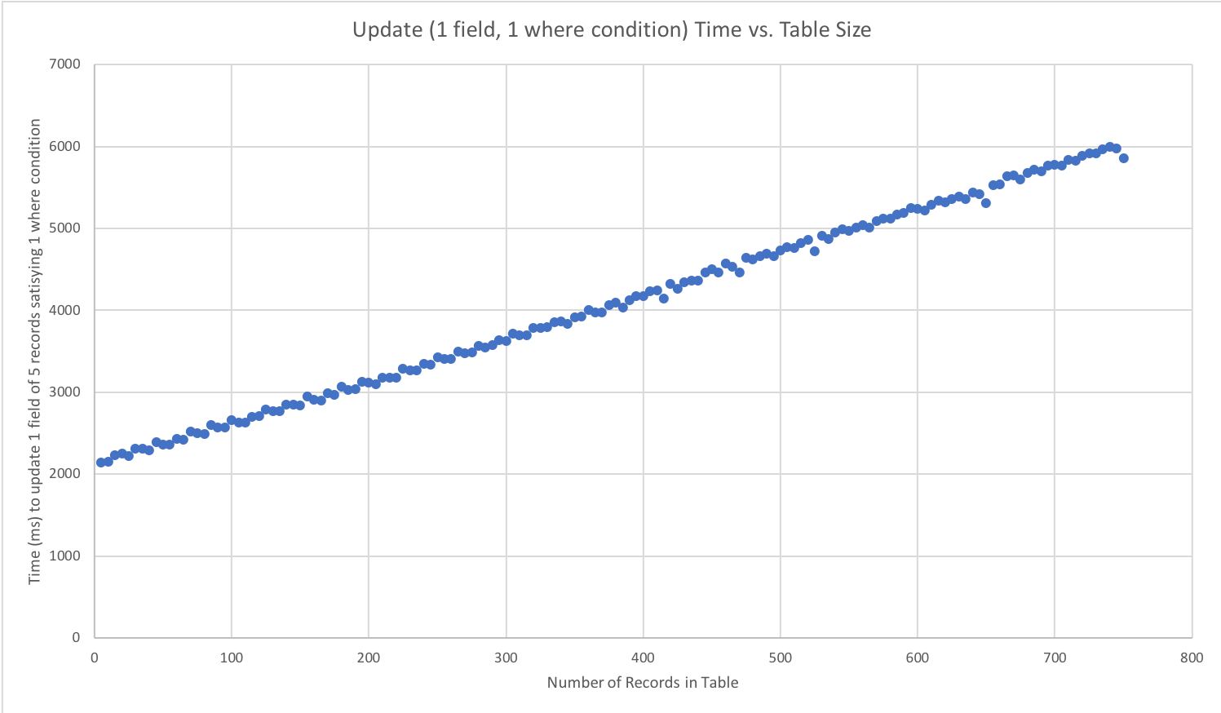
Experimental Results
Mean: 4066.14 ms, Standard Deviation: 1135.43 ms
25
Notes:
In particular, the results of performing 5 update commands, where 1 field is being updated and the command includes 1 where condition, is shown in the figure. The mean performance time was calculated to be just over 4 seconds, which is comparable to standard IonDB performance.

Slide 26
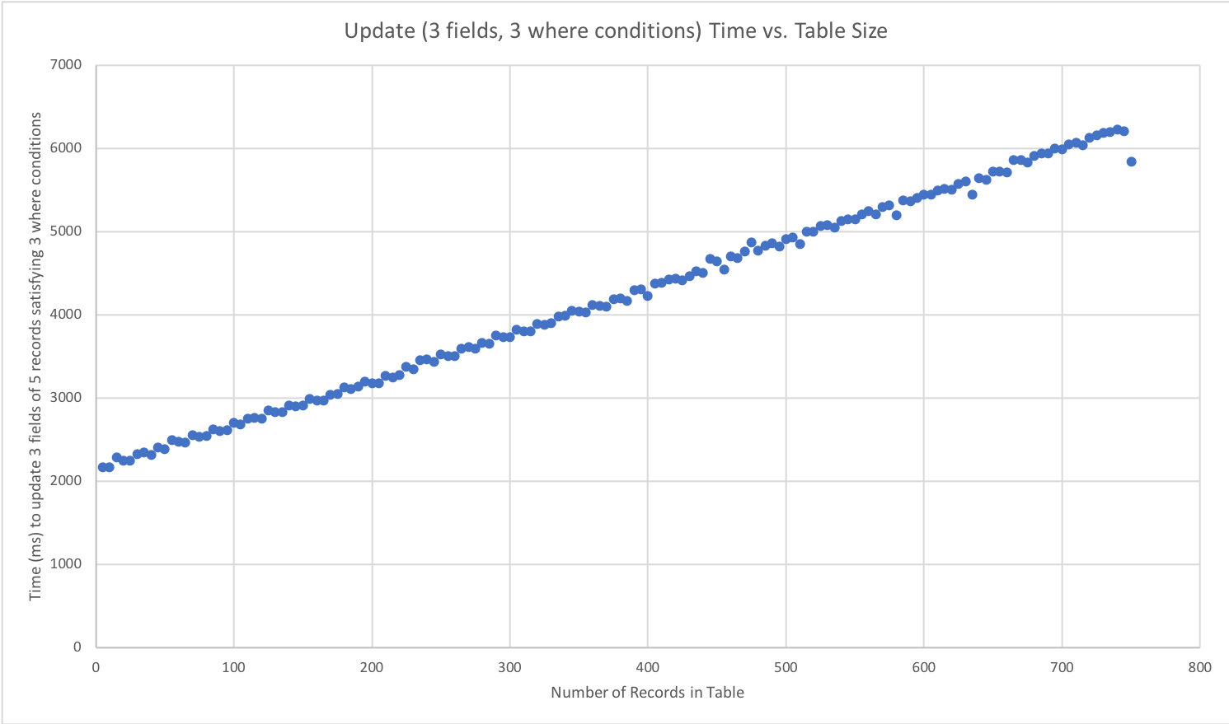
Experimental Results
Mean: 4199.41 ms, Standard Deviation: 1197.64 ms
26
Notes:
In addition, I re-performed the same test using an update command where 3 fields in the record are being updated and the command includes 3 where conditions. As expected, due to the additional updates and where conditions, the mean performance time of this test as well as the standard deviation, are slightly increased. However, the performance time remains respectable.

Slide 27
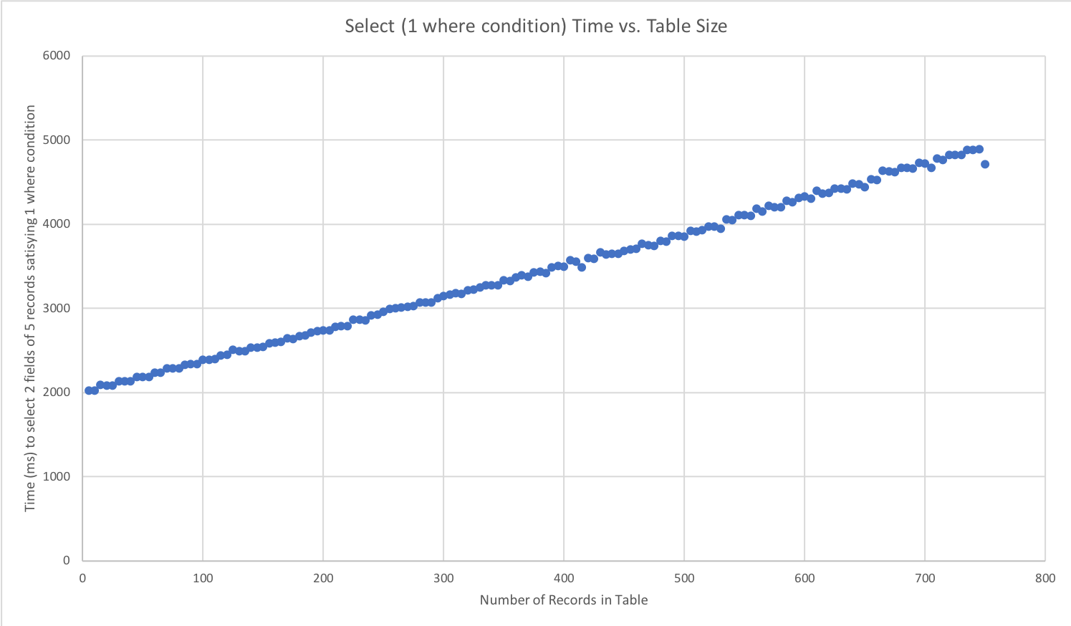
Experimental Results
Mean: 3439.19 ms, Standard Deviation: 841.82 ms
27
Notes:
The performance time of a select statement selecting 2 fields from our table with one WHERE condition is shown in the figure. In comparison to update, selects performance time is faster due to only one table scan. In addition, the time to iterate through the result set returned by the select statement is not measured as it is performed based on user preference.

Slide 28
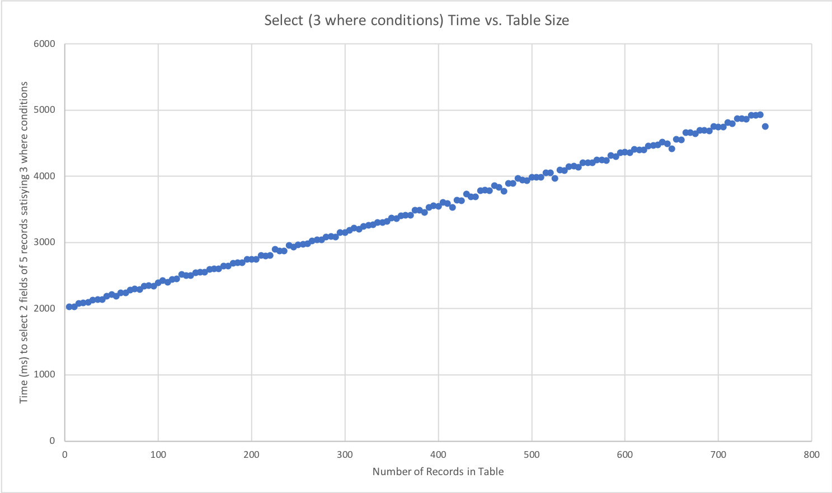
Experimental Results
Mean: 3470.17 ms, Standard Deviation: 856.49 ms
28
Notes:
As expected, performance time of a select statement increases to roughly 3.5 seconds when 2 additional where conditions are added. However, this increase is miniscule in overall performance time.

Slide 29
Conclusions and Future Work
IINQ was created to support SQL user code
Maintains IonDB’s level of performance
Code base is dynamic as it only includes required functions
Performs all user code parsing in Java translator
Additional SELECT features need to be implemented
Aggregates, GROUP BY, ORDER BY
Utilization of query planning through UnityJDBC
29
Notes:
In summary, the development and performance evaluation of an SQL interface for IonDB were demonstrated, including the compile-time optimization and automatic code generation that translates user-specified SQL queries into optimized C code for execution on the device. The experimental results showed that in an embedded device environment, IINQ remains memory efficient and performance competitive.
With further development, IINQ can be extended to include more complex features of SELECT such as aggregates, order by and group by clauses. In addition, IINQ can be integrated to utilize the UnityJDBC driver to further optimize its query planning.
Through IINQ, IonDB can now be extended to a greater audience that is familiar with the universal syntax of SQL.

Slide 30
References
[1] W. Penson, E. Huang, D. Klamut, E. Wardle, G. Douglas, S. Fazackerley and R. Lawrence, "Continuous Integration Platform for Arduino Embedded Software," in 2017 IEEE 30th Canadian Conference on Electrical and Computer Engineering (CCECE), Windsor, 2017.
[2] S. Fazackerley, E. Huang, G. Douglas, R. Kudlac and R. Lawrence, "Key-value store implementations for Arduino microcontrollers," in 2015 IEEE 28th Canadian Conference on Electrical and Computer Engineering (CCECE), Halifax, 2015.
[3] D. Lorentz and J. Gregoire, "Oracle Database SQL Reference," December 2003. [Online]. Available: https://docs.oracle.com/cd/B13789_01/server.101/b10759/intro001.htm. [Accessed 22 February 2018].
[4] P. Garner and J. Mariani, "Learning SQL in steps," Journal of Systemics, Cybernetics and Informatics, vol. 13, no. 4, p. 19, August 2015.
[5] J. Patel, "The 9 Most In-Demand Programming Languages of 2017," 7 February 2017. [Online]. Available: https://www.codingdojo.com//blog/9-most-in-demand-programming-languages-of-2017/.
Notes:
Thank you.

