Slide 1
Efficient Interactive Text Playback for Code Sharing and Tutorials
Undergraduate Research Conference 2017
Eric Huang
Ramon Lawrence
Computer science

Slide 2
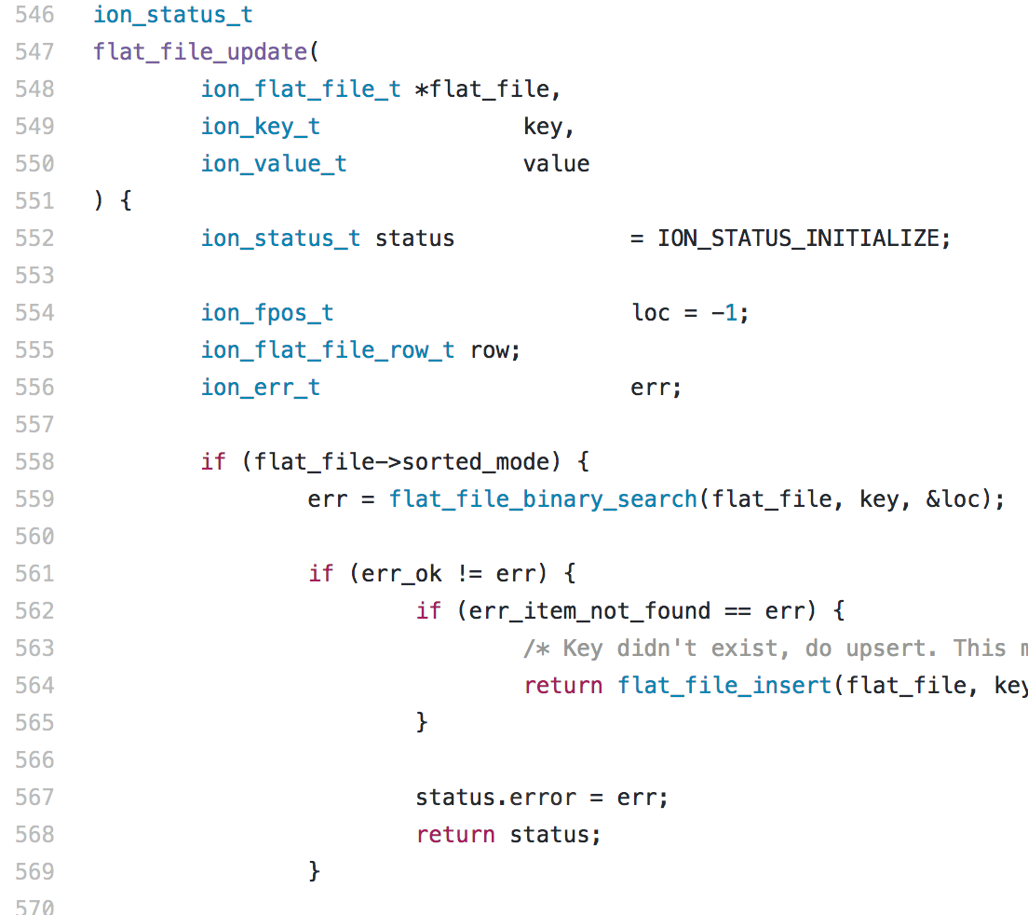
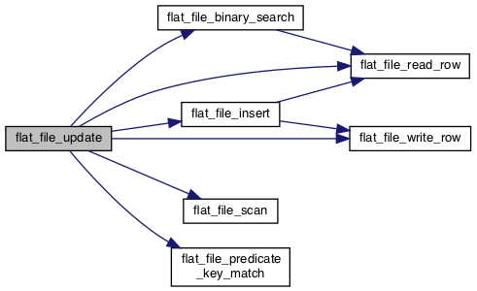
Background
Software is written organically in a dynamic, fluid fashion
We read it linearly, top to bottom – why?
Notes:
Talk about writing code (organic) versus reading code (linear, top to bottom) [diagrams]

Slide 3
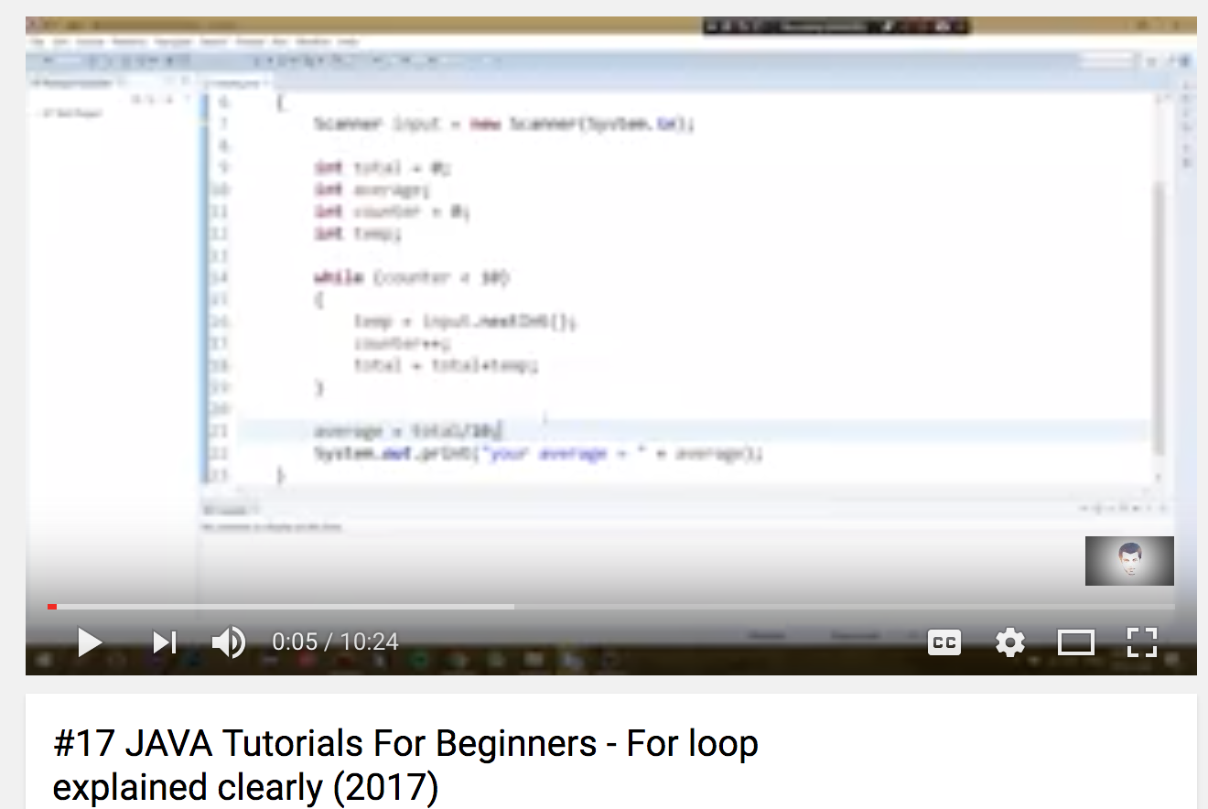
background
The modern solution to this problem:
Notes:
Lead to coding videos as an alternative learning method [picture of bad quality tutorial]

Slide 4
Motivation
The problem with videos:
File size
Quality
Immutability – Copy & Paste

Slide 5
Motivation
Core idea:
“What if we stored a recording of the text itself, instead?”
Benefits:
Significantly smaller file size
Perfect quality
Can manipulate like other text

Slide 6
design
Compact storage by only recording timestamps and keystrokes
Result: Filesize is bounded only by number of actions, not length
Storage format?
Markup (XML, JSON) – human readable, but high overhead. Requires complex/slow parsing.
Binary – not human readable, but very compact. Cheaper parse.
Notes:
Possible storage ideas: [with short example pictures]

Slide 7
Protobuf: Google protocol buffers
Protobuf:
“A binary record format designed for fast parsing and compact transfer”
Reasons for Protobuf:
Extremely fast parse: “20 to 100 times faster than XML”
Compact size : “3 to 10 times smaller than XML”
Parsing is easily susceptible to bugs
Provides backwards compatibility
Network ready – no intermediate serialization required
Notes:
Compact size [show numbers vs xml/json, emphasize why important for BITR]

Slide 8
BITR: Binary Interactive Text Recording
Core components:
Reader – Custom GUI (Java)
Writer – IntelliJ Plugin
File format specification – Protobuf
BITR features:
Play/Pause
Fast Forward
Seek
Copy & Paste
Notes:
Describe capabilities [play, pause, copy/paste, fastforward, rewind, seek, streaming capability]

Slide 9
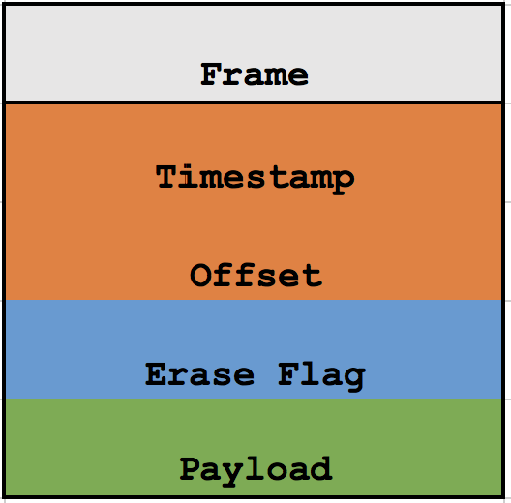
BITr terminology
Frame – a record containing one edit action
Timestamp – milliseconds since start
Offset – location of edit
Erase flag – was it a delete?
Payload – string

Slide 10
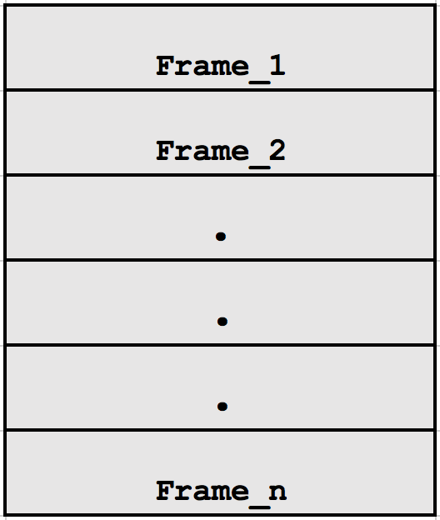
BITr terminology
Timeline – a sequence of frames
Forms a complete BITR file
Notes:
Describe playback sequence (loading frames and applying changes iteratively to the text)

Slide 11
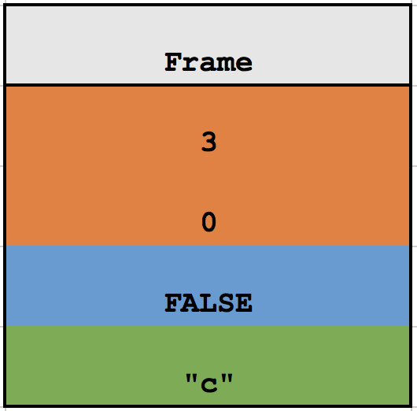
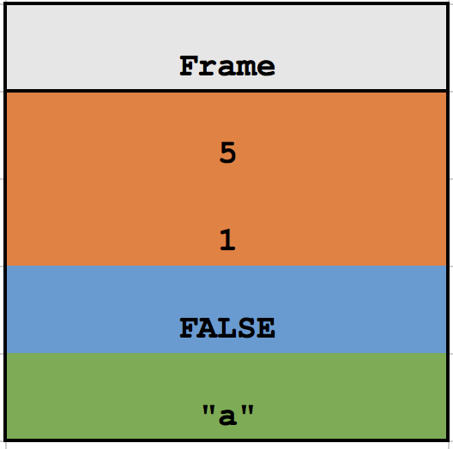
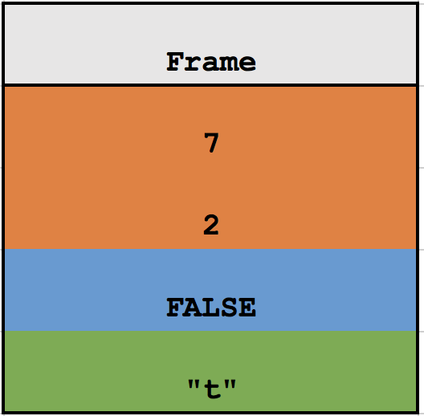
BITR example
User types “cat”

Slide 12
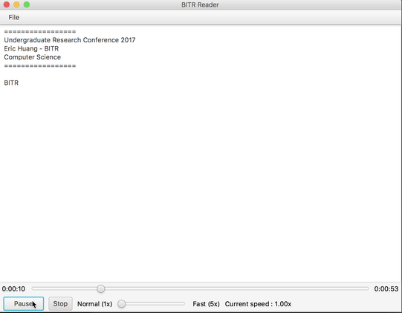
Bitr example: Speed control

Slide 13
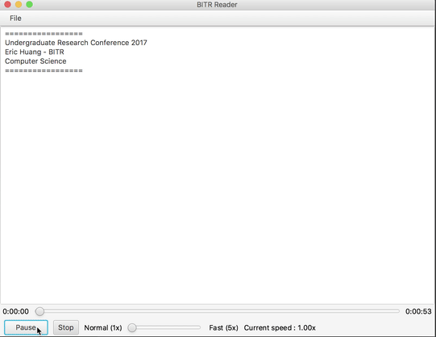
Bitr example: seek

Slide 14
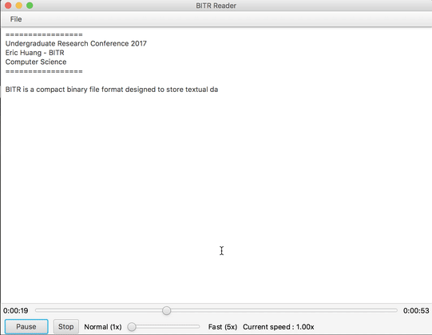
Bitr example: copy & paste

Slide 15
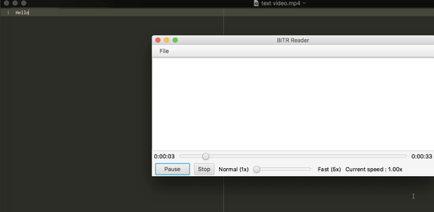
Experimental results
Video: 49,707,974 bytes (47.4MB)
BITR: 1,844 bytes (2KB)

Slide 16
applications
Codebase familiarization
Plagiarism detection
Multicast streaming
Notes:
Explore impact on how it affects someone learning a codebase
Plagiarism detection
[application to grading assignments and knowing if the user was legit]
Expand to multicast streaming [live streams using BITR as the protocol]

Slide 17
Conclusions and future work
Simultaneous multiple file support
Edit cursor position, mouse cursor
Annotation support
Special thanks to Dr. Ramon Lawrence for his continued support and mentorship throughout my undergraduate degree.
Notes:
Like an ide

