Slide 1
An Exploration of the Multi-Armed Bandit for Performance-Driven Marketing
a presentation by Giuseppe A. Burtini in partial fulfillment of the requirements for the degree of Master of Science
Notes:
Open a text area for writing notes on my screen, open thesis, set up speaker notes, plug in if possible.
Email: g.burtini@alumni.ubc.ca
Presented: Oct. 6., 2015.

Slide 2
Outline
A Short Introduction to Bandit Problems
Definition, history and interesting stories.
Some complicating factors of the multi-armed bandit.
Motivating Examples
A high-level overview of application areas.
A look at my specific application area, what tools already exist in that space, why they were not adequate.
Research Contributions
Nonstationarity in Multi-Armed Bandits
What it is, why it matters and a new technique to deal with it.
Measurement Issues in Multi-Armed Bandits
Regret(s) and statistical regret.
Other Research Contributions
A Discussion of Open Questions
Notes:
Don't get in to sub bullet points.
First, I'll introduce the multi-armed bandit in general, as well as provide a real short quick-fire history of bandit research, some interesting little tidbits I've picked up along the way, things like that. I'll introduce some of the complications of the simple form of the model and then provide some story of motivating examples before introducing my own application area.
\\~\\
We'll highlight a few of my major research contributions:
\\~\\
1. I'll present (at a high level) an algorithm called LinTS with WLS for a common type of bandits that recognizes that the real world is constantly changing and show some results on how it performs compared to the state-of-the-art.
\\~\\
2. I'll present a discussion of the many different forms our principle objective criteria, \emph{regret}, can take on.
This became really interesting when we started exploring some of the implementation questions, as some of the (important) research results that are out there were only true if you used a definition of regret that, in my opinion, did not reflect real world considerations.
\\~\\
3. I'll present a cool way to work around a computational problem in the ``real world'' for comparing different bandit algorithms.
\\~\\
Finally, once we've gotten through all that, I'll show you a few slides that really quickly discusses some of the huge set of other stuff I did that doesn't fit nicely in to a 25 minute presentation. Then, in the last few minutes of this talk, I'll show you that there's a huge set of open questions here and much lucrative research to be done going forward.

Slide 3
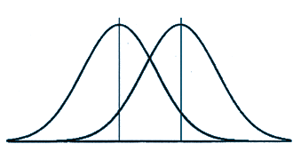
What is the multi-armed bandit?
Imagine a row of K slot machines (so called arms) with unknown and variable payoffs, and a player who must choose which machines to play over a time horizon H.
At each time step t, the agent collects a reward from the selected arm i – providing some information – but learns nothing about the other arms.
Notes:
Adaptive experiments are experiments where the parameters of the experiment (sample size, selection mechanism, treatments, etc.) may change as information is revealed.
The actual terminology "multi-armed bandit" was first used in 1952 by Herbert Robbins in his paper "Some aspects of the sequential design of experiments." But, it built on prior work of Wald (1947) and others in the space of "adaptive experiments."
Some go as far back as to credit Thompson (1933) with the original bandit problem.
Whittle (1979) tells a story which implies Allied research during WWII (1939 - 1945)
Interesting story in the history here...
"Originally considered by Allied scientists in World War II, it proved so intractable that, according to Peter Whittle, the problem was proposed to be dropped over Germany so that German scientists "could also waste their time on it".^{[12]}"
"Thompson (1933) provides an answer to a related question: how to identify the probability of a distribution being better than all others from a set of distributions, and has thusly been sometimes credited as the origin of the multi-armed bandit.
Even more confounding on the origins of the multi-armed bandit, Dr. Peter Whittle said in review of the 1979 paper of Gittins [67] the following:
'As I said, the problem is a classic one; it was formulated during the war, and efforts to solve it so sapped the energies and minds of Allied analysts that the suggestion was made that the problem be dropped over Germany, as the ultimate instrument of intellectual sabotage. In the event, it seems to have landed on Cardiff Arms Park. And there is justice now, for if a Welsh Rugby pack scrumming down is not a multi-armed bandit, then what is?'
As World War II ended in 1945, this provides evidence that the problem was under discussion at least privately by the military if not elsewhere prior to the Robbins (1952) paper. Robbins (1952) is the first indexed paper to call the problem the multi-armed bandit and provides a formulation similar to the formulation used to date."

Slide 4
Bandits, continued.
What is the player to do? He must balance exploration (the discovery of new information) with exploitation (the use of information he already has).
At the start, the player knows nothing about the arms - they must explore to produce estimates of each arm's payoff distribution.
The key: the player wants to maximize their profit or minimize their regret across all plays.
Notes:
The player wants to build a model to understand the world, and use it to maximize his profit. Next slide talks about regret.
This is really fundamental - the idea that after the very first time you play an arm, you don't have a "complete picture" is core to the story of the multi-armed bandit. We need to decide, continuously, how to deal with uncertainties.
This is also what makes the bandit problem such a great applied tool: it reflects reality, the idea of balancing learning more and using what you know occurs everywhere: from shopping, to career choices, to specific business-objectives like website optimization.
As the player becomes more confident in his estimates of the arm payoffs, he will transition to exploiting his knowledge -- playing the best known arm.

Slide 5
Regret
Regret can be taken with a similar definition as it has in English. I propose this definition as an appropriate one:
“The remorse (that would be) felt as a result of dissatisfaction with the agent’s choices.”
The regret measure is the difference in what the best arm (in reality) would have paid and the payout from the selected arm.
Regret requires an oracle or prescient agent to calculate.
Notes:
There are many subtlely different definitions of regret, but...
The need for an oracle to score algorithms in terms of regret is core. I present a strategy later for comparing bandit algorithms that is oracle-free which is really important in the "real world" when you cannot necessarily do simulation studies.
The reason we use regret instead of maximization is that it produces a value that is comparable regardless of the absolute scale of the rewards. If the rewards are all shifted up by 100, the regret is still measured the same. They are otherwise equivalent, other than some edge case stuff when you start talking about discounting rewards.

Slide 6
Playing Strategy (example): ɛ-first (Auer et al. 2002)
A simple (and suboptimal) example strategy or policy:
Imagine playing each machine a fixed number of times (say, 10), call this the "exploration phase."
And, then playing the best performing machine from that sample forever: the "exploitation phase."
Notes:
Share only one reason it is bad. Not all algorithms switch between "exploration" and "exploitation" phases.
Why is this bad? Lots of reasons.
Fixed number of trials does not take into consideration variation or closeness between arms.
If arms are very variable or very close together, the fixed number may be too few (and thus a wrong arm can be identified often)
If arms are not very variable or very far apart, the fixed number may be wasteful.
Need to select N (the fixed number) perfectly. This is best done with information that will be collected while playing.
It doesn't adjust over time -- if the world is changing, doing all your "exploration" up-front is bad.
In the way I've proposed it here, it is myopic: it doesn't consider how long we have to play (if we're only playing 20 times, you shouldn't spend all of them exploring).
We can do better. Much better.
Even in epsilon strategies, we can do better by rephrasing this as epsilon-greedy.
Epsilon-first where we don't play a fixed number, but rather a calibrated fraction of time can be better.
Need to calibrate the fraction. Selecting N is hard.

Slide 7
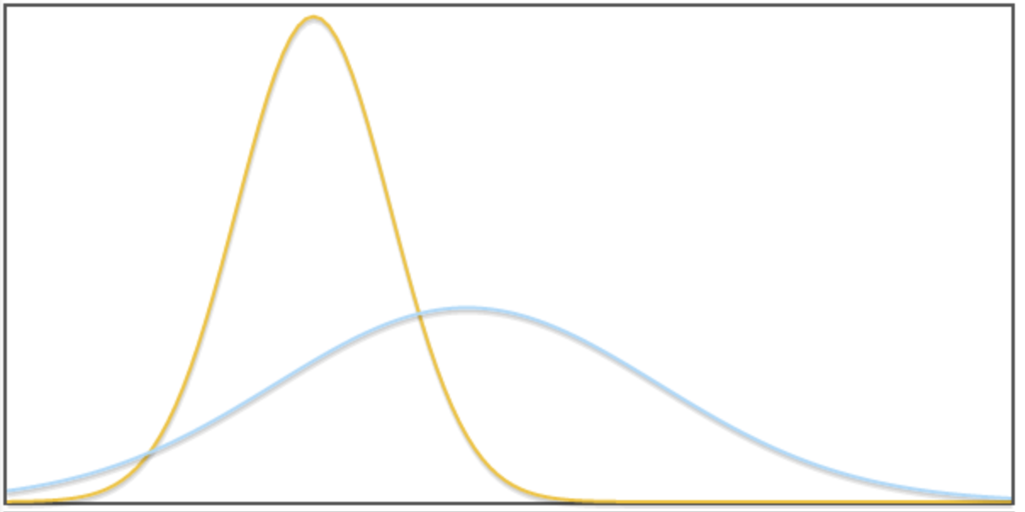
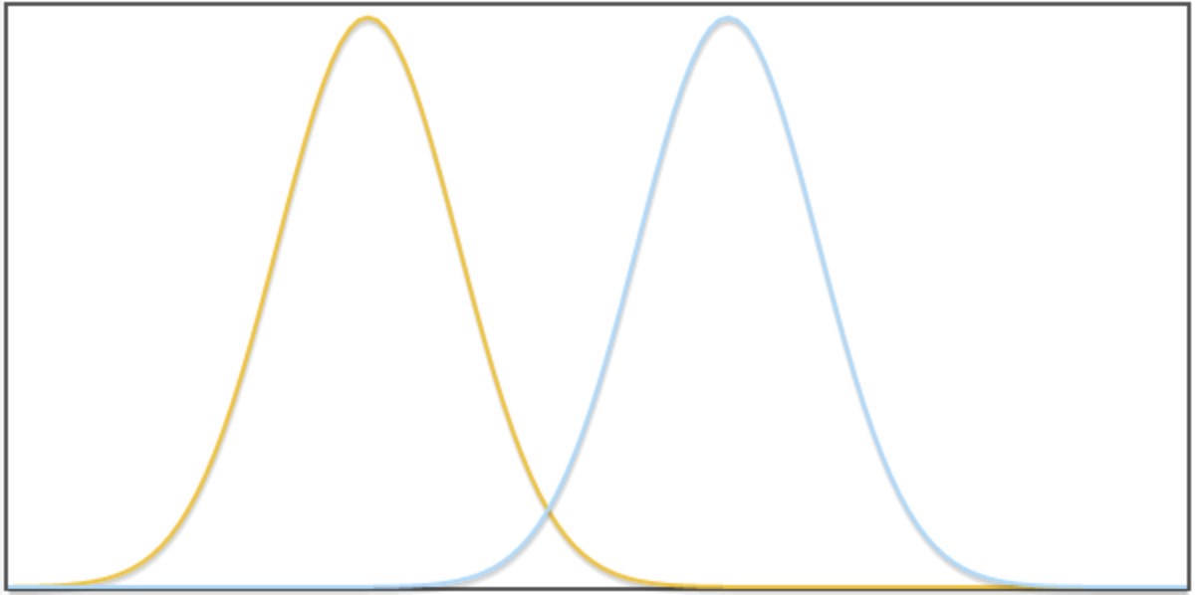
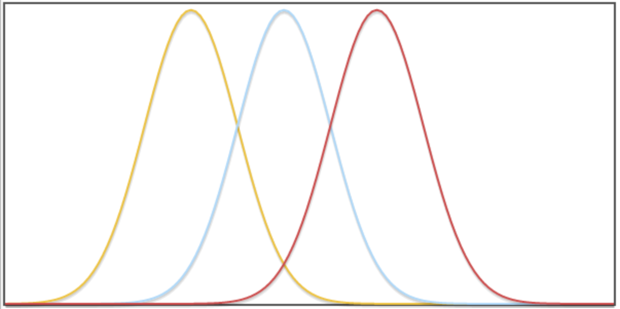
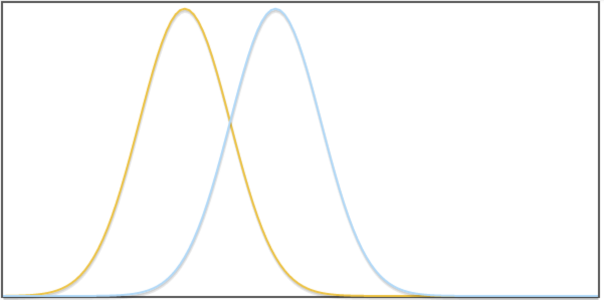
Strategies, Environments and Complications
There are many strategies, appropriate for different environments.
The length of the horizon can differ.
The arms can differ in a number of ways.
Gaps, variance, distributions, number, heterogeneity.
Example worlds pictured below as normally distributed, but can be any distribution.
Notes:
Transition to next slide
And, there are some complicating factors that give rise to structured variants of the problem, with completely different strategies.
Probably only discuss the below if it is asked v.
Which profit should the player maximize?
Quadratically discounted profits.
Non-discounted profit.
"Worst case" profit, variance or drawdown aware profit.
Images made here: http://jsfiddle.net/6pqxcy68/ by me.

Slide 8
Complications of the Multi-Armed Bandit
There are many, many possible complicating factors which make the bandit problem "more interesting" for particular applications.
Nonstationarity or "drift": nonstationary bandits
Available context and covariates: contextual bandits
Continuous bandits
Adversarial bandits
Feedback delayed bandits
Cost-aware bandits
Budget-constrained bandits
Switching cost bandits
Multiple-play bandits
Notes:
Don't try to define all these. Just "I'm going to focus on two."
Nonstationarity
the reward is varying in time, data received now will be "less valuable," in some sense, later.
Context
the reward of each arm can be influenced by other variables either observed or unobserved. By considering these, we can do better!
Continuity
where the arm selection is a continuous variable (e.g., selecting a price). Hard!
Adversarial
where the rewards are picked by an adversary.
the most general form, as we cannot assume anything about the distribution.
the algorithms for this form often perform poorly in the real world
Feedback Delay
where we don't know the reward of an arm immediately
Cost Aware
where playing an arm has a fixed cost, there's a maximal budget or switching the arm being played has an associated cost.
Multiple Play
More than one (distinct) arm must be selected simultaneously, for example, positioning multiple ads on a website.

Slide 9
Application Areas
The casino example is just a great story. Why do we really care about multi-armed bandits? There are many applications.
Clinical trials. This is a space where the cost of "wrong" trials in our experiments can be very high (people's lives!). Bandits can provide a lower cost for identifying between two competing drugs.
Adaptive routing. The problem of identifying the best route through a network.
Employee allocation. In almost any context where performance can be measured, employee performance on a task can be modeled as an experiment with the continual goal of maximizing their performance.
Notes:
Clinical trials has high costs associated with "wrong" trials, which make it a strong candidate for using bandits rather than traditional experiment designs.
Adaptive routing has ongoing experiment considerations including nonstationarity (perhaps, locally drifting though).
Computer (LAN, WAN), roadway (e.g., UPS or FedEx) or otherwise. This has a notion of "ongoing" experiment associated with it as the demands on the network are continually changing.

Slide 10
Application Areas, continued.
The "real" world: it isn't true that these experiments must be confined to well-defined rigorous studies.
Dumitriu et al. discusses selection of golf balls.
Anglers must select appropriate tackle and bait to catch more fish.
Marathon runners must select shoes to optimize their performance.
In so many cases, experimentation has historically had high costs associated with it in terms of selecting the "wrong" variant. Life is short, people have goals or expectations they must achieve.
Notes:
Not all experiments have to be stodgy lab coat type experiments: integrate experiments in to lots of real world environments by reducing cost.
On the last point there, bandit strategies largely solve this problem by dramatically reducing the cost of experimentation -- it is often true that very little time will be spent on suboptimal arms if they're clearly different, and if they're not, it didn't matter anyway. :)
'the pursuit of a good life can be represented as finding a balance between “exploration,” or the investigation of new options and “exploitation,” the utilization of the knowledge one has already accrued. '
Peter Whittle: “Bandit problems embody in essential form a conflict evident in all human action: information versus immediate payoff.”

Slide 11
Bandits for Online Marketing
Online marketing experiments are the core application area of my work.
In my application, the multi-armed bandits' "arms" are variants of a website and the reward is some function of the action we wish the user to perform.
We need a technique for conducting experiments on the web, with all the conflating factors built in to that environment.
Notes:
Conflating factors like high dimensional user covariates, social interaction issues, measurement issues, nonstationarity, small sample size and more.
We might be looking to detect changes that could be extremely small. That is, we might have variants of a website where some of a set of changes don't matter much at all, but one or two matter a lot. The traditional experiment really falls apart there.

Slide 12
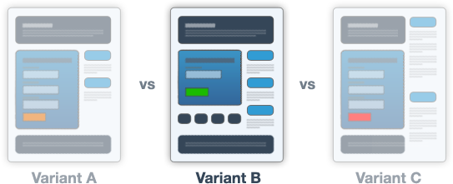
What sort of experiments?
Changing text on a website to increase sales.
...the color of a button to increase clicks.
A complete overhaul (replacing a variant of a website with a new one).
Any discrete experiment (A vs. B vs. C vs. ...). No limit, and with an effective bandit process, there is little reason to not experiment more: convergence is either very fast or doesn't matter.
Image redistributed with permission under the GFDL. Wikipedia.
Notes:
In particular, in traditional t-test based experiments, detecting small changes between variants might cost a large number of observations. This limits the number of experiments we can conduct. In the bandit mechanism we have two situations:
The difference between the variants in question is small. In this case, it will take a long time for us to identify the better variant, but the "cost" ("regret") among those changes is small.
The difference between the variants is large. Learning happens quickly in this case.
This is distinct from a sample-size fixed t-test (the "proper" way to conduct such an experiment), where we can only consider a guess or prior estimate of the gap ahead of time.

Slide 13
What already exists?
There's a lot of A/B testing (t-test / z-test) solutions for this.
But, A/B testing solutions are bad for most users.
Sample sizes for detecting small changes are huge and must be established before the designer knows. (for many users, a single experiment might require 20 years of traffic to "achieve significance")
During an experiment, even if one variant is much worse, 50% of the users are still delivered an inferior variant Lost revenue!
Many implementations get the model wrong or require a statistically knowledgeable experimenter. (this can be as bad as 63% false positive if the test is conducted after every visitor - worse than a coin flip!)
Notes:
Even commercial implementations get the model wrong. One popular package has a mode called "stop when significance is reached" that performs the test (without repeated testing correction) after each trial. This means you'll keep going if you don't like the result, and stop if you do like it, and your estimates of "significance" are all wrong: you will achieve a "significant" result far more often than your test intended.

Slide 14
Multi-Armed Bandits Solve This
We move from trying to capture a strong estimate of the value of each variant to only trying to identify the best variant (or conversely, to discard bad variants).
There is no concept of "significance" anymore. (The experiment doesn't even have a concept of "being over," it is just "getting better")
The model doesn't have as many implicit assumptions baked into it. (It is harder to build a simple strategy and get it seriously wrong.)
The model is continuously optimizing its behavior towards the best variant. (Lost revenue from bad variants is much smaller, as they're shown less often.)
Notes:
Negative factors; we often can't compare suboptimal results, because we didn't collect enough data about them. In a clinical trials context, Kaptein (2015) shows that this isn't (necessarily) a problem.
I concluded at this point that the MAB was the "right tool" for web development.

Slide 15
So, I set out to build it...
...and there were many unresolved questions, no infrastructure to test them in.
Nonstationarity was mostly unconsidered.
This may be because the experiment horizon is often very short or because medical trials have been a common motivating example case. Nonetheless, with an experiment "never" ending, this is important!
Public implementations of most algorithms was missing or incomplete.
Original papers left many questions about implementation open to interpretation or left important questions unexplored.
Some things just didn't feel right!
This encouraged extensive experimentation and validation of existing assumptions/results.
Notes:
The problem was well known, there was a lot of discussion, etc.
THINGS THAT DIDN'T FEEL RIGHT:
e.g., Optimism went against many of my intuitions, conflated by some confusing results in the published work. Regret was very hard to talk about: it always brought up questions of how to define it appropriately.
Medical trials can be modeled as ongoing experiments in an interesting sense though -- consider the case of antibiotic use within a community. For a given (suspected) symptom, there is a diagnosis of "possibly bacterial" and a class of antibiotic that is appropriate for use. The choice of antibiotic is generally left up to the medical professional while community-borne resistances vary. This could be setup as a continuous drifting experiment with multi-armed bandits.
In some cases, (3) has been resolved in the background issue of my thesis. When there were issues with reproduction, I've reached out to the authors via e-mail to produce a "correct" implementation of their algorithm. This has been a challenge in a number of senses, especially because this area of research is filled with one-off research projects that have long been abandoned.
The issue in (4) was made worse a lot by the Chapelle and Li paper that showed a small benefit to optimism. We in fact find quite a large (and proportional to variance) benefit to optimism, but we also find that the sampling technique for producing optimism "wasted" half the samples.

Slide 16
Nonstationarity: "Help, the World Changes!"
In the context of a "continuous" experiment any static model we select may be inappropriate to continually represent the world. In other words: the world changes. Things change a lot.
It is important to be able to track changes as they happen. We do not want to get stuck on old results.
Note: The work in this section has been published and previously presented in the Proceedings of the International Conference on Enterprise Information Systems.
Notes:
As just an example of what I mean by the short term experiment "poorly understood", it is quite possible that we measure the "effect" of two variants on Monday and then find on Saturday the results no longer hold. The "correct" model was to measure the effect with a weekend covariate, but we had no way of knowing that a priori.

Slide 17
Nonstationarity, continued.
The majority of the discussion in the bandits literature of nonstationarity comes down to a belief, conjectured but untested, that the algorithms can deal with so-called "reasonable" nonstationarities with no modifications.
This is not true! Many common forms of drift are incompatible with the popular algorithms.
Notes:
Usually in the literature we just assume it isn't a problem -- some algorithms are "constantly updating" and thus are expected to handle drift. For some kinds of small (less than variance) continually active drift, it is true, it is "handled" by increasing uncertainties with any policy, but this is not true in general.

Slide 18
Nonstationarity, continued.
Other than the assumption that it isn't a problem, two major strategies exist in the literature:
Sliding windows or discounting.
Meta-bandits and "change point detection."
An algorithm called Adapt-EvE (Hartland et al.) is a great example of this. It won a challenge for handling a diverse set of bandit cases (PASCAL EvE Challenge).
Hierarchy of bandits - top level decides whether we should use old data or discard it and start learning (usually from scratch) again.
Notes:
Building an implementation of Adapt-EvE was a challenge. Even after email communication with the authors we could not reproduce their results, and the authors in question have moved on from the work for other projects. This was also true for Mellor (2014) and an email out to his team found that they had even bigger problems reproducing the results.
SWUCB, DiscountedUCB, both by the same set of authors.
In some sense, our algorithm implements a "discounting" strategy, but let's get to that...

Slide 19
Some ideas from econometrics.
Nonstationarity is a serious problem in many forms of applied statistics, including econometrics.
In that space, two common ideas come up to make drifting series' stationary:
Autoregression Linear Detrending
There is a ton of work in this space. A really fantastic summary is available in Kennedy (2008): A Guide to Econometrics.
Notes:
Autoregression: (where a model depends on its previous value)
detrending: (where a model has a time term added to "capture" the drift)
Simplest of each model presented here. The autoregression AR(1) model presented shows beta capturing the autoregressive component of the model (the relationship between each time step). The detrending (linear) model shows beta capturing the effect of a single time step (showing a continuous monotonous drift).
We test these. We also attempted to test integration with poor results.

Slide 20
Ideas from econometrics, continued.
Weighted Least Squares (WLS) is a technique for fitting a regression model where each observation has a different "weight."
This corresponds with a simple intuition about nonstationarity: older data has less value to current predictions and should be given a lower weight.
Notes:
Unrelated to those two techniques, an idea in econometrics (and other regression analysis) is interesting.
WLS is prescriptively used when the variability of data changes over some range. We've re-appropriated it for this, but we show it works well.
Somewhat non-standard use case, although the idea of "uncertainty" changing on old data as it gets older is a nice parallel.

Slide 21
Regression, WLS and the MAB
To really integrate WLS into the multi-armed bandit, we still need a method to balance exploration and exploitation in this framework.
An existing policy - LinUCB (Li et al.) provides an angle for integrating regression coefficients into a bandit structure by tying together the idea of modelling the payoffs with the linear model and sampling from them with Upper Confidence Bounds (UCB).
Notes:
The next few slides explain UCB and LinUCB in more depth.

Slide 22
LinUCB (Li et al. 2010)
The simplest form of LinUCB is a model that looks like:
Where r is the estimated reward, a is a binary variable for each arm, and β is the estimated payoff of the arm.
Fitting the model with the technique of ordinary least squares, we get an estimate of each parameter (βs) and the standard error of each parameter.
We then can compute an Upper Confidence Bound of the estimate and use this to invoke optimism to select the next arm to play.
Notes:
It is also true that instead of that simple functional form, we can include contextual variables (by adding them to the model specification) and complicate the model in any linear way we feel appropriate and still get an estimate.
There's a huge literature on how to use regression techniques to perform modelling of this sort, and as such, this is a very valuable technique.

Slide 23
Thompson Sampling (Thompson 1933, May et al. 2011)
A popular technique that competes with UCB on the non-regression stage is Thompson Sampling. Roughly, mapping the probability of "being the best" to the probability that you select an arm.
This is a fantastic policy in general and it is very simple to implement.
For example, if we assume normality, we measure (compute) the mean and variance of what we've observed for each arm, and draw a single normal random distributed the same way sample for each arm and select the maximizer from this sample.
The strategy works well and generally improves on UCB quantitatively.
Notes:
Spend a bit of time here explaining TS.

Slide 24
LinTS: Linear Thompson Sampler (Burtini et al. 2015)
Combining the ideas, I introduce a variant of the LinUCB algorithm called LinTS.
Instead of producing an upper confidence bound estimate, we can produce an approximate estimate of the distribution underlying the parameter being estimated.
Then, sample from each estimated distribution (once per play) and select the largest sample as the arm to play.
Notes:
Straightforward. Fit the model, compute estimates for each arm's mean and uncertainty, sample from that and play the best sample. This integrates the variation in our estimates and payoffs naturally and produces an algorithm that learns nice and cleanly.

Slide 25
Introducing WLS to LinTS (Burtini et al. 2015)
A weighted least squares (WLS) procedure is used to model both (optionally) context and nonstationarity.
Imagine using a regression to pick the next arm
reward ~ arms [+ context] + error
We then have a database of time, arm played, and reward observed. How do we decide how to weight our values?
Notes:
Next slide talks about how we weight values.

Slide 26
Weighting Procedure (Burtini et al. 2015)
Instead of assuming all observations have equal value (weight), assume they have a weight w(t) where t is the number of plays in the past the observation is.
Linear weight:
Exponential weight:
Other weights are possible, for example: sinusoidal weight:
(in all cases, c and d are constants picked a priori)
Notes:
Don't explain sin. We have some ideas for how to pick weights, but we don't know. So, we designed an experiment in a framework that tests on a huge set of representative worlds.
IMPORTANTLY, if we know about how the world is evolving, we can pick a weighting strategy accordingly and achieve a converged strategy which perfectly predicts the uncertainties/changes.

Slide 27
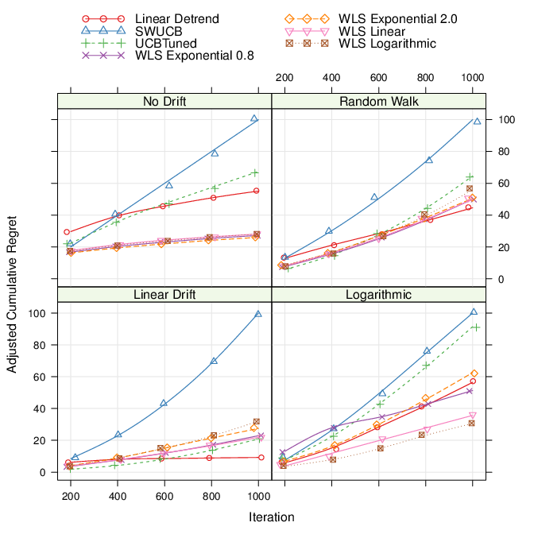
Simulation Environment
We conducted 1,000 replicates of 1,000 iterates (plays) of each of a set of selected "true worlds."
For example, a world could be 2 binomial arms, with one of them a clear winner, or 6 normal arms, with differing variance and mean payoffs.
Then, for each world, we introduced variants of it to simulation nonstationarity: linear drifts (each time step each arm moves by a constant amount), random walk drift (each time step a random movement is made) and logarithmic drift (each time step a c*log(t) movement is made) are presented here.
Regret, the amount of "loss" seen compared to an oracle method, was standardized to have a range of [0, 100]
Notes:
Next slide highlights results. Linear detrend and WLS w/ exponential weights tends to perform well overall in all cases.
Surprisingly, it even performs well in the no-drift case.
SWUCB implements "sliding windows", a similar discounted UCB strategy implements discounting. but SWUCB always did better, so DUCB isn't shown here.
Other methods are all mine.

Slide 28
Simulation Environment
We conducted 1,000 replicates of 1,000 iterates (plays) of each of a set of selected "true worlds."
For example, a world could be 2 binomial arms, with one of them a clear winner, or 6 normal arms, with differing variance and mean payoffs.
Then, for each world, we introduced variants of it to simulation nonstationarity: linear drifts (each time step each arm moves by a constant amount), random walk drift (each time step a random movement is made) and logarithmic drift (each time step a c*log(t) movement is made) are presented here.
Regret, the amount of "loss" seen compared to an oracle method, was standardized to have a range of [0, 100]
Notes:
Sliding Windows (SWUCB) is the blue line. The traditional discounting strategy, DiscountedUCB in all variants performed slightly worse (more regret) than SWUCB so it isn't pictured here. Surprisingly, traditional algorithms outperform the existing work for nonstationarity, but as we can see here, my results consistently outperform the state of the art.
Linear detrending and exponential decay models work across all states of the world we tested, including ones that aren't pictured here.

Slide 29
Definitions of Regret (Burtini et al., 2015b)
It turns out regret isn't a simple variable. There is substantial room for confusion.
Many papers talk about "regret" and never define it.
When definitions are given, they're often not precise enough to determine which variables are realizations and which are random variables.
It is important to be clear and precise about which form of regret you're using.
We produced a complete taxonomy of every variant of regret we could identify.
We identified eight functionally distinct definitions of regret all of which are sometimes called "regret" in the literature.
Proofs, research results and derived bounds are regularly dependent on using a specific definition of regret.
Note: The work in this section has been submitted to the Journal of Machine Learning Research.
Notes:
Often, it wasn't obvious at first glance that regret definitions differed. They're subtle: what "levels" of randomness expectations are taken over matters, where brackets go in the formula matter, whether sums happen before or after expectations matter.
As we started exploring bandits with contextual variables (or covariates), there became even more definitions of regret.
In some sense, the contribution in terms of capturing the differing types of regret is one of helping the research community be rigorous and well-understood. Identifying plausible confusions and confounding factors.
Proofs have usually been pretty clear about their form of regret, but many empirical results have not.

Slide 30
Statistical Regret for Applications (Burtini et al., 2015b)
Even with an understanding of the substantially varying and unclear definitions of regret, there's a problem.
Regret always required an oracle. It could only be computed in a simulation.
In the real world, if you have an oracle, you don't need to do any experimentation and the multi-armed bandit entirely loses its value.
It is hard to do comparisons of bandit algorithms "in the field" without some understanding of whether you know what you think you know. That is, after an experiment has completed, how can we know if the arm we converged on is truly the best arm?
Notes:
"Why do we need it?" This is reminiscint of hypothesis testing in traditional statistics/experiment design.
An oracle is a prescient "predictor" of the best arm at any point in time. Basically, its a theoretical concept that knows the answer before the experiment has been conducted (making the experiment pointless!)
We need a measure of regret that doesn't require an oracle!
The next page defines statistical regret.

Slide 31
How to Compute Statistical Regret (Burtini et al., 2015b)
A simple principle produces what I call Statistical Regret. At any point in the experiment, we have an estimate for the payoff of each arm.
Some of those estimates are relatively uncertain (this is by design, we don't want to be playing arms we believe to be inferior).
But, when we're confident about selecting the right arm, their estimates don't overlap "too much."
Our current confidence interval can be "replayed" over our all prior choices to produce an interval of how poorly we did.
We can compute a regret based on this information. We derive statistical regret as an interval based on the latest (highest quality) information.
Notes:
This gives us a really cool tool -- after an experiment has run, or at any point during an experiment, we have an interval that captures how well we have done. Statistical regret comes in two forms and we've done experiments to show that it tracks the original forms -- expectation and payoff regrets.
This is better than just measuring reward as it acknowledges our uncertainties; if our uncertainties are high, they will be captured in our regret interval.
This is the last slide on statistical regret. We go on to other research after.

Slide 32
I did a lot of other stuff...
Construction of a complete simulation environment.
Arbitrary algorithms, testing environments ("worlds"), arm behavior (distributional support, nonstationarities, contextual variables)
A comprehensive story of regret.
A full exploration of the literature and a proposed taxonomy of regret to clear up some of the definitions.
A background of a selection of studied algorithms.
Each algorithm is provided with implementation details, some theoretical discussion and their integration into the major complicating factors of bandits (nonstationarity, contextual variables, infinite armed bandits). Currently in review at Statistics Surveys (IMS).

Slide 33
I did a lot of other stuff... (continued)
Experiments in how to implement Thompson sampling.
We both rigorously define the idea of "optimism in the face of uncertainty" and generalize it to a mechanism that can be very simply implemented.
More data in support of optimism as a principle which reduces regret (to a larger extent than previously expected).
Efficient sampling techniques.
Introduction of the Simple Sampler
A "random sampling with replacement" technique that produces regret comparable to other Thompson sampling implementations, with none of the implementation complexity.
Notes:
Optimism is better for us than previously because of the sampling techniques.
Efficient sampling techniques is fundamental because at least one major, well-cited paper makes an inferior choice, resulting in research that suggests an effect called "optimism" is much less significant than it truly is.

Slide 34
...and there's still a lot of questions!
Feedback delay. Quantifying the costs, testing strategies for resolving. The rewards are not observed immediately in most applications, other variants might be run in the interim. How do we maximally use that information?
Continuous tracking of regression coefficients with online L-BFGS. Recomputing regression coefficients can be very expensive. Schraudolph et al. (2007, 2014) present an algorithm for stochastic optimization called OLBFGS. Can we use it to keep the regression coefficients up to date in an online fashion?
Feasibility studies (computation time vs. return). Some algorithms can be computed rapidly (Thompson Sampling) while others may be slow. Amazon has shown a 1% decline in sales revenue for every additional 100ms of load time they observe (Kohavi and Longbotham 2008). Can we show that certain algorithms are not feasible because of this cost?
Integrating time-discounted rewards to contextual or TS bandits. Long running experiments might require a discount rate to appropriately deal with time value. Results today matter more than results tomorrow.
...and much, much more, this is a fascinating and deep research space!
Notes:
Complexity of regression equation is O(C^2 N) where C is the number of context variables + arm variables and N is the number of plays.

Slide 35
Thank you!

Slide 36
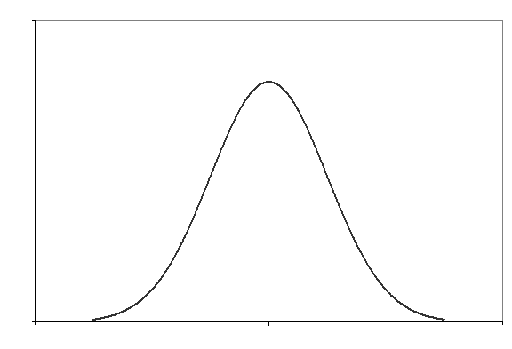
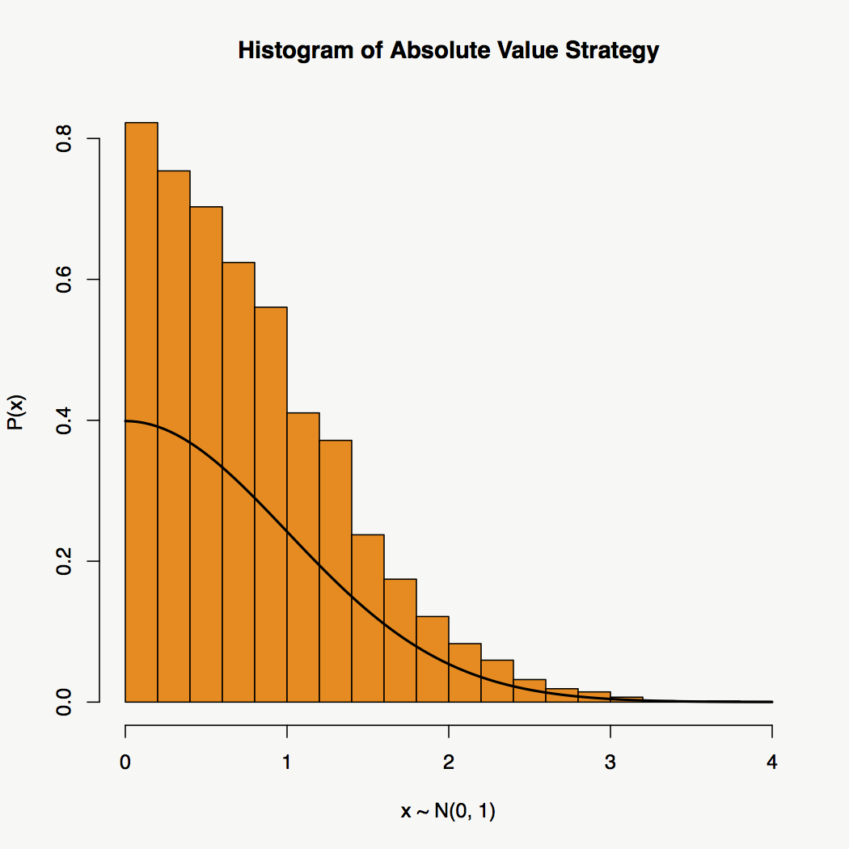
Appendix on Efficient Sampling
Applying the principle of "optimism in the face of uncertainty." Rather than sampling from the distribution evenly, we allow samples to only come from the top half of the distribution.
To do this, we simply calculate our distribution as μ + |N(0, σ)| rather than N(μ, σ).
On the left, an unbiased normal distribution sampler. On the right, our optimistic "right only" sampler.

Slide 37
Efficient Nonsymmetric Sampling
1. Find the quantile, v, of the measure used to bound optimism (for example, for median-optimism, set v = 0.5).
2. Draw a random value from a uniform distribution t ∼ UNIF(v, 1) indicating the quantile of the desired value.
3. Find the value in our original distribution at that point, s = Q(t), this is our sample. Where Q is the quantile function, producing the value at which t% of the distribution is lesser.
Notes:
This produces optimism for generalized distributions, in a statistically efficient (in other words, it produces the optimistic sampling we intended) and computationally efficient (does not require simulations) form.

Slide 38
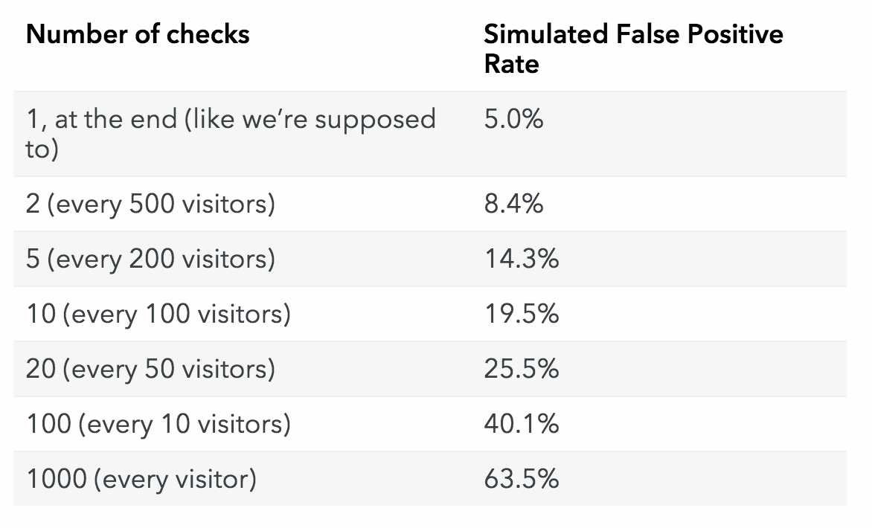
Notes:
Simulated false positives for repeated testing problem in A/B testing.

Slide 39
Appendix on Even More Research Questions
Feedback delay. Quantify the effects.
Bounds for small sample size or "finite time" bounds.
Continuous tracking of regression coefficients with online L-BFGS.
The handling of large contextual variable sets? Hierarchical contextual variables such as country > province? "Selection" vs "observed" variables.
Stationarity tests for adjusting bandit algorithms.
Feasibility studies (computation time vs. return).
Ignorant Thompson Sampling (how to sample when there is imperfect information about the distribution: can we use a bound like Chernoff's?)
Integrating time-discounted rewards to contextual or TS bandits.
Prior elicitation and integration of prior experiments.
Type 1 and Type 2 error on stopping bandit tests. Costs of persistent tests.
Multiple objective functions and the implications of objective selection.
Notes:
Why OL-BFGS mentioned here: because very early in the regression function there is some strange behavior (non-stochastic "optimums" jump around a lot, OL-BFGS is described in the stochastic case). By moving to an online L-BFGS (Schraudolph 2007, JMLR) there may still be early sample size problems (and these are the most important): if that is the case, one should just fit the model accurately early on and move forward.
In my experience, these "integrations" of two disconnected literatures often elicit more questions than they answer when actually gone to implement. I'm confident there's interesting research here.
The hashing trick common in machine learning does not work well here as we have a set of variables that are "selected."
What about gamma for optimism mean vs. median? There's still no difference.
Type 1 and type 2 error for stopping bandit tests is interesting. In our model, the test "never" ends, it simply optimizes to the best result. This, in the limit, for most algorithms, guarantees that we will find the best result (the so-called "zero regret" strategies).
Regression is M^2 N for M feautres and N observations. Online regression can do better on the N term at a relatively high fixed cost. This is bad for large context sets.

Slide 40
Example Web Experiments
Images used under Fair Dealing provision of the Copyright Act of 1985. Copyright © Optimizely, WordStream, BufferApp in clockwise rotation.
Notes:
Sub-10% of content. Unpublished. Does not compete with the original product. Used for private study and education. This meets all the requirements for Fair Dealing.
REMOVE THIS SLIDE BEFORE PUBLISHING.

Slide 41
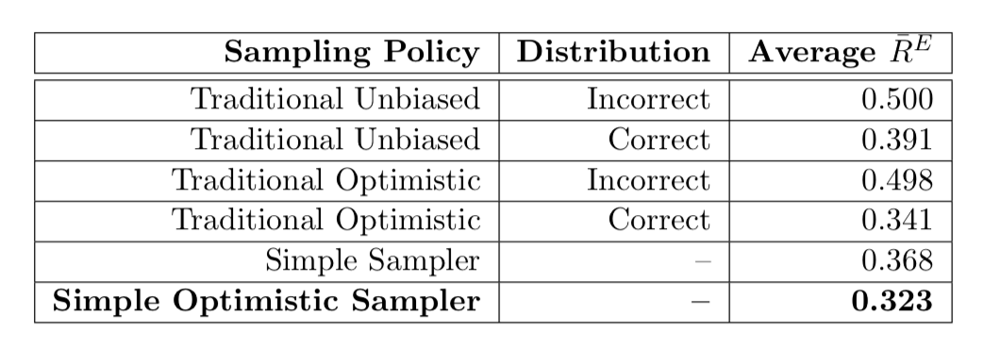
Simple Optimistic Sampler Results
Notes:
SS/SOS is nonparametric -- makes no assumptions about the distribution. The benefit that accrues to optimism has been shown empirically.
This is valuable because as we can see, we can do 20-30% worse if we get the distribution wrong in traditional samplers. It's even cooler than this does better than even the correct specification.
There is no variances listed here but these numbers are computed over 500 million iterates (52 worlds @ 1000 replicates of 1000 iterates).

