Slide 1
Softball Player Registration
and Management Website
Honors Thesis
Presented by Joseph Pruner
March 30th, 2019
Advisor: Dr. Ramon Lawrence

Slide 2
Introduction

Slide 3
Joseph Pruner
4th year
Computer Science
Fun facts about me:
From Massachusetts
Former Audio Engineer and music producer
Worked as a manager at an NYC Jazz club
Same birthday as Steve Wozniak (August 11th)

Slide 4
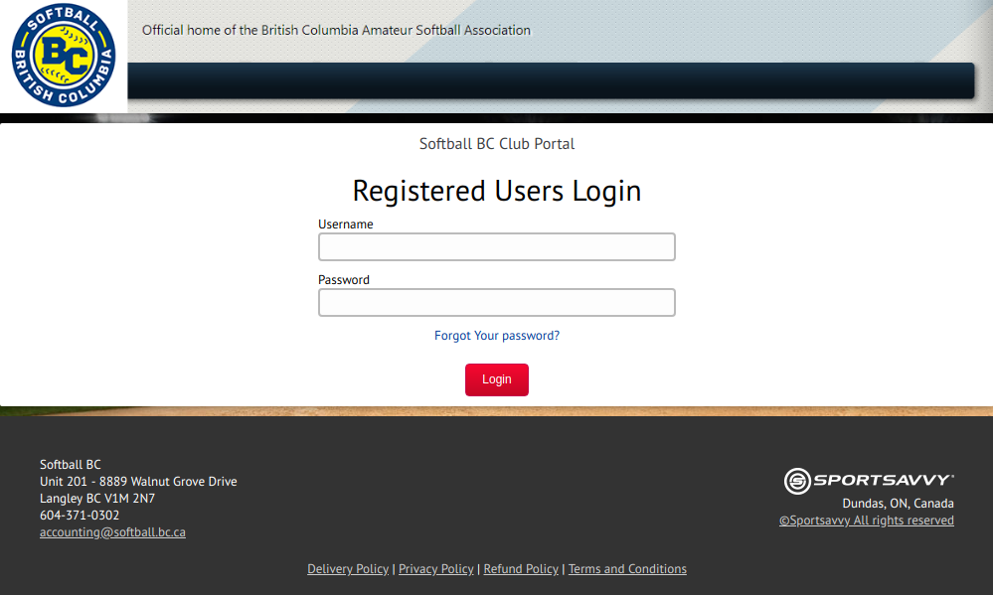
Redesign the Softball BC Registration System
What?
Softball BC is used to store thousands of player, team club and season records for the BCASA
Users of various admin levels and affiliations log in to manage their respective records
Notes:
SBBC is a non-profit, so it doesn't have a large IT budget.

Slide 5
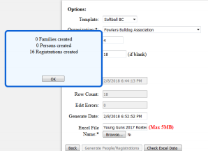
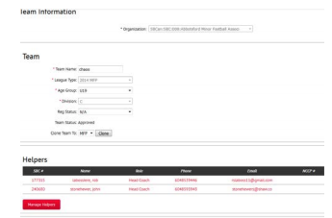
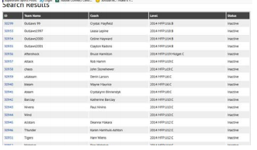
Redesign the Softball BC Registration System
Why?
The website is quite old, and the style and user interface reflect that.
Most interactions result in a full page reload, or redirection to a new page.
Certain records cannot be edited, and must be deleted and recreated to update.
Notes:
Windows 95
SBBC is a non-profit, so it doesn't have a large IT budget.

Slide 6


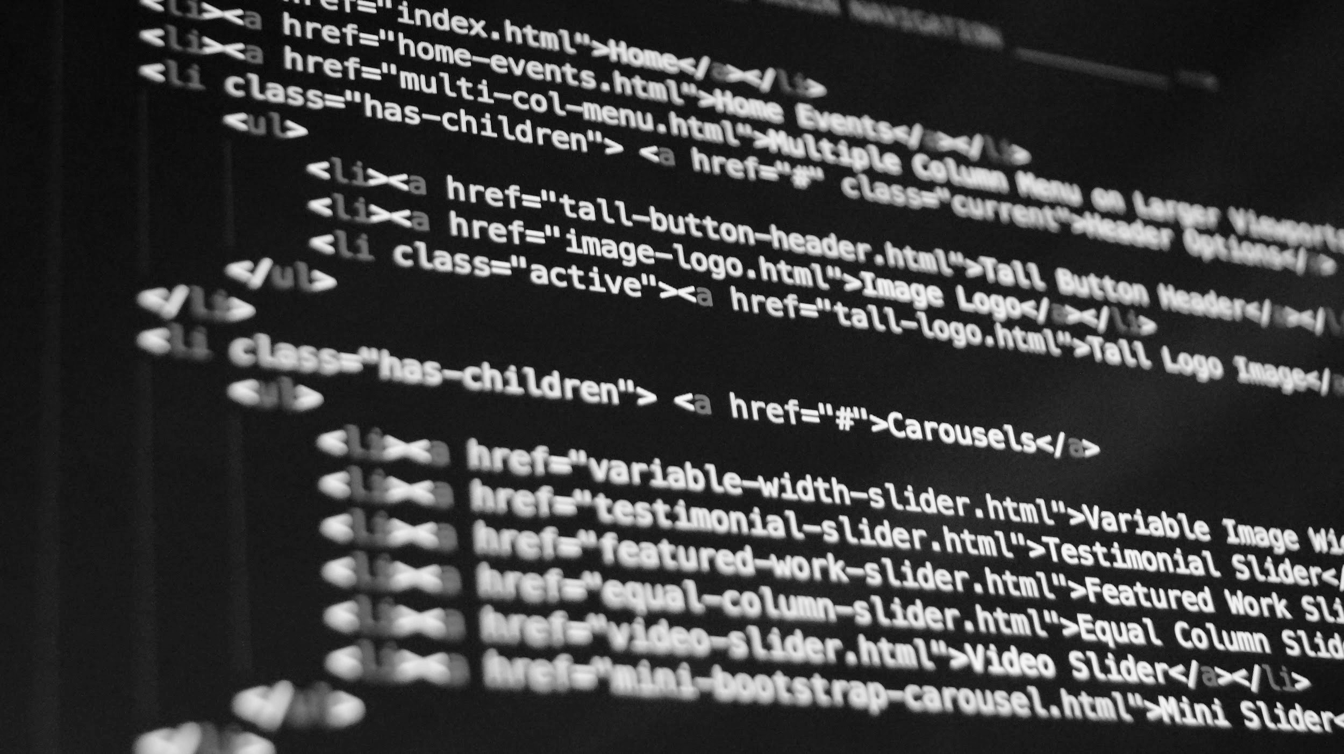
Redesign the Softball BC Registration System
How?
Explore and apply modern User Experience and Human Computer Interaction design concepts
Implement current underlying technologies that enable a robust and responsive website
Have fun and learn!

Slide 7
Planning

Slide 8
The Time line
Term 1
Database Design
Wireframe Mockups
Choose Tools and Begin Developing
Develop
Develop
Frantically
Develop
Initial Planning and Choose Tools
Term 2

Slide 9



Preliminary Design Tools

Slide 10
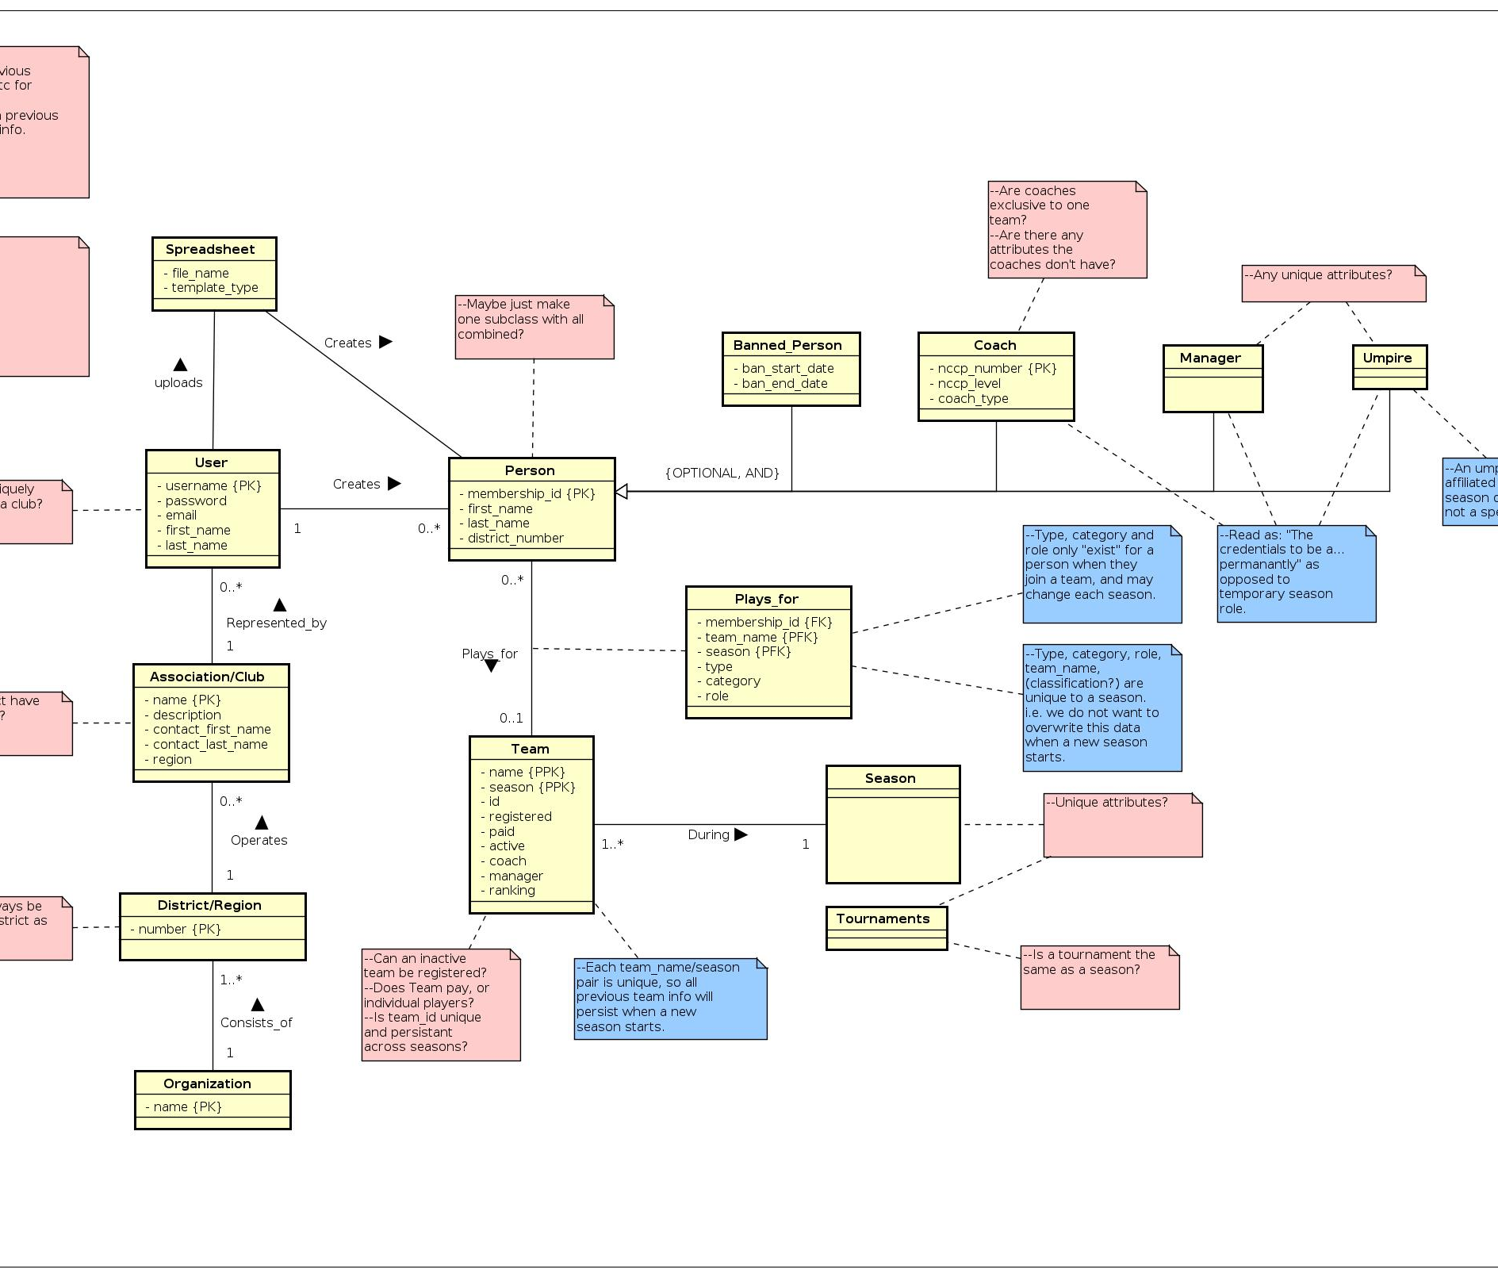
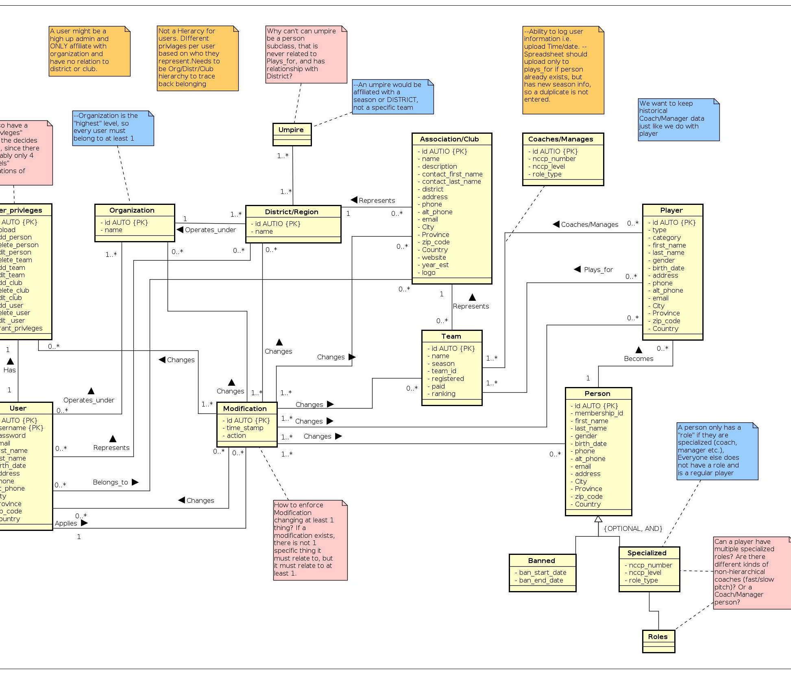
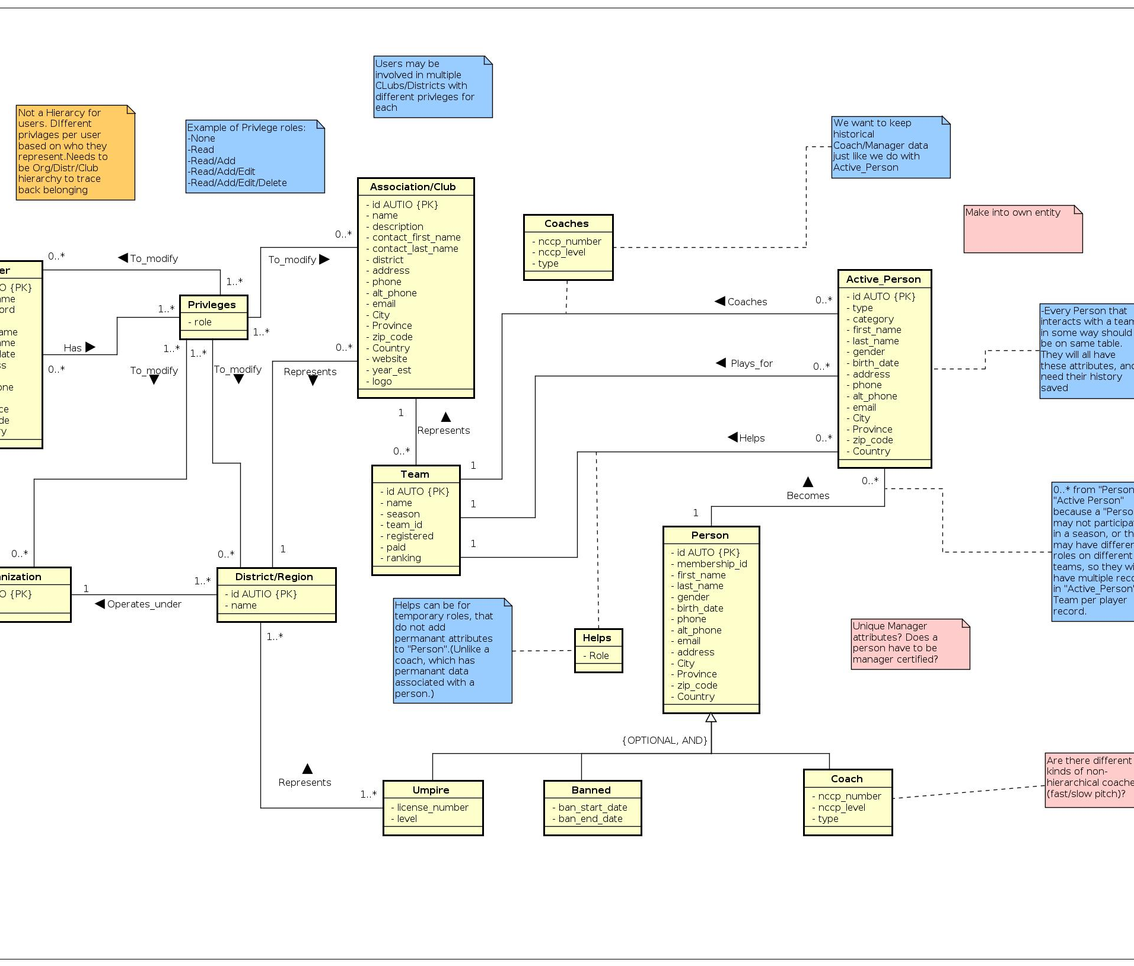
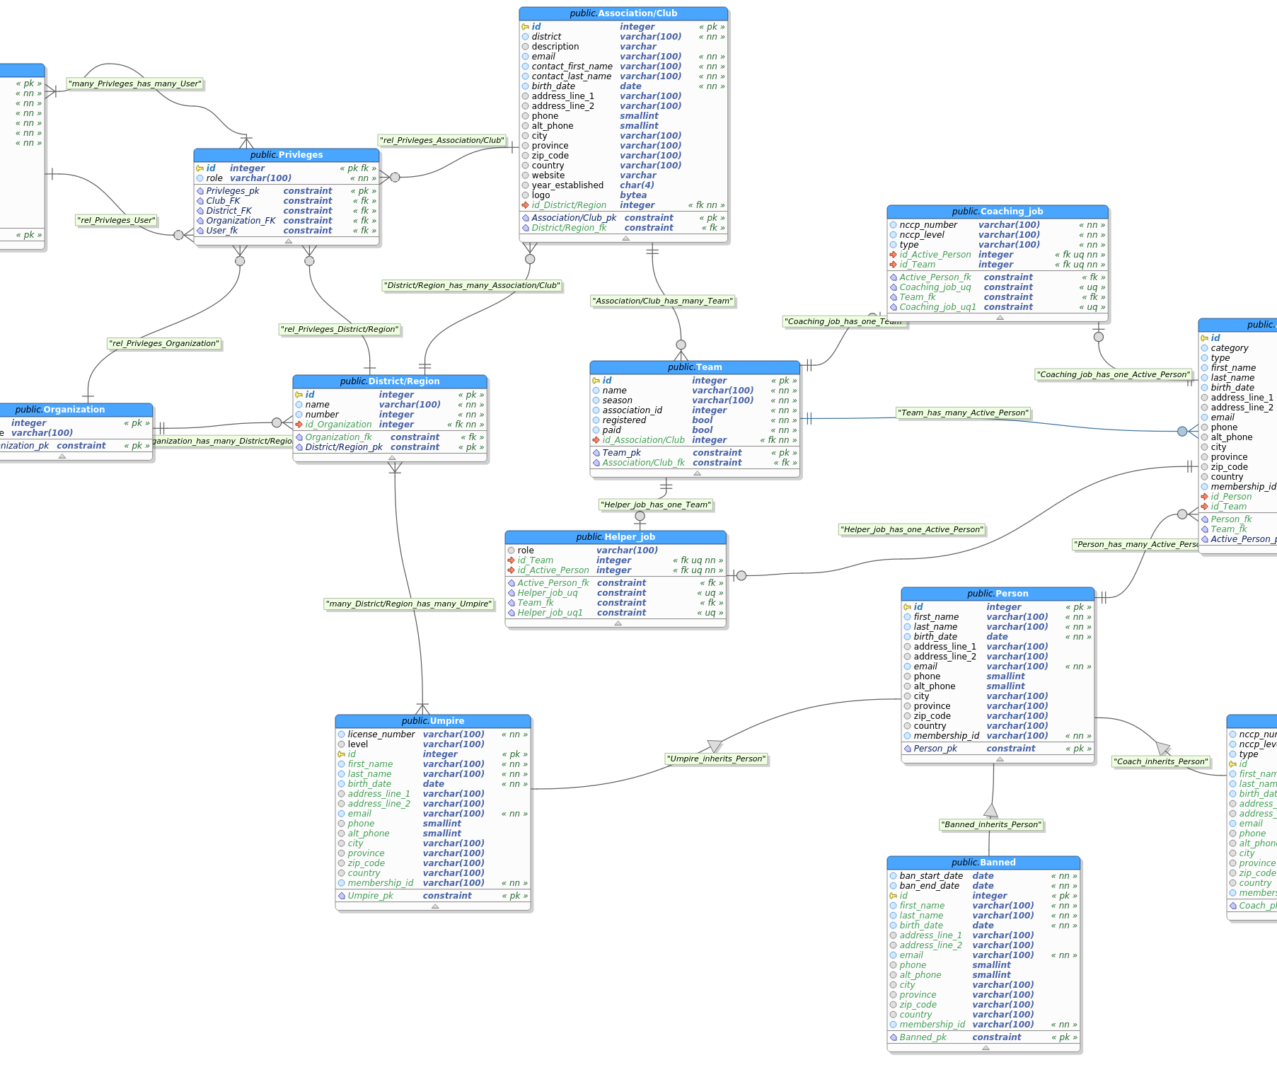
Database Design
Refine and repeat
First iteration
Second iteration
Third iteration
Final design
With each iteration, new and important entities emerged, as well as relationships between them. Entities were combined or divided when possible to reduce redundancy and increase database efficiency.

Slide 11
Database Design
Final Design

Slide 12
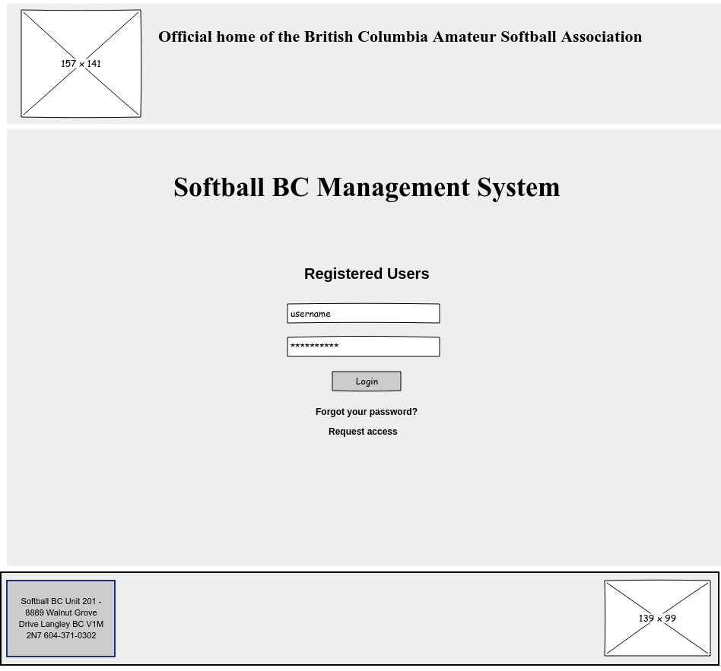
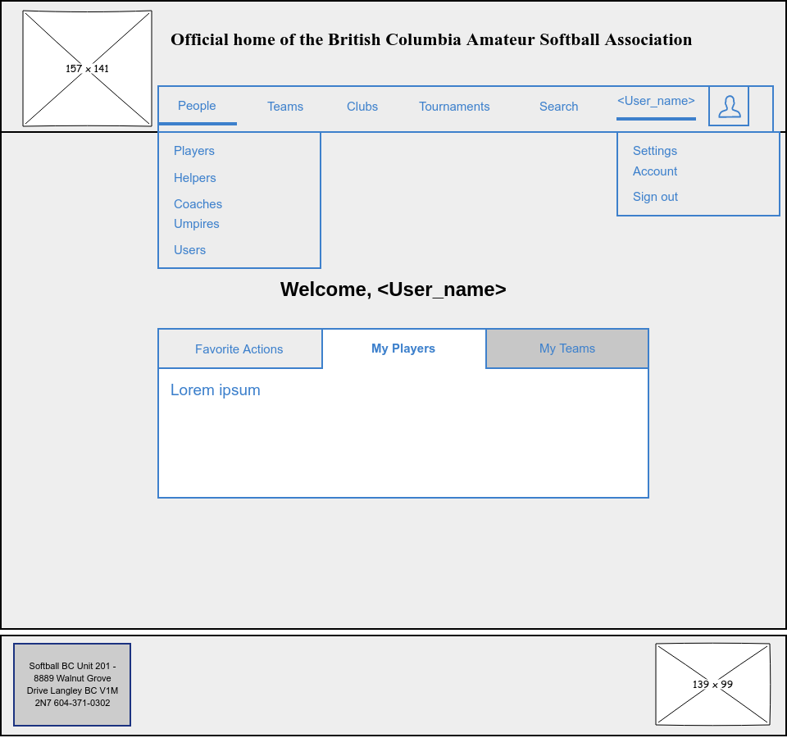
Wireframe mockups

Slide 13

Wireframe mockups
Helps get UI ideas flowing
Understand underlying structure and linkage of pages.
Influences refinements on the database model.

Slide 14
Development

Slide 15




Development Tools

Slide 16
While developing, I kept important principles in mind, such as Jakob Nielson's Usability Heuristics for User Interface Design
Which helped me:
Identify seemingly minor UI elements taken for granted
View from an open perspective

Slide 17
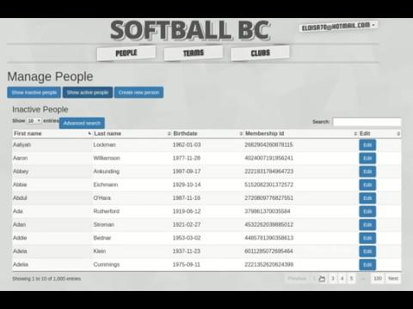
Visibility of system status
Feedback is vital
50%
Essential for large database querying.
The appearance of the "Loading..." bar signals to the user that their interaction was acknowledged.

Slide 18
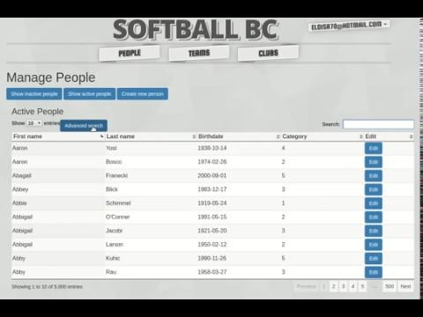
Flexibility and efficiency of use
Options
50%
Users have different skill levels, and tasks to complete.
Having an optional Advanced Search feature can speed up querying for users who need it.
Notes:
Could distract people who don't need it.

Slide 19
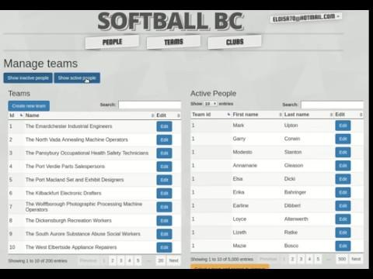
Aesthetic and minimalist design
Less clutter
50%
Prevent users from displaying unecessary information, or creating confusion within layout.
The information of interest should be the main focus.

Slide 20
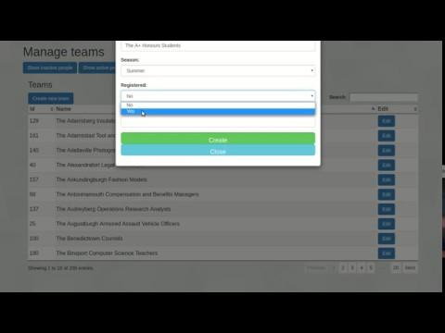
Create New Team
50%

Slide 21
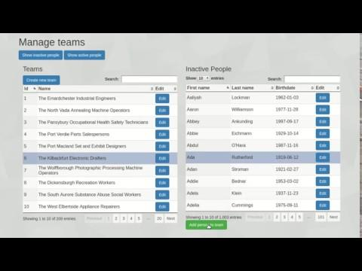
Add and remove people from Teams
50%

Slide 22
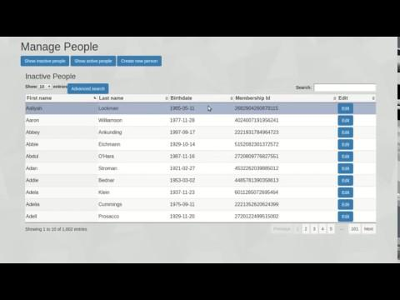
Edit Person
50%

Slide 23
Challenges

Slide 24
Challenges I faced
Oh so many...
Overeager : Beginning development before tools are fully explored and commited to. Wanting to code from scratch.
Result : Wasted time due to re-development with tools that better suit the project and constraints.
Lesson : Research tools based on the big picture. Expect everything to be more difficult and time consuming than anticipated

Slide 25
Challenges I faced
Oh so many...
Priorities : Getting caught up in aesthetics and details.
Result : Too much time spent tweaking visual aspects of the website resulted in less time to work on core functionality.
Lesson : Ask myself "Is this critical to the user experience?". Take a short, intentional, timed break to work on non-critical design.

Slide 26
Challenges I faced
Oh so many...
Scattered : Not always developing one component at a time.
Result : Momentum and train of thought is lost by jumping between different components.
Lesson : Keep an organized document on hand to jot down ideas for other components.

Slide 27
Challenges I faced
Oh so many...
Relentless : Refusing to ignore non-critical minor bugs or errors that only hinder the user's experience slightly, or not at all.
Result : Too much time troubleshooting resulted in less time to work on core functionality.
Lesson : Ask myself "Is this breaking anything important, or causing glaring user interface issues?" Make a note for later.

Slide 28
Conclusion

Slide 29
In conclusion
Improved skills in 4 languages and learned a new framework
A great experience
Better understanding of my own tendencies that interfere with work-flow
Deepened knowledge of database design, web design, and initial project planning
More realistic expectations for time-lines and development difficulties
Reinforced importance of a consistent, well organized project structure and workspace

Slide 30
Current status:
Future
I really enoyed developing this project, and will continue to do so as my time allows.
Potential features:
Tournament tracking
Team, player and season statistic reports.
CSV team roster upload
User action logging
Still in development
It needs more work before it becomes fully functional, secure, and ready for deployment.

Slide 31
Special thanks to
Dr. Ramon Lawrence!
Your expert advice and feedback is invaluable

Slide 32
Thank you!
Questions?
(Stack Overflow)

Slide 35
Credits
Shapes & Icons
Backgrounds
Images
Vectorial Shapes in this Template were created by Free Google Slides Templates and downloaded from pexels.com and unsplash.com.
Icons in this Template are part of Google® Material Icons and 1001freedownloads.com.
The backgrounds were created by Free Google Slides Templates.
Photos in this template were downloaded from pixabay.com. Attribution is located in each slide notes and the Credits slide.
Fonts
Color Palette
Trademarks
The fonts used in this template are taken from Google fonts. ( Muli )
You can download the fonts from the following url: https://www.google.com/fonts/
The Template provides a theme with four basic colors:
Microsoft® and PowerPoint® are trademarks or registered trademarks of Microsoft Corporation.
© 2016 Google Inc, used with permission. Google and the Google logo are registered trademarks of Google Inc.
Google Drive® is a registered trademark of Google Inc.
#4e6e9aff
#4e6e9acc
#5477a7cc
#eeeeeeff

