Slide 1
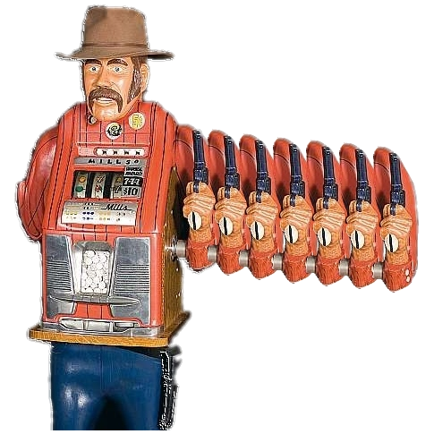
Multi – Armed Bandit Application on Game Development
By: Kenny Raharjo

Slide 2
Agenda
Problem scope and goals
Game development trend
Multi-armed bandit (MAB) introduction
Integrating MAB into game development
Project finding and results

Slide 3
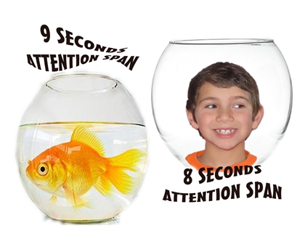
Background
Video Games rapidly developing
Current generation have shorter attention span
Thanks technology!
Easily give up /frustrated on games.
Too hard
Repetitive
Boring
Challenge: Develop engaging games
Use MAB to optimize happiness
Player satisfaction -> Revenue

Slide 4
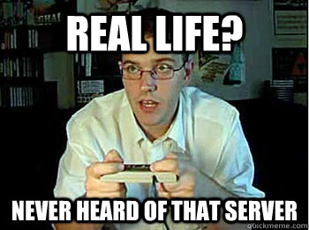
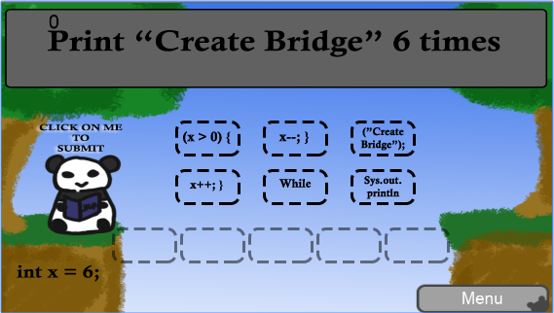
Why Game?
People play video games to :
Destress
Pass time
Edutainment (Educational Entertainment)
Self – esteem boost

Slide 5
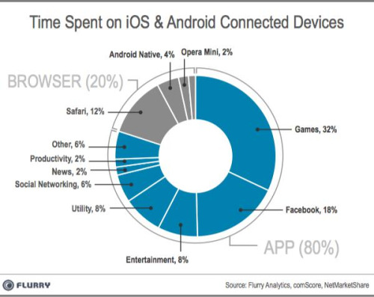
Gaming Trend
Technology advancing rapidly
Gaming has become a “norm”
Smartphone availability
All ages
32% of phone time: games
Nintendo
Console -> Mobile

Slide 6
Gaming Trend
Offline games: hard to collect data and fix bugs.
Glitches and bugs will stay. Developers will pay.
Online games: easy data collection and bug patches
Bug fixes and Downloadable Content (DLC)
Consumers: short attention span & picky.
< Goldfish attention span
Complain if game is bad
Solution?

Slide 7
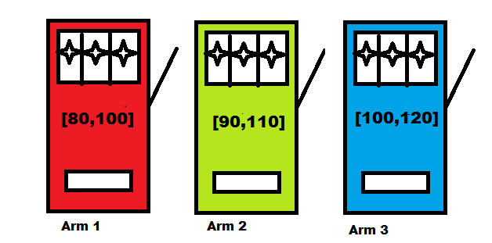
Multi-Armed Bandit
Origin: Gambler in casino want to maximize winnings by playing slot machines
Balance exploration and exploitation
Objective: Given a set of K distinct arms, each with unknown reward distribution, find the maximum sum of rewards.
Example: 3 slot machines

Slide 8
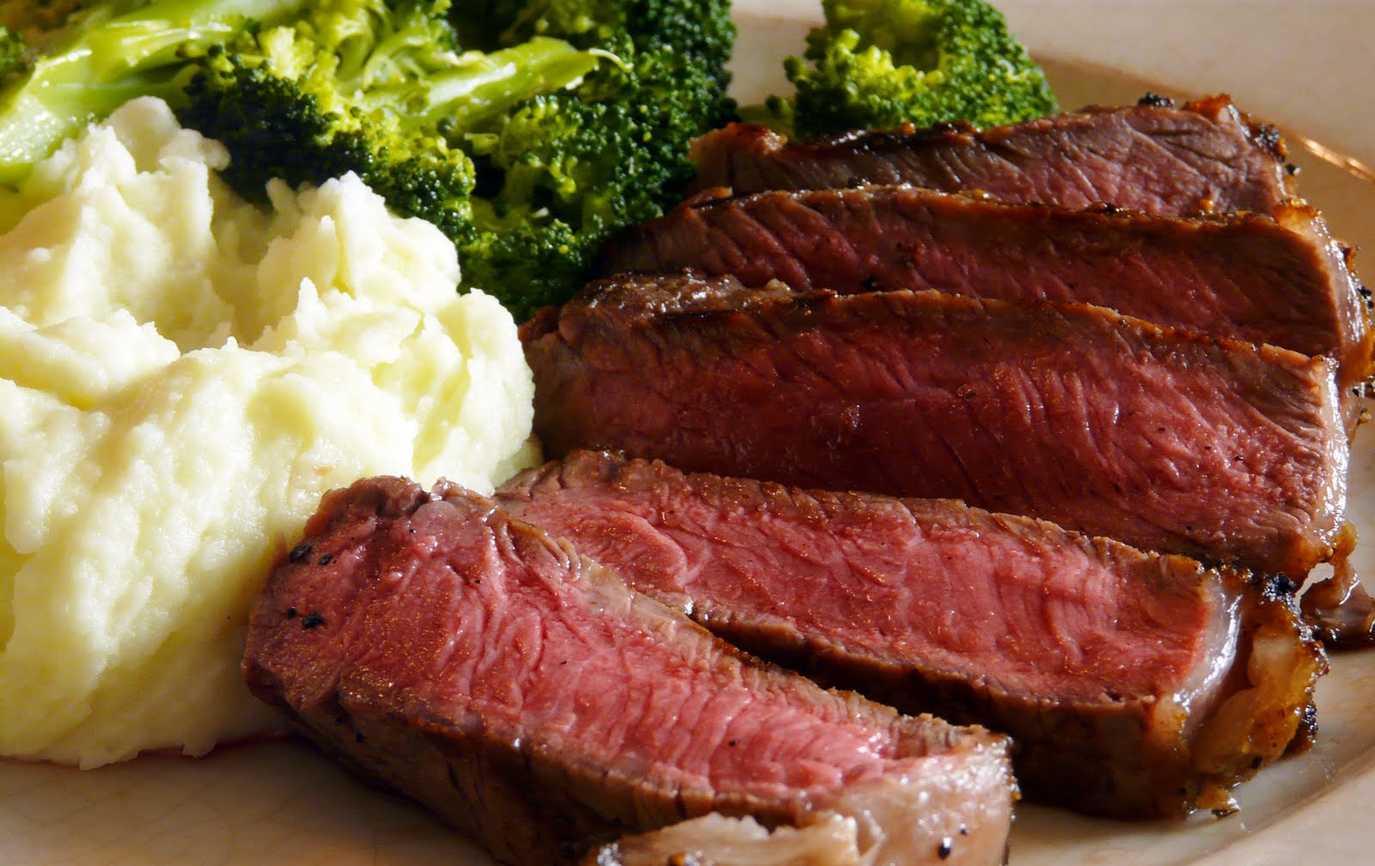
Multi-Armed Bandit
Example: Restaurant example
Arms: Restaurants
Reward: Happiness
Should I:
Go to a new place to try?
Stick with best option?

Slide 9
Multi-Armed Bandit
Arms: Parameter choices
What you want to optimize
Rewards: observed outcome
What you want to maximize
Might be a quantifiable value
Or a measure of happiness (Opportunity cost)
Regret: Additional reward if started with optimal choice.
What you want to minimize
MAB algorithms guarantee minimal regret

Slide 10
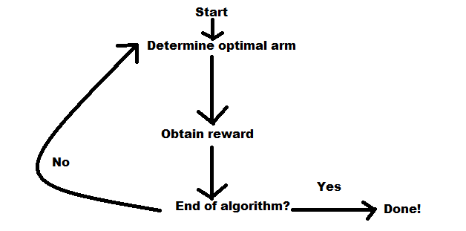
Multi-Armed Bandit
Bandit algorithm: basic idea

Slide 11
Multi-Armed Bandit
Bandit algorithm: ε-greedy
P(explore choices) = ε P(exploit best choice so far) = 1 – ε
Guarantee random behavior
Common practice: Initial data (seed)

Slide 12
Multi-Armed Bandit
Pros:
Re-evaluate bad draws
No supervision needed
Cons:
Result focused
Does not explain trends

Slide 13
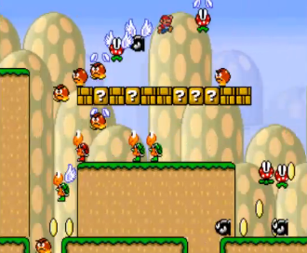
Applying MAB to game development
Dynamically changing content
Infinite Mario
Mario Kart
MAB constantly improve game (difficult or design) over time
Maximize Satisfaction
Happy customers -> $$

Slide 14
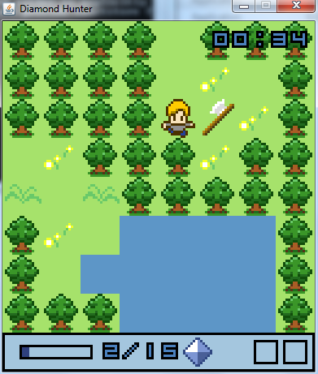
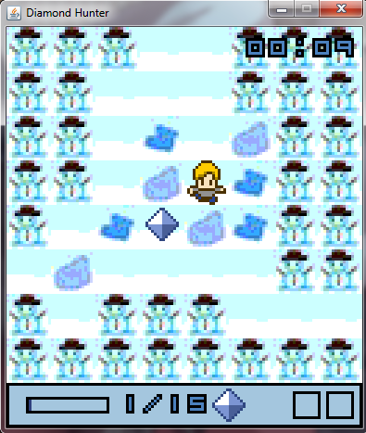
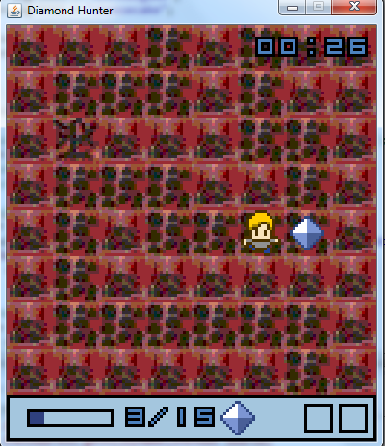
Study Outline
Simple, short retro RPG game (5-7 minutes)
Arms: different skin (aesthetic)
Reward: Game time
Compute optimal skin
One skin per game
Data saved in a database

Slide 15
Result and Summary
ε-Greedy algorithm
Plot Frequency VS Iteration #
42 data points
Winner: Variant 0 (Forest)
All options re-evaluated
Could Improve by:
More samples
Reward as function of time and score

Slide 16
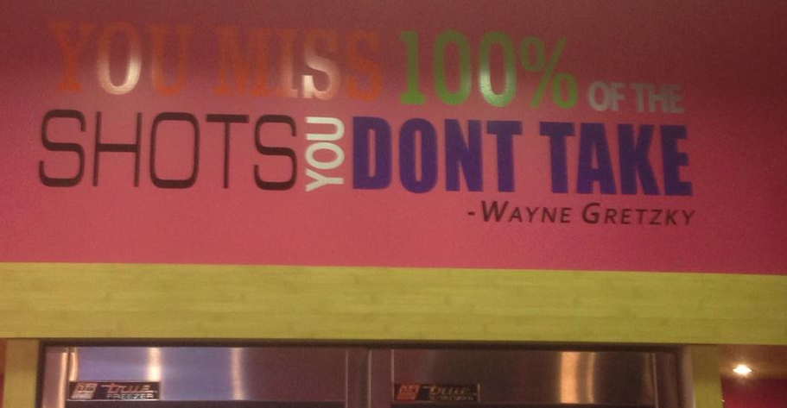
Thank You!
Q&A
Contact: KennyRaharjo@gmail.com

