Slide 1
Matching Techniques For Historical Datasets
By Matthew Currie
Supervisor: Dr. ramon lawrence

Slide 2
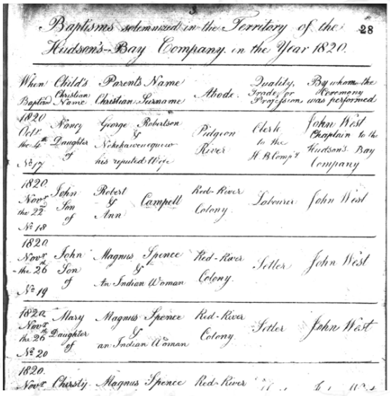
Digital Archive Database Project (DADP)
1
Primarily a Métis Historical Archive
Techniques developed using sacramental data
Marriage Records
Baptismal Records
Death Records
165,000 Records
dadp.ok.ubc.ca

Slide 3
Identifying Matching Historical Figures
2
Person Table
Contains 213,963 Records
Entries refer to people contained in historical records
The same person might have multiple different records in the person table
Goal: Identify which person records refer to the same person

Slide 4
Example
3
Marriage Record of
Adolphe Desroches
Helene Desroches
Marriage Record of
Xavier Belcourt
Helene Desroches
Helene Desroches appears in two marriage records
Thus, Helene Desroches has two different entries in the Person table
Goal is to find matching pairs
Person Table
ID: 256235, NAME: Helene Desroches, ROLE: husbandMother
ID: 256105, NAME: Helene Desroches, ROLE: wifeMother

Slide 5
Steps in Matching Person Records
4
STEPS
1. Preprocessing
2. Indexing
3. Comparing & Grouping Records

Slide 6
Preprocessing
5
Purpose:
Standardize Data
Formatting Dates, Names, Locations
Example:
Oct. 6, 1897 => 1897/10/06
Helene DESROCHES => helene desroches

Slide 7
INDEXING
6
1897/10/06
Helene Desroches
Husband’s Mother
Adolphe,…
St Patrick Tiny
1899/11/03
Helene Desroches
1901/09/22
Helene Desroches
Wife’s Mother
Xavier,…
St Patrick Tiny
Second Witness
Joseph,…
St Patrick Tiny
Index: “helenedesroches”
Purpose:
Reduce Time Complexity
How?
Create an index and group records by their index to prevent comparing clear nonmatches
Index group is sorted by date for ease of comparing time periods

Slide 8
Comparing & Grouping
7
Purpose:
Determine whether two or more records refer to the same person
Comparing Step: Ensures that all fields meet the matching criteria
Grouping Step: Groups matching records into sets of matching records

Slide 9
Comparing & Grouping
8
Group Records as a Match
Check Similar Time Period
Check Matching Names
Check Matching Location
Check Similar Relationships
Check Valid Roles
Two records have their fields compared and if all the comparisons return true, then the two records are a match.

Slide 10
Difficulties with Names & The Father-Son Problem
9
Names are not unique identifiers
Fathers often share a name with one of their sons

Slide 11
Results
10
98%
95%
Gathered by reviewing a random sample of >100 sets of matching records for each table.

Slide 12
Graphing Relationships From Matching Data
11
Nodes are person records
Edges are connections between person records that occur in the historical records

Slide 13
Conclusion
Using relational data and other field comparisons, historical records can be accurately matched.
Visualizing a matched person’s relational data on a network graph can illustrate relationships between nodes that were not obvious before.

