Slide 1
Faster Sorting for Flash Memory Embedded Devices
James Riley Jackson
Undergraduate Honours Thesis
Supervisor - Dr. Ramon Lawrence
Faculty - Computer Science

Slide 2
Overview
Introduction
Background
Implementation
Experimental Results
Conclusions and Future Work

Slide 3
Introduction
Embedded devices are used in a wide variety of applications.
Personal and consumer electronics
Remote data logging sensors
Medical devices
Internet of Things (IOT) interconnection of computing devices via the internet.
Devices attached to IOT can send and receive data
Embedded devices may need to work together
Data may need to be collected on one device and analyzed on another

Slide 4
Motivation
Data processing is required for data analysis and decision making
May need to process large amounts of data
Processing on embedded devices can have several advantages
Reduce data that needs to be sent over the network
Process data and make decisions on site
Better energy efficiency
Limitations of embedded devices make data processing challenging
Limited CPU resources
Limited memory
Limited battery

Slide 5
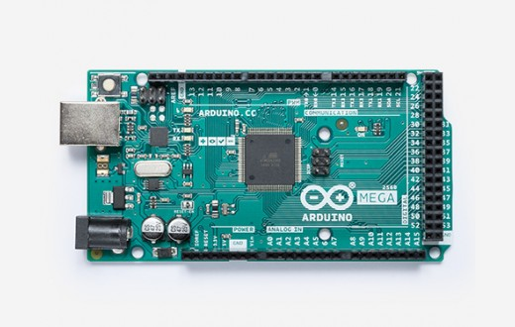
Background - Arduino
Arduino group of single board microprocessors
Usually used for education
Easy to upload programs and run tests
Arduino Mega 2560
Limited CPU resources
8 KB SRAM
Attached to 2 GB SD card (disk storage)
Notes:
8kb is 8192 characters about 1300 words. 2 pages single spaced. 2GB is 3.5 million pages

Slide 6
Background - Sorting
Sorting is a common operation with many uses
Data analysis can be performed on sorted data
Many operations are faster on sorted data
Operations such as joins, aggregate functions, result ordering
Sorting algorithm is a process for sorting data
Many different sorting algorithms
Good algorithms can be a lot faster and scale better than bad algorithms
Different algorithms may be better or worse in specific conditions

Slide 7
Background - External Sorting
Random Access Memory (RAM) stores data that is being worked on
Holds limited amounts of data
Fast reads and writes
Disk memory is where data is stored
Can hold large amounts of memory
Slow reads and writes
External sorting used to sort data that does not fit into RAM
Load parts of data into RAM, work on it, then save it back into disk
Reload parts that were saved to disk and repeat
Goal is to reduce the number of reads and writes to disk memory

Slide 8
Background - External Merge Sort
3
9
12
2
3
5
9
10
12
M:3
Records Per Block:1
Create sorted sublists of size M
Buffer first block of first 2 sublists into memory
Write smallest value of either buffered block to next sublist
Repeat until sublists merged
Recursively merge next sublists
12
3
9
2
10
5
6
1
4
11
8
7
1
2
3
4
5
6
7
8
9
10
11
12
2
5
10
1
4
6
1
4
6
7
8
11
7
8
11
Notes:
Need 3 buffers. Need to take things from both group A and B and put them in the output

Slide 9
External Merge Sort Buffers
M:3
Records Per Block:3
Read smallest tuple into output buffer, increment pointer and repeat
1
3
5
1
3
5
Output Buffer
Output Buffer
(Empty)
Read first block of first sublist into buffer 1
1
2
2
4
6
2
4
6
Read first block of second sublist into buffer 2

Slide 10
External Merge Sort Buffers
M:3
Records Per Block:3
Output:
1
2
3
Output buffer is full, write it to output
1
3
5
1
3
5
Output Buffer
Output Buffer
1
2
3
WRITE
2
4
6
2
4
6

Slide 11
No Buffer Sort Contribution
No buffer sort external merge sort without a dedicated output buffer
Reduces the minimum number of buffered blocks required from 3 to 2
Reduces number of reads and writes by increasing number of in memory swaps
External Merge Sort
Requires buffer size 3 blocks
Buffers M-1 blocks into memory
Creates M-1 sublists per run
Performs log_{m-1} (runs)
Requires less swaps in RAM
No Output Buffer Sort
Requires buffer size 2 blocks
Buffers M blocks into memory
Creates M sublists per runs
Performs log_{m} (runs)
Requires more swaps in RAM

Slide 12
No Buffer Sort Implementation
Output buffer swaps its records with the sorted output as records are added
Needs to keep track of its records in other blocks
Temporarily swaps result records out when next output block needs to be read
M:2
Records Per Block:4
Start
After 2 Swaps
Buffer 0
(Output)
Buffer 1
Buffer 0
(Output)
Buffer 1
5
6
7
8
1
2
3
4
1
2
7
8
5
6
3
4

Slide 13
No Buffer Sort Implementation
External Merge Sort
Output
Buffer
Output
Buffer
Buffer 1
Buffer 2
Buffer 1
Buffer 2
M:3
Records Per Block:4
1
2
3
4
8
1
2
3
8
5
6
7
4
5
6
7
NoOutput Sort
Buffer 0
(Output)
Buffer 1
Buffer 2
Buffer 0
(Output)
Buffer 1
Buffer 2
1
2
3
4
6
7
9
10
8
5
11
12
1
6
7
8
2
3
9
10
4
5
11
12

Slide 14
Implementation Challenges
Lots of pointers to track
Several unique cases which requires specific strategies and code to handle
Buffer 0
(Output)
Buffer 0
After Insertion
Buffer 0
(Output)
Buffer 1
Buffer 1
Example 1:
Need to read in buffer 1 but, it has value from buffer 0 in it
Example 2:
Need to keep values sorted when moving between buffers
1
6
8
1
6
7
8
7
7
1
2
7

Slide 15
Implementation Challenges
Scaling to any number of blocks
2
3
8
9
8
9
1
5
6
7
5
6
7
10
11
12
13
1
2
3
11
12
8
9
10
5
6
7
1
2
3
13

Slide 16
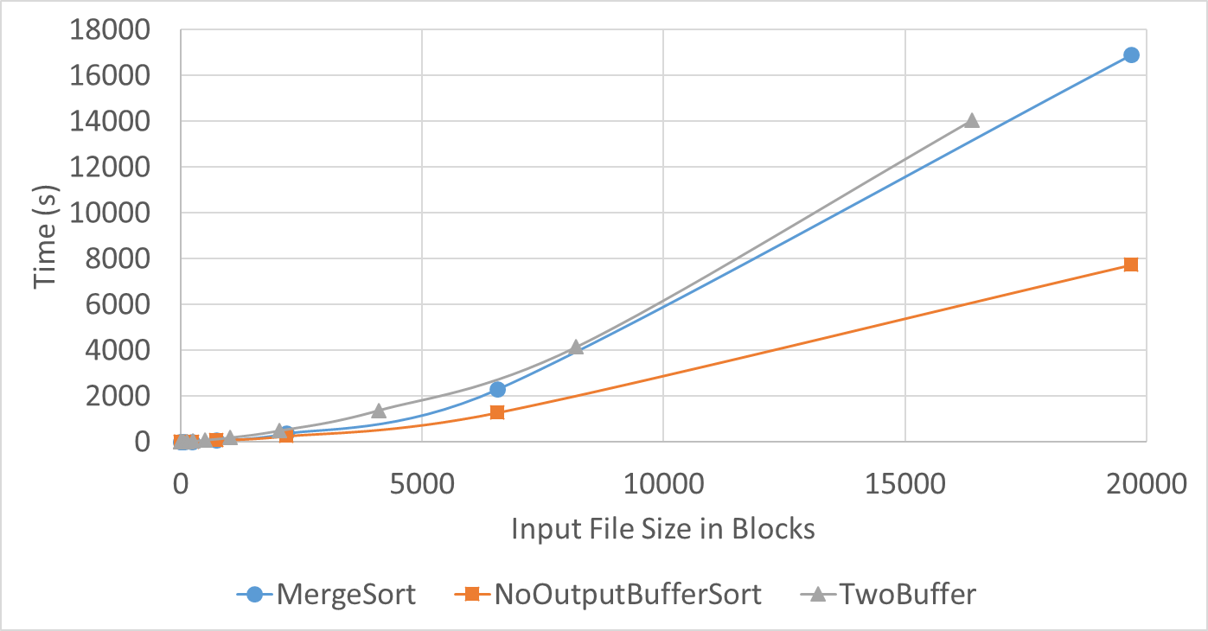
Experimental Results
Compared NoBuffer and External Merge Sort
Ran both algorithms on identical data sets
Measured I/Os and execution time
Block size 512 MB
Record size 16 Bytes
32 Records/Block
Execution Time
External Merge sort Buffer size of 3 blocks
NoBuffer with 2 buffers is similar
NoBuffer sort with 3 blocks is faster
Notes:
Close to theoretical increase of 37%
Less memory and same speed
Same amount of memory and faster

Slide 17
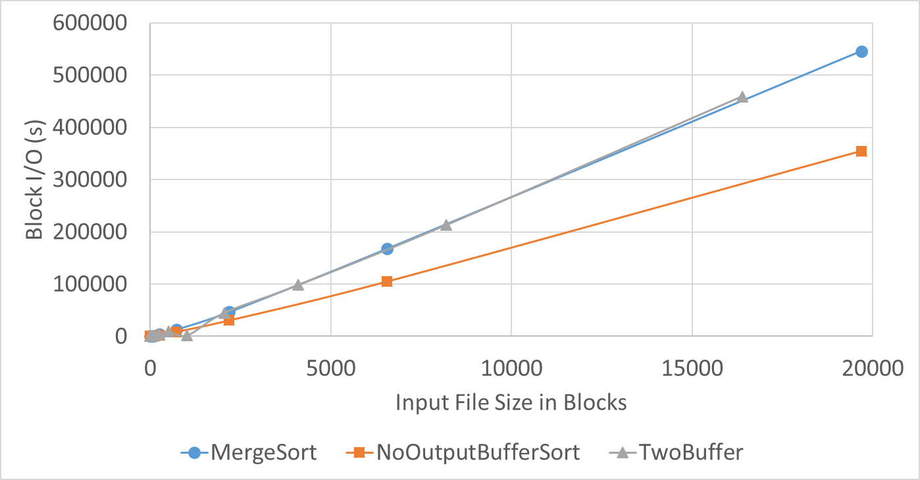
Experimental Results
Reads and Writes
I/Os of both algorithms matched theoretical number
No Output Sort matches theoretical increase of 37%
Block size 512 MB
Record size 16 Bytes
32 Records/Block
External Merge Sort:
B*(2[log_{M-1}(B/M)] + 1)
NoBuffer Sort:
B*(2[log_{M}(B/M)] + 1)

Slide 18
Conclusions and Future Work
NoOutput Sort only requires two blocks instead of three
NoOutput Sort vs External Merge Sort
NoOutput sort using 2 blocks is about the same speed as External Merge Sort when using 3 blocks
NoOutput sort is faster than External Merge Sort when both algorithms are give a buffer size of 3 blocks
Replacement Selection can potentially improve speed.
Different sized runs
Run sizes must be stored
Faster on almost sorted data
Notes:
Reduces buffers to 2 useful
More efficient for same amount of memory

Slide 19
References
R. Jackson and R. Lawrence, “Faster Sorting for Flash Memory Embedded Devices” 2019 IEEE Canadian Conference of Electrical and Computer Engineering (CCECE)
Thank You!

