Slide 2
Improving Sustainability and Efficiency in Kelowna Parks Using a Mobile Application
Robert Ryan Trenholm
M.Sc. Thesis Defence
Notes:
University examiner, committee members, mr. chairman, ladies and gents. My name…
Sustainability in the infrastructure of the park (includes equipment, grass, and plants at the parks) and efficiency in the field workers

Slide 3
Outline
Motivation
Background
Irrigation Management App
Case Study
Results
Conclusions

Slide 4
Motivation
City green spaces are important
Recreation, sports, outdoor activities, entertainment venues
Grass and trees remove carbon dioxide, filter air pollution, reduce dust ^{[1]}
Offer significant cooling effects to nearby buildings and homes ^{[1]}
Large amounts of water are used in city parks
Canada ranked as one of world’s largest consumers of fresh water ^{[2,3]}
Kelowna ranked among highest Canadian water users ^{[4]}
20% peak summer time water use for parks alone ^{[5]}
[1] Robert N. Carrow. Can we maintain turf to customers satisfaction with less water? Agricultural Water Management, 80(13):117 - 131, 2006.
[2] OECD. OECD Factbook 2014. pages 12-13, 168-169, 2014.
[3] Environment Canada. 2011 municipal water use report. 2011. Technical Report.
[4] City of Kelowna. Water use statistics. http://www.kelowna.ca/CM/page2635.aspx, 2010. Accessed September 10, 2014.
[5] Jennifer Wong. Get Water Smart, Kelowna, BC. The POLIS Project on Ecological Governance Water Sustainability Project, 2008. Technical Report.

Slide 5
Motivation (continued)
Park management is costly and time consuming
Field workers need up-to-date info on parks, otherwise:
Delay in activities
Less efficient work
Unnecessary water waste
Management needs accurate info on work performed and costs
Lund Park on Black Mountain Drive
Notes:
Image is of Lund Park on Black Mountain Drive

Slide 6
Background: Irrigation Systems
Commercial systems offer range of irrigation technology
Simple automated timers to sophisticated weather-based controllers
Issues with deployment, high costs, low interoperability, and maintenance
Research systems typically focus on improving irrigation efficiency through automation ^{[6,7,8,9]}
Primarily agriculture and residential water users
Also have issues with labour, deployment, and maintenance costs ^{[9]}
[6] Md. Taslim Aren, Mithun Banik, Imtiajur Rahim, Tawqul Islam, and Tithi Biswas. Automated irrigation control system: An advanced approach. In 2012 International Conference on Informatics, Electronics Vision (ICIEV), pages 516-520, May 2012.
[7] Joaquin Gutierrez, Juan Francisco Villa-Medina, Alejandra Nieto-Garibay, and Miguel Angel Porta-Gandara. Automated irrigation system using a wireless sensor network and GPRS module. IEEE Transactions on Instrumentation and Measurement, 63(1):166-176, Jan 2014.
[8] Naim Karasekreter and Ugur Fidan. Developing agricultural irrigation technology compatible with national energy efficiency policy. In 2013 IEEE International Symposium on Innovations in Intelligent Systems and Applications (INISTA), pages 1-5, June 2013.
[9] Scott Fazackerley, Andrew Campbell, Robert Ryan Trenholm, and Ramon Lawrence. A holistic framework for water sustainability and education in municipal green spaces. In 2012 25th IEEE Canadian Conference on Electrical Computer Engineering (CCECE), pages 1-6, April 2012.

Slide 7
Background: Irrigation Sustainability
Irrigation sustainability requires more than efficient water use
Continual maintenance and proper layout of equipment
Consideration of soil, plant, landscape and climate
Commitment from people managing and maintaining the parks
Decision and management support can be helpful ^{[10,11,12]}
Calculate watering requirements and improve irrigation practices
Typically limited to desktop and in-office applications
[10] Leng Zhong-Xiao and Hamid Yimit. Decision support systems for improving irrigation scheme management in arid area. In First International Workshop on Education Technology and Computer Science, 2009. ETCS '09., volume 3, pages 332-335, March 2009.
[11] M. Allani, M. Jabloun, A. Sahli, V. Hennings, J. Massmann, and H. Muller. Enhancing on farm and regional irrigation management using MABIA-Region tool. In 2012 IEEE Fourth International Symposium on Plant Growth Modeling, Simulation, Visualization and Applications (PMA), pages 18-21, Oct 2012.
[12] Mladen Todorovic and Pasquale Steduto. A GIS for irrigation management. Physics and Chemistry of the Earth, Parts A/B/C, 28(45):163 -174, 2003. Water Resources Assessment for catchment management.

Slide 8
Background: Mobile Technology
Increasingly affordable, available, and integrated into society
4.6 billion mobile users world-wide as of 2014 ^{[13]}
Features
Portability, location and spatial awareness, built-in cameras, touch screen interface, and remote data access
Constraints
Physical limitations of device: smaller batteries, less powerful hardware, smaller memory, and less computational resources
Data services need to meet increasing demand
Research mobile applications for field maintenance have seen some success
Road management, Mandarin Satsuma production, and utility industry
[13] International Telecommunication Union. The World in 2014: ICT Facts and Figures, 2014. Accessed September 22, 2014.
Notes:
4.6 billion = 65% of world population

Slide 9
Background: Mobile Development
Native application
Advantages
Direct access to features such as camera, GPS, and notifications
Incorporate touch gestures
Disadvantages
Each device requires its own deployment
Web application
Advantages
Easily runs on multiple devices
More manageable for maintenance, updates, and new features
Avoid some device limitations
Disadvantages
Reliant on browser support of web technologies
Notes:
Native apps = programs developed for specific mobile devices
Web apps = websites that act like native apps

Slide 10
Background: Usability Concerns
Usability defined as characteristics which make it easy to use
How quickly task done
Number of mistakes made
User satisfaction
Usability testing measures quality of user experience
Scenario-based testing
Questionnaires
Usability?
Notes:
Be sure to explain scenario-based testing and questionnaires (as I use them later)

Slide 11
Background: Kelowna Parks Services
Over 300 unique irrigated areas and parks in Kelowna
Only 6 full-time employees to manage them
Significant time to become knowledgeable about each park
High turn-over rate of new employees each year
1 new employee per year for past 4 years
Years can go by before fundamental issues identified and addressed properly

Slide 12
Background: Park Maintenance
Employees can visit 20 parks during workday
Can spend several days at park if greater maintenance required
Typical maintenance activities:
Locate equipment and irrigation
Identify problems or malfunctions
Repair damaged equipment
Determining watering requirements
Ensuring new installations minimally impact equipment and park
Sprinkler repair at Lund Park

Slide 13
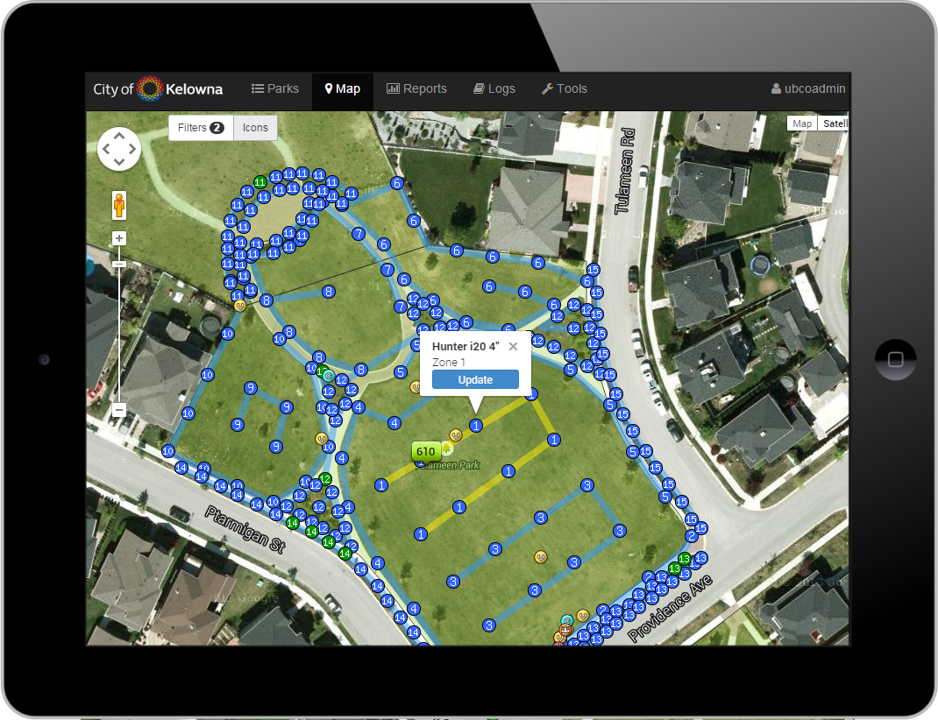
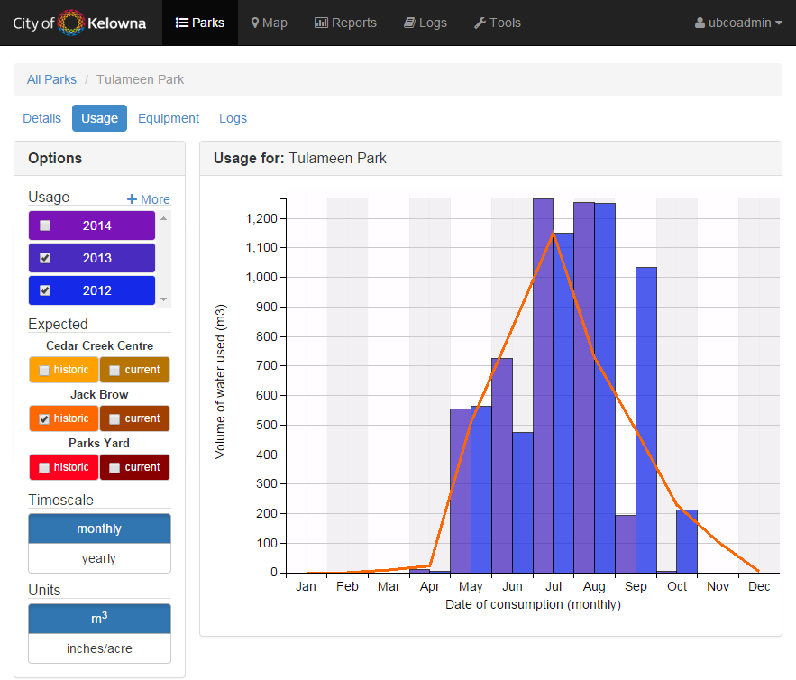
Irrigation Management Application
Cloud-based, mobile service for managing site info and recording maintenance
Aids field employees with maintenance activities and decisions in the parks
Allows managers to generate dynamic reports and charts

Slide 14
Development
Development process
Over two years with Parks Services department
Monthly meetings with managers and supervisors
Demonstrate application
Receive feedback on features, functionality, and appearance
Ensure usability of application
Irrigation technicians provided with couple opportunities to request features and provide feedback on appearance
Data collection
Water usage and park info from Parks Services managers
Park boundaries from Kelowna Open Data Catalogue
Equipment GPS locations collected by researcher, city employee, and hired student

Slide 15
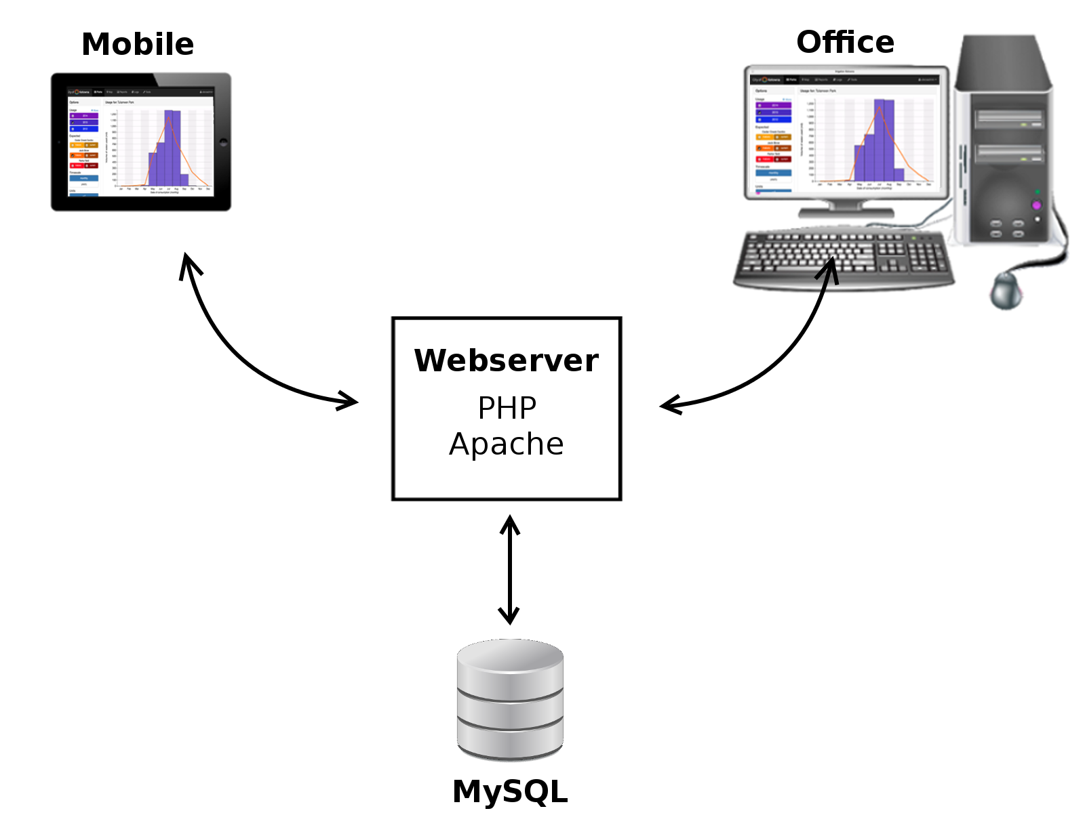
Development (continued)
Technology
Apache server
MySQL database
PHP
JavaScript
Architecture
Notes:
The application itself is hosted on an Apache server, uses a MySQL database, and is built using PHP and JavaScript. It also uses the Bootstrap HTML and JavaScript library to ensure responsiveness on any mobile device, but it is optimized for the Apple iPad. This is illustrated in the architecture diagram.

Slide 16
Features
Site searching, browsing, and details
Google Maps visualization of site equipment and features
Logging of site maintenance including text and images
Equipment inventory
User and role-based management and security
Data import and export for system interoperability
Customizable reporting
Notes:
Logging can be done by voice entry.

Slide 17
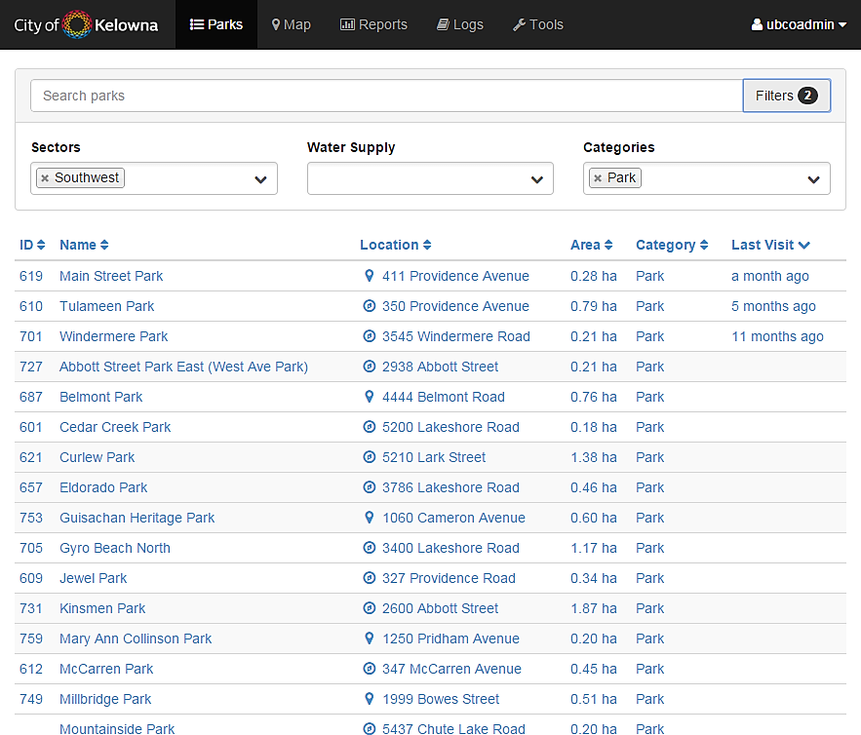
Screenshot – List of parks

Slide 18
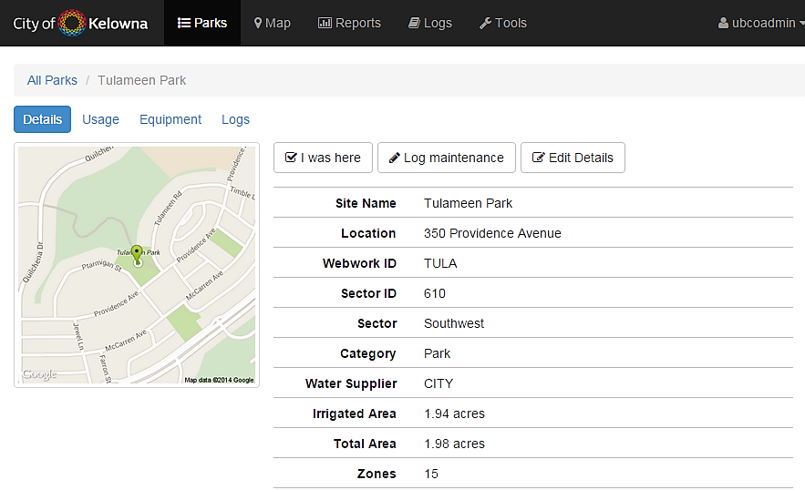
Screenshot – Park details

Slide 19
Screenshot – Park water usage

Slide 20
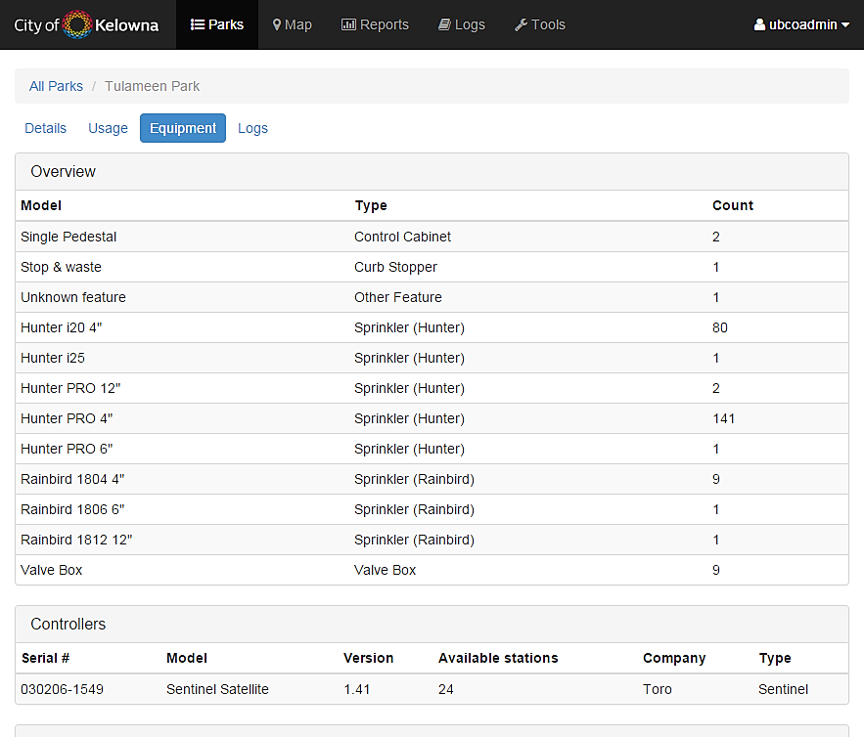
Screenshot – Park equipment inventory

Slide 21
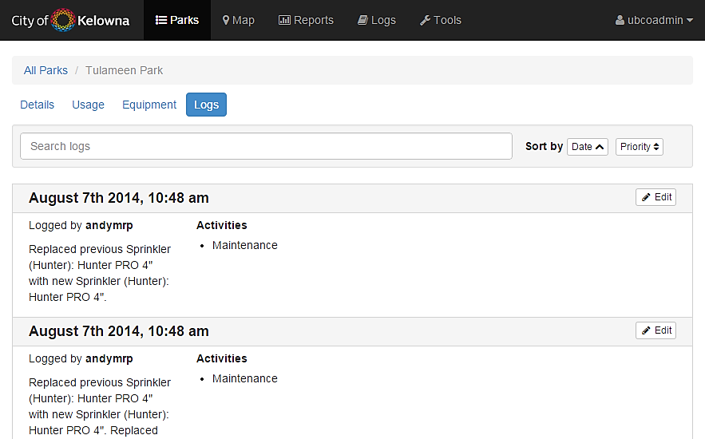
Screenshot – Park maintenance logs

Slide 22
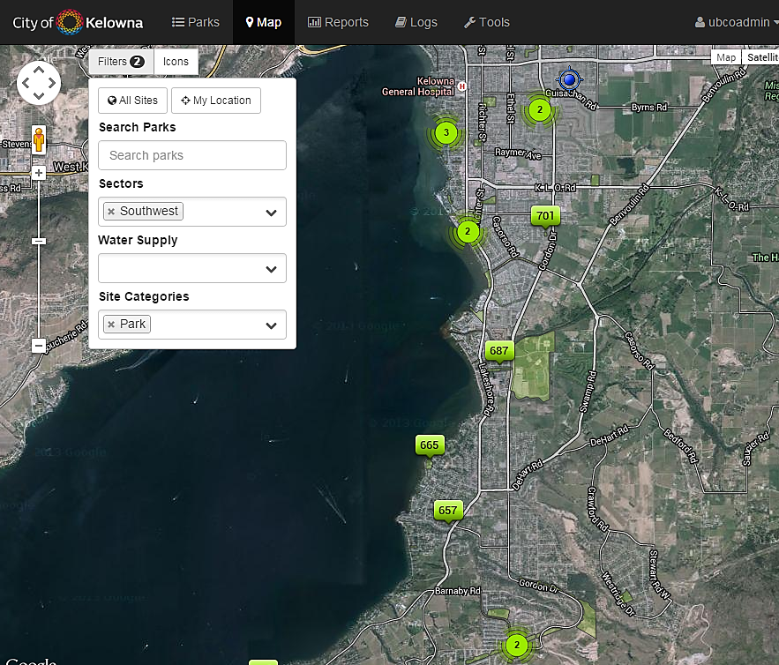
Screenshot – Map of all parks

Slide 23
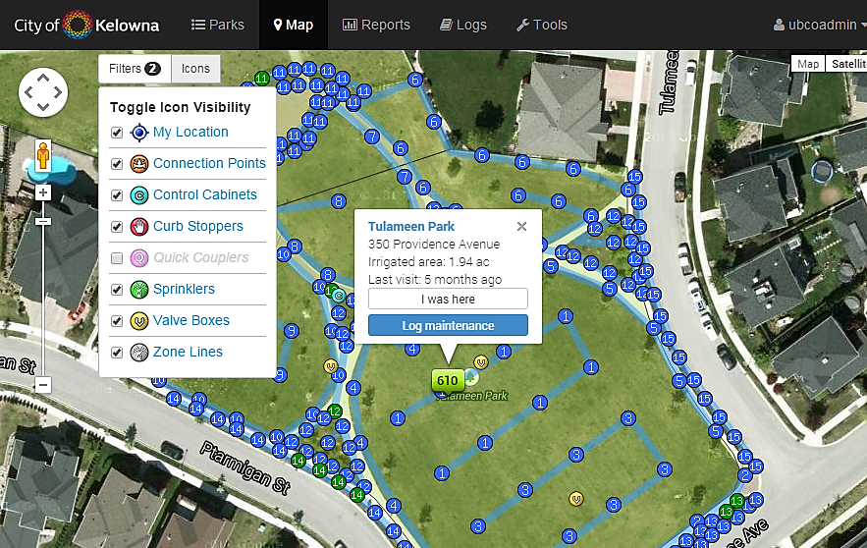
Screenshot – Map of park layout

Slide 24
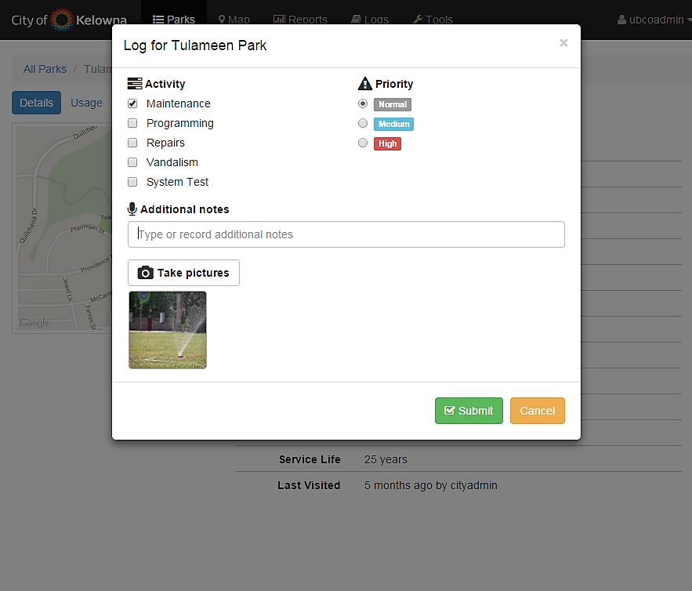
Screenshot – Creating maintenance logs

Slide 25
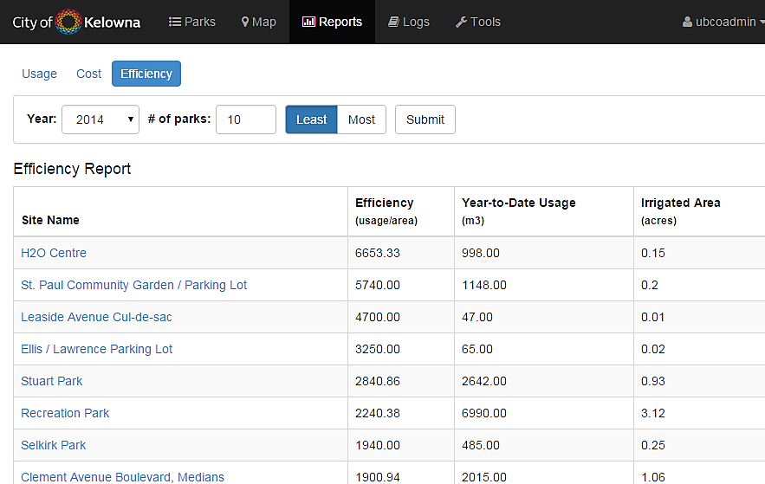
Screenshot – Generating reports

Slide 26
Case Study: City of Kelowna
Hypothesis
Mobile application in the field will allow irrigation technicians to perform maintenance activities more efficiently at parks
Goals
Improve maintenance activity efficiency
Simplify irrigation decisions
Evaluate usability of app in the field
Approach
Scenario-based testing
Questionnaires
Research ethics approval under certificate H13-03194

Slide 27
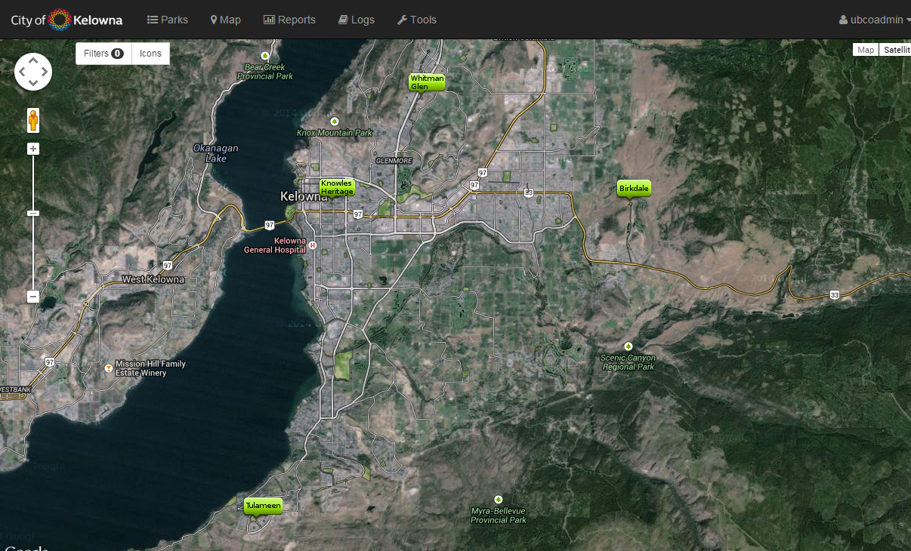
Study Procedures: Park Selection
Selected parks
Birkdale Park
Knowles Heritage Park
Tulameen Park
Whitman Glen Park
Criteria
Average irrigated area
Average irrigation zones
Recent GPS data collected
Whitman Glen
Knowles Heritage
Birkdale
Tulameen
Notes:
Approved by Parks Services managers

Slide 28
Study Procedures: Participants
7 irrigation technicians
'Expert' → Familiar with park
'Novice' → Unfamiliar with park
Testing conditions
Expert without iPad (baseline performance)
Novice without iPad or application
Novice using iPad and application
Notes:
6 full-time and 1 part-time irrigation technicians. Experts have those parks as part of their regular responsibilities, the novices do not
Due to the fact the Parks Services department is such a small, closed environment, no other demographics were collected to ensure their privacy.

Slide 29
Study Procedures: Test Scenarios
Scenario 1: Routine maintenance
Find control cabinet, connection point, curb stopper, and valve boxes
Scenario 2: Watering program alterations
Identify irrigation zone(s), and report program changes
Scenario 3: Tree planting
Identify irrigation zone(s), and determine where safe to plant
Scenario 4: Repair damaged sprinkler
Identify irrigation zone and replacement parts, and report repairs

Slide 30
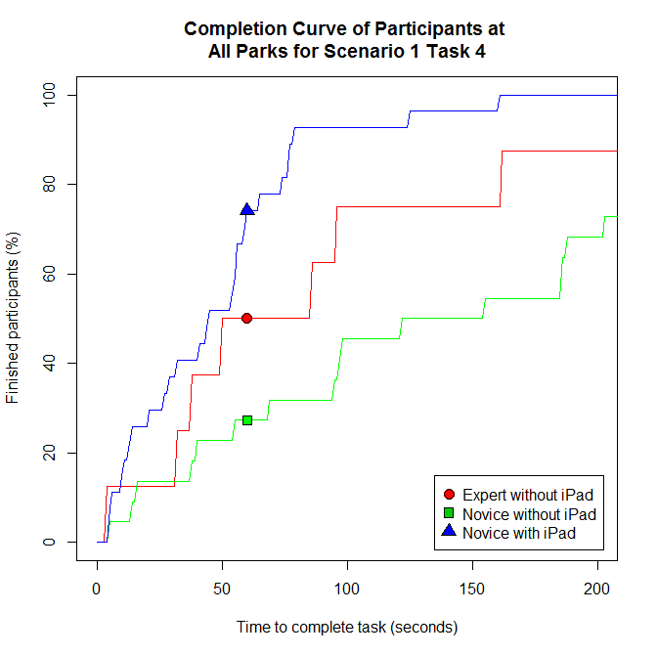
Results: Scenario 1 Task 4
Finding valve box for specific irrigation zone
Average completion time:
Experts without iPad: 122 seconds
Novices without iPad: 154 seconds
Novices using iPad: 49 seconds
Percentage of participants finished after one minute:
Experts without iPad: 50%
Novices without iPad: 27%
Novices using iPad: 74%

Slide 31
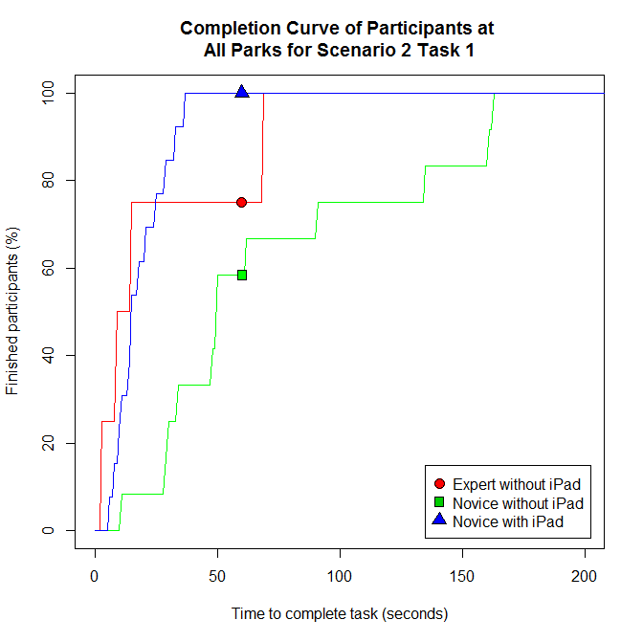
Results: Scenario 2 Task 1
Identify irrigation zone(s) with dry brown grass
Average completion time:
Experts without iPad: 25 seconds
Novices without iPad: 72 seconds
Novices using iPad: 19 seconds
Percentage of participants finished after one minute:
Experts without iPad: 75%
Novices without iPad: 58%
Novices using iPad: 100%

Slide 32
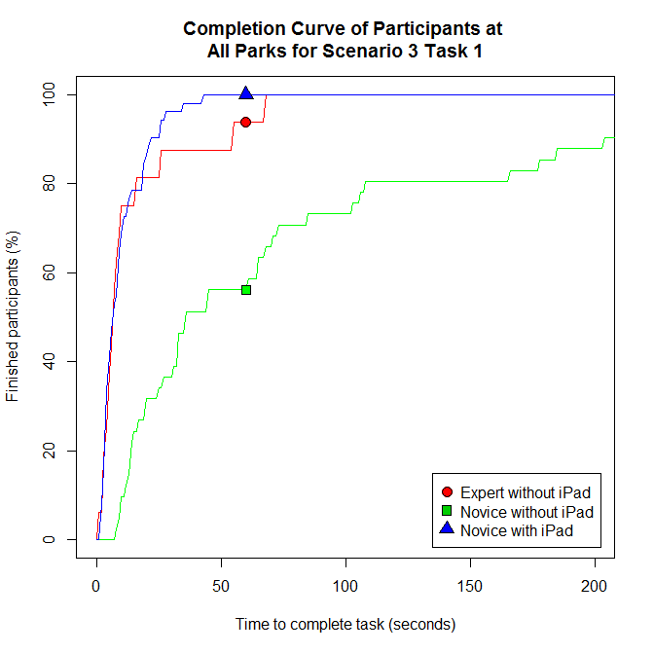
Results: Scenario 3 Task 1
Identify irrigation zone(s) affected by tree planting
Average completion time:
Experts without iPad: 15 seconds
Novices without iPad: 95 seconds
Novices using iPad: 11 seconds
Percentage of participants finished after one minute:
Experts without iPad: 90%
Novices without iPad: 56%
Novices using iPad: 100%

Slide 33
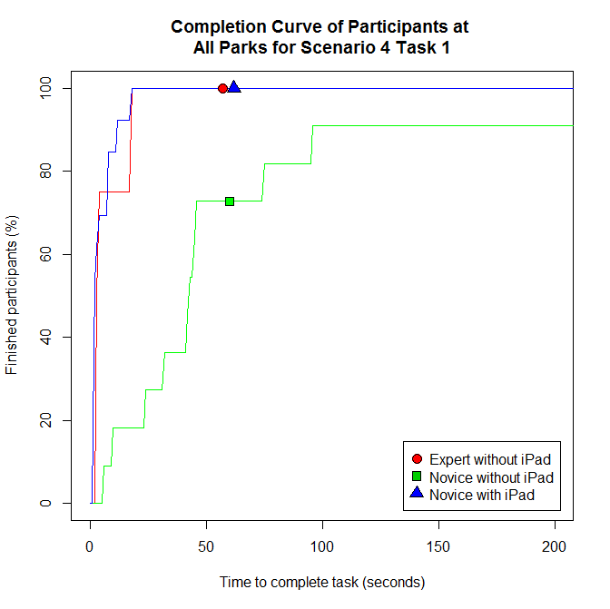
Results: Scenario 4 Task 1
Identify irrigation zone with damaged sprinkler
Average completion time:
Experts without iPad: 8 seconds
Novices without iPad: 57 seconds
Novices using iPad: 6 seconds
Percentage of participants finished after one minute:
Experts without iPad: 100%
Novices without iPad: 73%
Novices using iPad: 100%

Slide 34
Summary of Performance
 | Novice Without iPad or app | Novice Using iPad and app
Scenario 1 Task 1: find control cabinet | +125% | +65%
Scenario 1 Task 2: find point of connection | +15% | +66%
Scenario 1 Task 3: find curb stopper | +42% | +51%
Scenario 1 Task 4: find valve boxes | +26% | -60%
Scenario 2 Task 1: identify irrigation zone with dry patch | +195% | -22%
Scenario 2 Task 2: report watering time changes | N/A | N/A
Scenario 3 Task 1: identify irrigation zones to plant trees | +532% | -28%
Scenario 3 Task 2: determine if safe to plant tree | +120% | +11%
Scenario 4 Task 1: identify zone with damaged sprinkler | +668% | -24%
Scenario 4 Task 2: determine replacement parts | +138% | -18%
Scenario 4 Task 3: report on repairs made | N/A | N/A
Notes:
This is the novice performance in comparison to the expert baseline performance without the iPad or irrigation management app.
POSITIVE = slower and NEGATIVE = faster than expert performance (without the app)
GREEN = faster, YELLOW = slightly slower, and RED = significantly slower than expert baseline performance

Slide 35
Summary of Performance
 | Novice Without iPad or app | Novice Using iPad and app
Scenario 1 Task 1: find control cabinet | +125% | +65%
Scenario 1 Task 2: find point of connection | +15% | +66%
Scenario 1 Task 3: find curb stopper | +42% | +51%
Scenario 1 Task 4: find valve boxes | +26% | -60%
Scenario 2 Task 1: identify irrigation zone with dry patch | +195% | -22%
Scenario 2 Task 2: report watering time changes | N/A | N/A
Scenario 3 Task 1: identify irrigation zones to plant trees | +532% | -28%
Scenario 3 Task 2: determine if safe to plant tree | +120% | +11%
Scenario 4 Task 1: identify zone with damaged sprinkler | +668% | -24%
Scenario 4 Task 2: determine replacement parts | +138% | -18%
Scenario 4 Task 3: report on repairs made | N/A | N/A
Notes:
For example, if we take a look at these tasks which are performed quite frequently at the parks, there is quite a dramatic difference in the performance of novice with and without the iPad and app in comparison to the baseline experts without the iPad.

Slide 36
Summary of Performance
 | Novice Without iPad or app | Novice Using iPad and app
Scenario 1 Task 1: find control cabinet | +125% | +65%
Scenario 1 Task 2: find point of connection | +15% | +66%
Scenario 1 Task 3: find curb stopper | +42% | +51%
Scenario 1 Task 4: find valve boxes | +26% | -60%
Scenario 2 Task 1: identify irrigation zone with dry patch | +195% | -22%
Scenario 2 Task 2: report watering time changes | N/A | N/A
Scenario 3 Task 1: identify irrigation zones to plant trees | +532% | -28%
Scenario 3 Task 2: determine if safe to plant tree | +120% | +11%
Scenario 4 Task 1: identify zone with damaged sprinkler | +668% | -24%
Scenario 4 Task 2: determine replacement parts | +138% | -18%
Scenario 4 Task 3: report on repairs made | N/A | N/A
Notes:
Irrigation employees do not currently record maintenance activities for each park. There was no time to compare against for the performance of this task because it is an activity that they have not been doing. Now, with the irrigation management app, they can start collecting data on the activities being performed at each park. This will allow them to determine where the vandalism hotspots are or if a specific type of sprinkler fails more frequently than others – things they currently do not have!

Slide 37
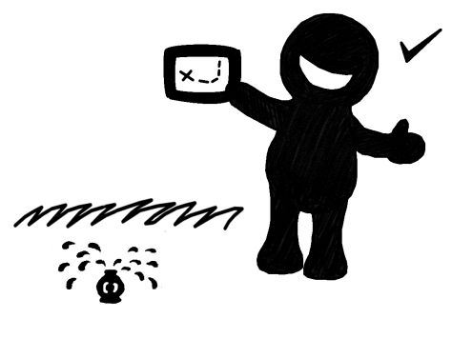
Feedback from Participants
Pre-test and post-test surveys
Measured confidence and anxiety towards mobile technology
Saw no negative impact on confidence or anxiety
Feedback on irrigation management application
Rated the app as user-friendly and easy to adopt
“I would be at a complete loss without the iPad and app, as it's not always clear where things are at the parks.”
“Things often get overlooked and forgotten, we are just so busy. But now, with the iPad and app, we can get stuff done instantly!”
“This app is so useful!”
Notes:
Mention pre- & post-test surveys; No negative impact; User-friendly and easy to adopt;

Slide 38
Conclusions
Allowed new employees to work at same or better level as experienced employees
App rated as user-friendly and easy to adopt
Reduced the time for many tasks by 24% (experienced) and 73% (new).
Allowed employees to record logs in <30 seconds including photos and field notes
Potential to improve employee efficiency by 15 to 60 minutes per day (per employee annual savings of $1,500 to $6,500)
Warrants further investigation and research
Notes:
Reporting now allows for the Parks Services department to capture trends out in the parks (vandalism hotspots).
Assume 261 work days and $25/hour rate, 5 maintenance tasks per park and 10 parks visited each day (reasonable assumption – no typical days!)
15 to 60 minutes per day saved, which translates to $1,500 to $6,500 per employee annual savings
Reiterate >70 parks per each employee

Slide 39
Future Work
Production roll-out in 2015
More support for generating reports
Adapt to Google Glass?
Use in other cities?
Notes:
Production roll-out in 2015 by Kelowna Parks Services
Provide more support for generating different and customizable reports
Adapt current system to work on mobile wearable technology such as Google Glass
Work with additional cities to implement their own irrigation management applications

Slide 40
Acknowledgements
Dr. Ramon Lawrence
Dr. Patricia Lasserre, Dr. Yves Lucet, Dr. Bowen Hui, and Dr. Jason Loeppky
Kelowna Parks Services department
Natural Sciences and Engineering Research Council of Canada (NSERC)
Notes:
List the people and organizations I should thank: Supervisory committee members?

Slide 41
Notes:
Ask for any questions

Slide 42
Additional Results

Slide 43
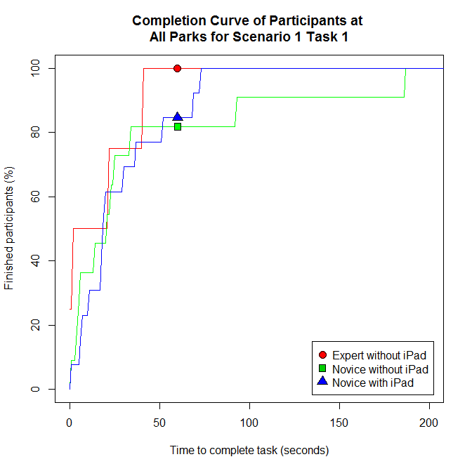
Results: Scenario 1 Task 1
Finding the control cabinet
Average completion time:
Experts without iPad: 17 seconds
Novices without iPad: 38 seconds
Novices using iPad: 30 seconds
Percentage of participants finished after one minute:
Experts without iPad: 100%
Novices without iPad: 81%
Novices using iPad: 85%

Slide 44
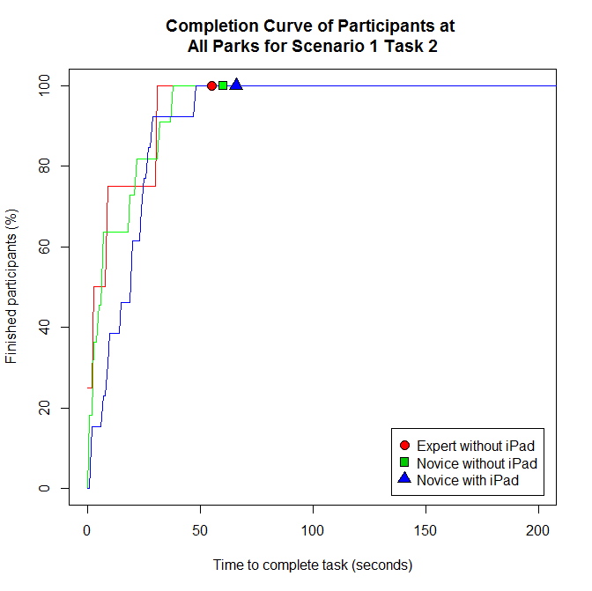
Results: Scenario 1 Task 2
Finding the connection point
Average completion time:
Experts without iPad: 11 seconds
Novices without iPad: 13 seconds
Novices using iPad: 19 seconds
Percentage of participants finished after one minute:
Experts without iPad: 100%
Novices without iPad: 100%
Novices using iPad: 100%

Slide 45
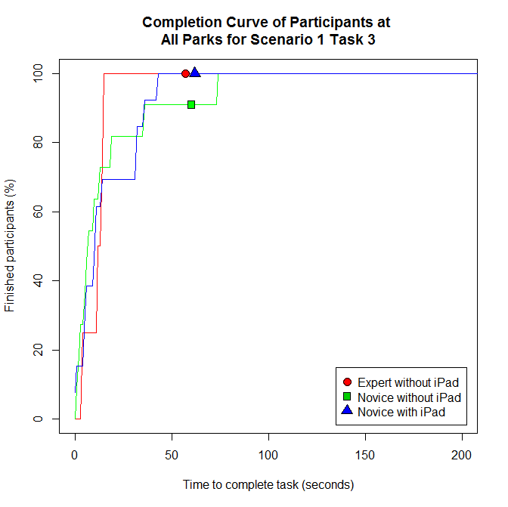
Results: Scenario 1 Task 3
Finding the curb stopper
Average completion time:
Experts without iPad: 12 seconds
Novices without iPad: 17 seconds
Novices using iPad: 18 seconds
Percentage of participants finished after one minute:
Experts without iPad: 100%
Novices without iPad: 91%
Novices using iPad: 100%

Slide 46
Results: Scenario 1 Task 4
Finding valve box for specific irrigation zone
Average completion time:
Experts without iPad: 122 seconds
Novices without iPad: 154 seconds
Novices using iPad: 49 seconds
Percentage of participants finished after one minute:
Experts without iPad: 50%
Novices without iPad: 27%
Novices using iPad: 74%

Slide 47
Results: Scenario 2 Task 1
Identify irrigation zone(s) with dry brown grass
Average completion time:
Experts without iPad: 25 seconds
Novices without iPad: 72 seconds
Novices using iPad: 19 seconds
Percentage of participants finished after one minute:
Experts without iPad: 75%
Novices without iPad: 58%
Novices using iPad: 100%

Slide 48
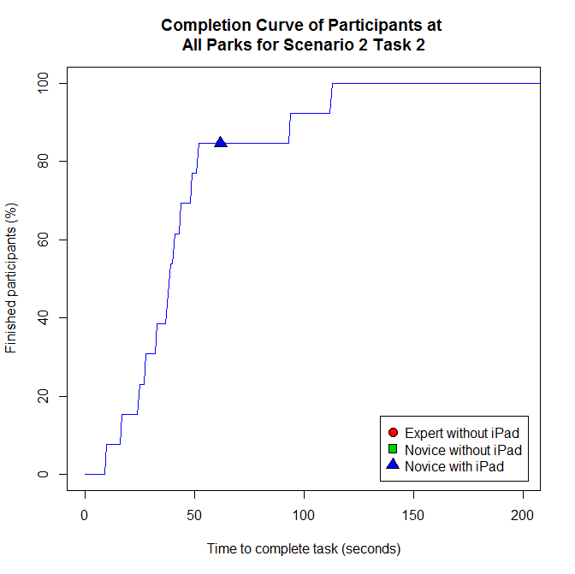
Results: Scenario 2 Task 2
Report which irrigation zone(s) need watering time altered
Average completion time:
Experts without iPad: N/A
Novices without iPad: N/A
Novices using iPad: 45 seconds
Percentage of participants finished after one minute:
Experts without iPad: N/A
Novices without iPad: N/A
Novices using iPad: 85%

Slide 49
Results: Scenario 3 Task 1
Identify irrigation zone(s) affected by tree planting
Average completion time:
Experts without iPad: 15 seconds
Novices without iPad: 95 seconds
Novices using iPad: 11 seconds
Percentage of participants finished after one minute:
Experts without iPad: 90%
Novices without iPad: 56%
Novices using iPad: 100%

Slide 50
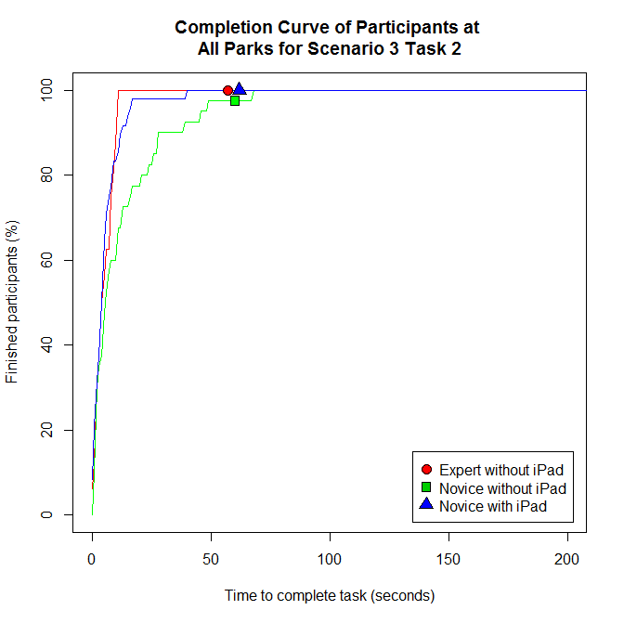
Results: Scenario 3 Task 2
Determine safest place to plant tree with minimal impact
Average completion time:
Experts without iPad: 6 seconds
Novices without iPad: 13 seconds
Novices using iPad: 7 seconds
Percentage of participants finished after one minute:
Experts without iPad: 100%
Novices without iPad: 97%
Novices using iPad: 100%

Slide 51
Results: Scenario 4 Task 1
Identify irrigation zone with damaged sprinkler
Average completion time:
Experts without iPad: 8 seconds
Novices without iPad: 57 seconds
Novices using iPad: 6 seconds
Percentage of participants finished after one minute:
Experts without iPad: 100%
Novices without iPad: 73%
Novices using iPad: 100%

Slide 52
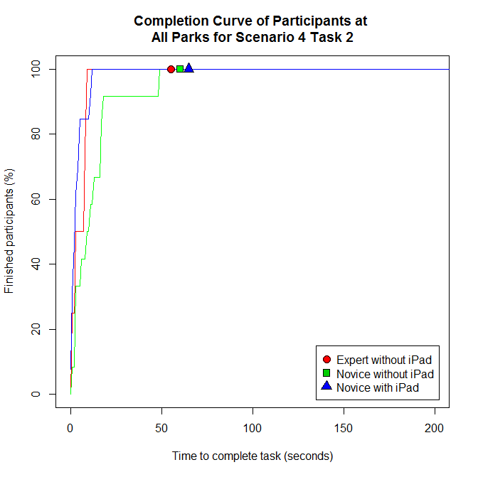
Results: Scenario 4 Task 2
Identify replacement part(s) required
Average completion time:
Experts without iPad: 5 seconds
Novices without iPad: 13 seconds
Novices using iPad: 4 seconds
Percentage of participants finished after one minute:
Experts without iPad: 100%
Novices without iPad: 100%
Novices using iPad: 100%

Slide 53
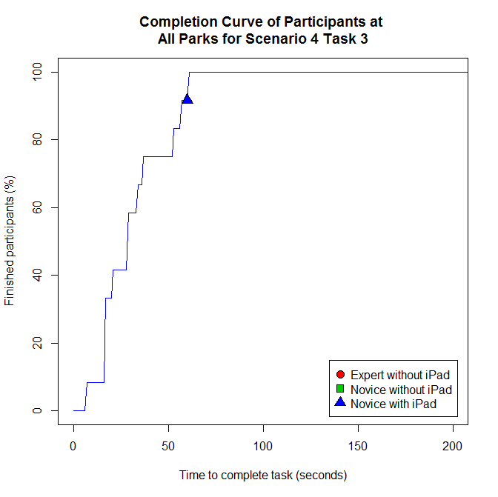
Results: Scenario 4 Task 3
Report on repairs that took place
Average completion time:
Experts without iPad: N/A
Novices without iPad: N/A
Novices using iPad: 30 seconds
Percentage of participants finished after one minute:
Experts without iPad: N/A
Novices without iPad: N/A
Novices using iPad: 92%

