Slide 1
Reducing Turfgrass Water Consumption with Adaptive Irrigation Controllers
Scott Fazackerley
M.Sc. Defence – The University of British Columbia
Notes:
University examiner, committee members, mr. chairman, ladies and gents. My name…

Slide 2
Overview
2
Problem and Motivation
Previous Work
Adaptive Irrigation Controller
Experimental Results
Summary Comments
Notes:
2

Slide 3
Introduction
Motivation
3
In North America, a considerable amount of water is used for residential irrigation
  Canada ranks in the top 10 water consumers
  Between 60% and 75% of municipal water consumption is directly attributed to turfgrass irrigation
  Cost of water is low so there is little motivation to conserve
  General controllers do not react to changing conditions
Goal: When and by how much should I water to keep my grass green without user intervention?
Notes:
-essentially treated as a free resource so we tend not to be aware of usage or habits
-requirements change over the season, current tech does not.
3

Slide 4
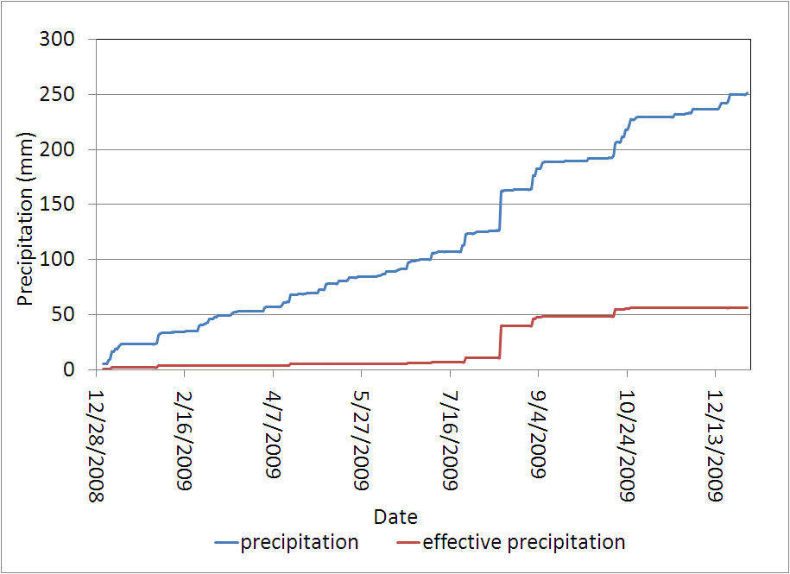
Introduction
Climate of the Okanagan Valley
4
2009 Okanagan Valley Moisture Deficit:
882 mm
Notes:
More water has been removed that supplied by precipt.
As a result, in the OK valley if we wish to grow we are religated to irrigation
Moisture Deficit = ET - Effective Precipitation , but is affected by temperature

Slide 5
Previous Work
5
Current controllers
  Preset schedule
  Bypass
    Rainfall sensor
    Soil Moisture Sensor
  Evapotranspiration (ET)
  Require infrastructure changes
  Cost and performance limitations
Notes:
Bypass RS and SMS have shown to offer moderate savings under specific conditions
1 sensor only for residential controllers and still rely on preset program
ET – based on the quality of the data and the model - $$$
Fail to address the questions of has the amount of water laid down satisfied the need
too little/too much

Slide 6
Previous Work cont.
6
Research Systems
  Examined wire replacement with wireless sensor networks
  Have used different measurement sensors
    Data collection only
    Difficult for a naive user to interpret data
    Requires user input
  No predictive closed loop strategy that attempts to deliver only the water needed

Slide 7
Adaptive Irrigation Controller
7
Desire a system that will adapt and respond to changes in soil conditions
Custom node designed to accommodate a variety of different environmental type sensors
A single design is used for both sensing and controller nodes
Supports both hard wired and wireless sensors
Compatible with numerous sensors
  Chose a low cost dielectric soil moisture sensor
Notes:
Time: 7 minutes or later

Slide 8
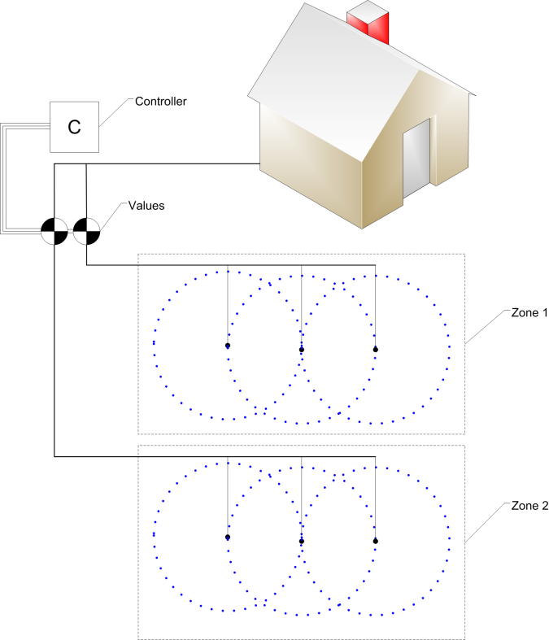
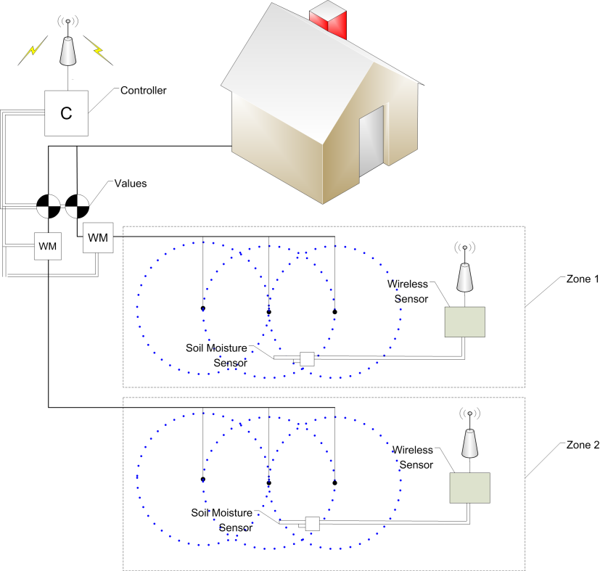
Adaptive Irrigation Controller cont.
Irrigation Systems
8
Notes:
Vision of what the system would entail
8

Slide 9
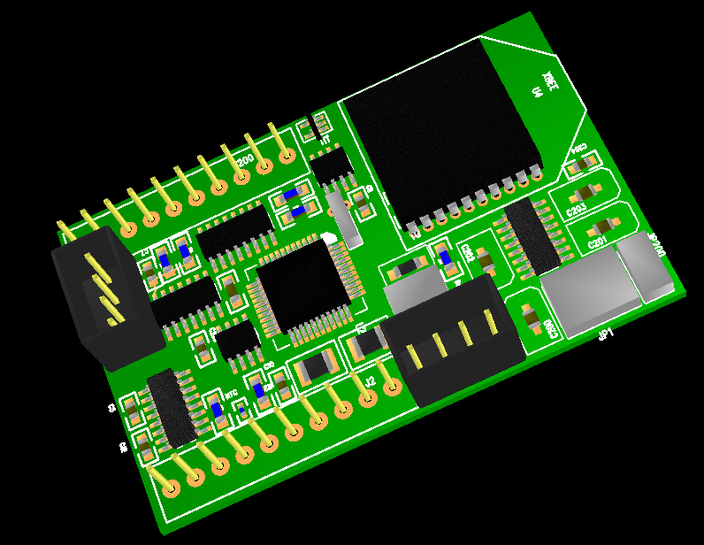
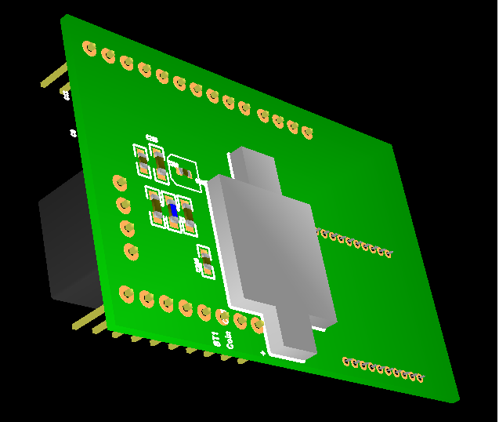
Adaptive Irrigation Controller cont.
Hardware
9
A
Notes:
Driven by the need to support numerous different sensors, small footprint and with a power efficient design, we designed a multipurpose device

Slide 10
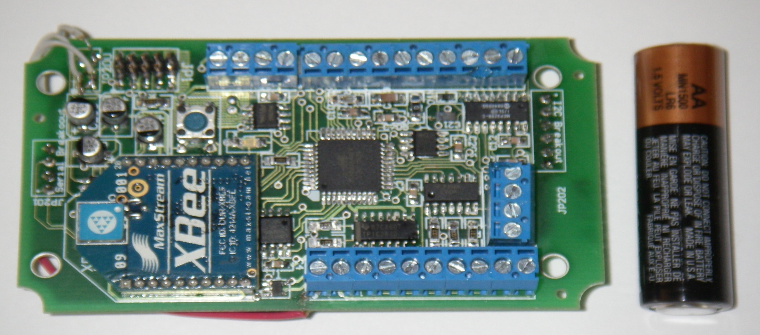
Adaptive Irrigation Controller cont.
Hardware
10
Processor
Analogue/Digital Inputs
A
Pulse Counters
Radio
Control Outputs
Notes:
Remember – pulse = flow meter

Slide 11
Adaptive Irrigation Program
11
Soil moisture is sampled on a regular basis
Controller node collects and analyzes data
  Monitors average flow
Application efficiency (Ae) is continually undated
Watering events (duration and interval) are dynamically scheduled based on needs of soil
Requires inputs of Application efficiency, Field Capacity, and Permanent Wilting Point as system parameters

Slide 12
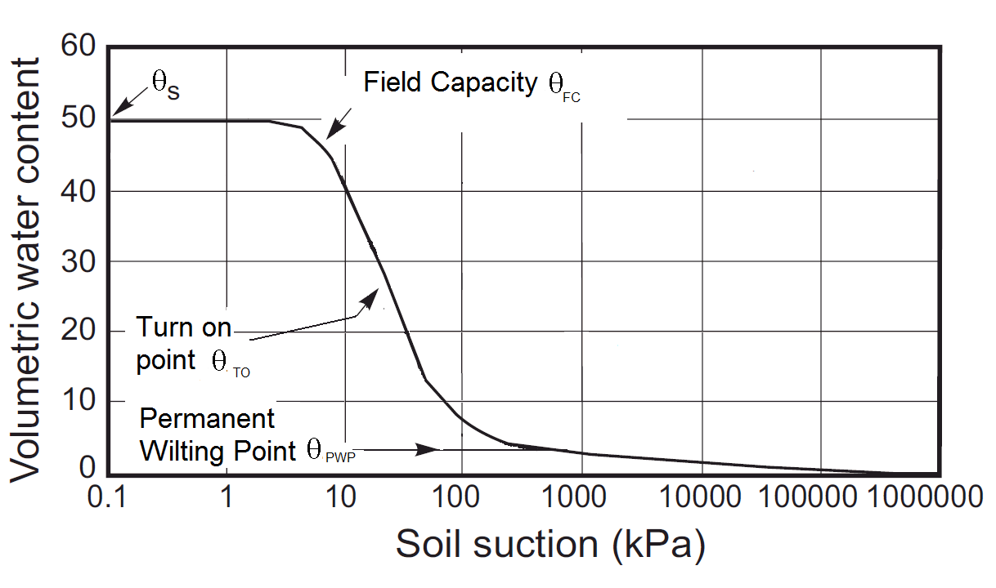
Adaptive Irrigation Program
Soil Water Storage
12
Notes:
Highlight-log/linear nature – simplistic example
-describe what this is – SWCC shows the relation between the amount of water in the soil and the energy at which the water is held in the soil matrix
-as water content lowers, water is held more tightly in the soil matrix
-we treat a soil as having a fixed storage capacity
Define FC, PWP and TO and why we wish to avoid high energy water -wilting

Slide 13
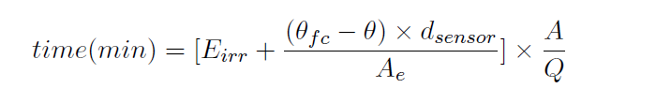
Adaptive Irrigation Program
13
  A = Area, Q = Average flow rate
Watering amount (time) is calculated to bring the water content back up to Field Capacity
Water conditions are assessed after watering
Performance of last event is used to update how next event will be performed

Slide 14
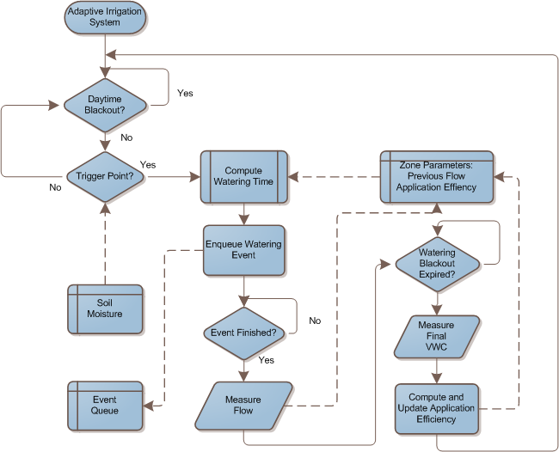
Adaptive Irrigation Program cont.
14

Slide 15
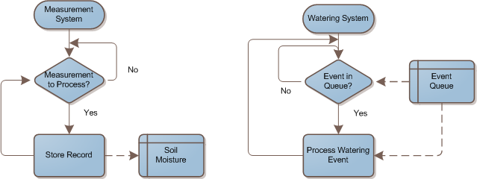
Adaptive Irrigation Program
15

Slide 16
Experimental Results
16
Watered during the 2009 growing season
Compared against control zone (daily watering)
Used the National Turfgrass Evaluation Program (NTEP) criteria for evaluating quality throughout season
Parameters:
      Test plot = 3 m x 3 m space
      Soil Moisture Sensor Depth 10 cm
      Initial Application Efficiency = 76%
Notes:
16

Slide 17
Experimental Results
July and August
17
 | Adaptive | Control | % Diff
Total Volume (litres) | 2915.4 | 6471.6 | 55%
Total Depth (meters) | 0.324 | 0.719 | 55%
Est. Evap. Loss (meters) | 0.065 | 0.265 | 75%
Notes:
-Normalized by area
-estimated loss
17

Slide 18
Experimental Results
Entire Season
18
 | Adaptive | Control | % Diff
Total Volume (litres) | 3347.4 | 11386.6 | 71%
Total Depth (meters) | 0.371 | 1.265 | 71%
Est. Evap. Loss (meters) | 0.075 | 0.455 | 84%
Notes:
18

Slide 19
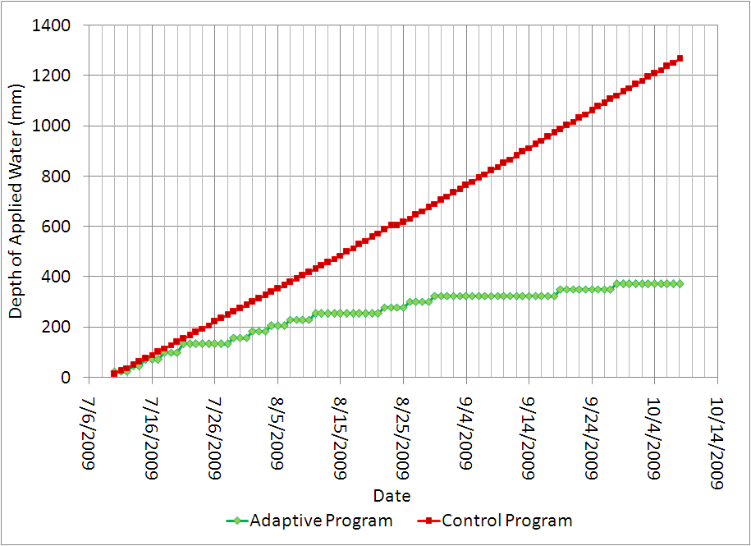
Experimental Results cont.
Cumulative Depth of Water
19
Notes:
-control matches well during start, by highlights the need for ongoing adjustment of the schedule
19

Slide 20
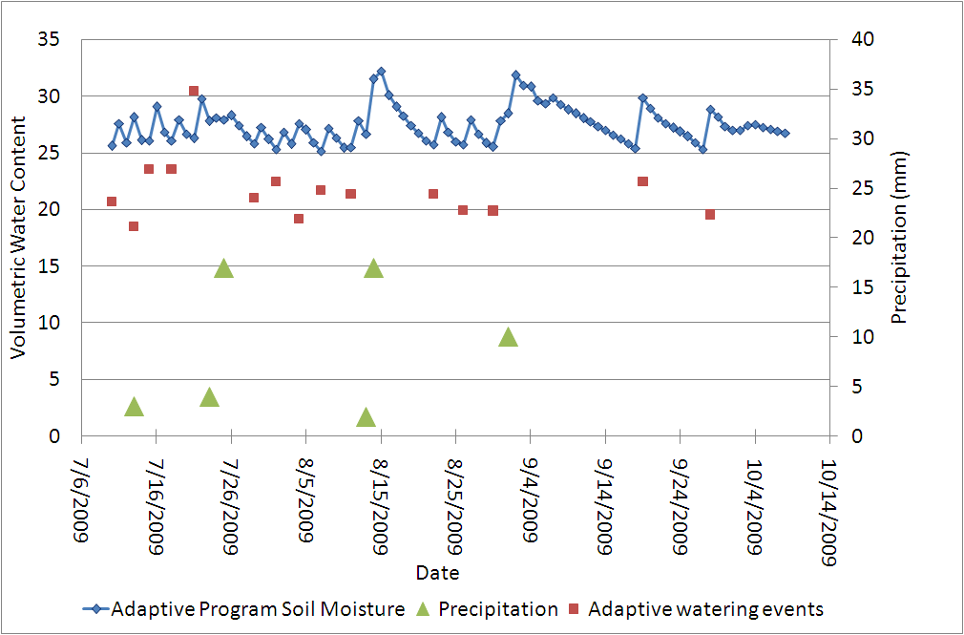
Experimental Results cont.
Watering Cycle: Losses and Additions
20
Notes:
Highlight what has gone on in adaptive zone
-Between TO and FC
-when it rains what happens to irrigation
-slope water content vs time changes over the season and the adaptive irrigation controller responds by irrigation less frequently
20

Slide 21
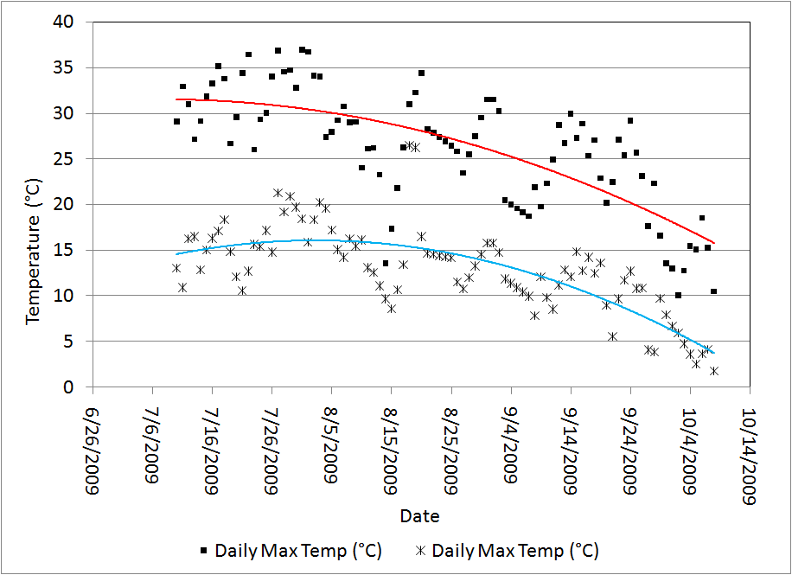
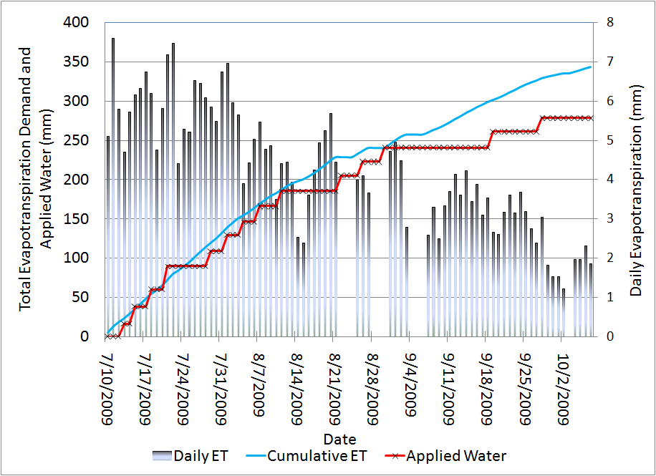
Experimental Results cont.
ET Response
21
Daily Temperature
Applied Water and ET
Notes:
As a better comparison, the amount of water delivered was compared to the actual calcualted daily ET
-farmwest monitoring site -> belgo
-ET stations use temperature
-track ET well until late in season where we deliver less than ET
-changes late in season, ET would overestimate due to site differences between test site and reference site
Adaptive irrigation allows for site specific irrigation
21

Slide 22
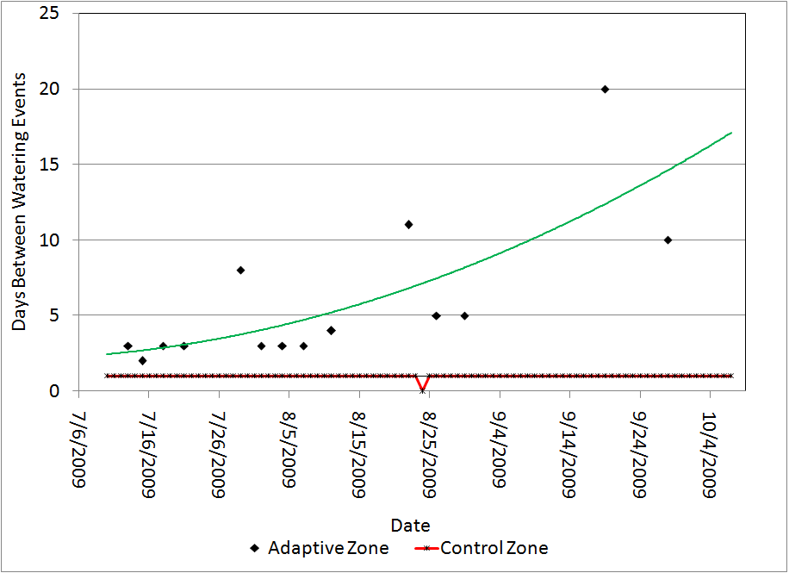
Experimental Results cont.
Days Between Watering
22
Notes:
22

Slide 23
Conclusions
23
The adaptive irrigation controller can realize significant water savings
Proactive strategy prevents overwatering
Keeps turfgrass healthy
Adapts to changes growing conditions to delivering only the water that is needed
Notes:
-as we focus on recharge and evaluate how well the recharge was achieved

Slide 24
Future Work
24
Improvement of soil sensor and enclosure
Large scale deployment in 2010 for turfgrass management utilizing multi-hop routing scheme for extended coverage
Simplification of infrastructure
  Replacement of flow meters with an online flow estimation method

Slide 25


Acknowledgments
25
  My family
  Dr. R. Lawrence, Dr. C. Nichol and Dr. D. Scott
  University of British Columbia Martha Piper Research Fund
  The Natural Sciences and Engineering Research Council of Canada
Notes:
Amy especically
25

Slide 26
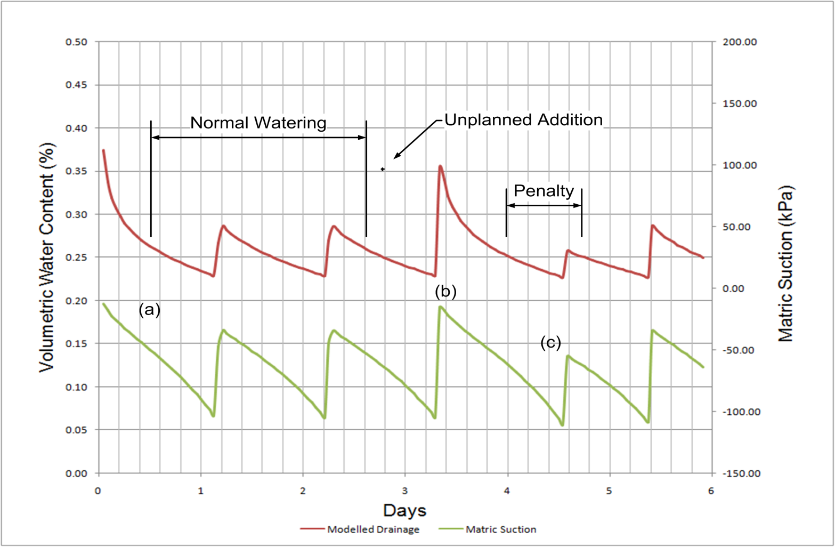
Extra
26
Notes:
Amy especically
26

Slide 27
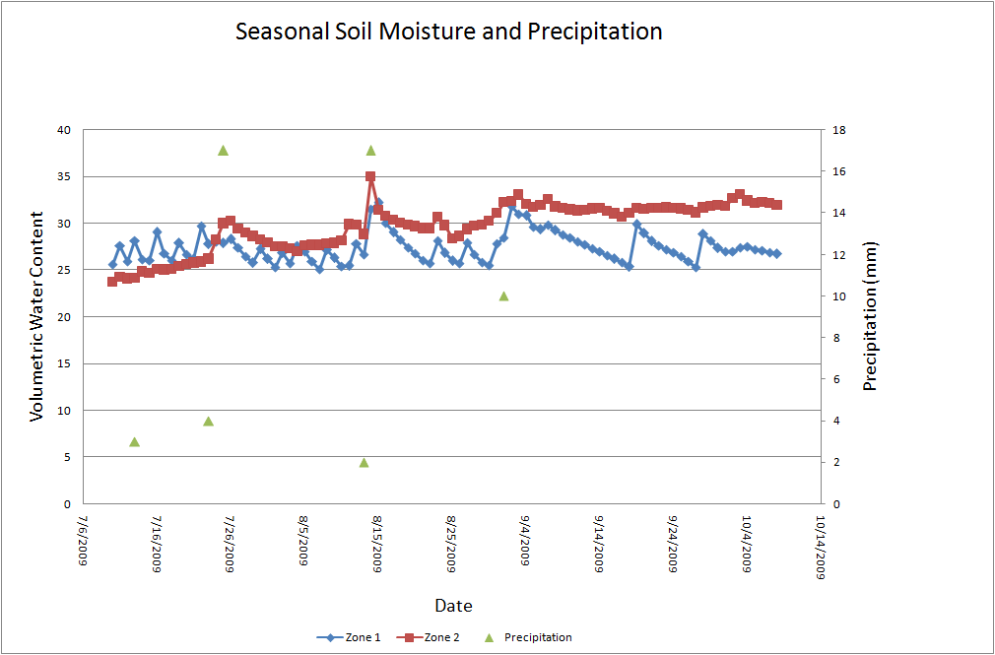
Extra
27
Notes:
Amy especically
27

