Slide 1
Linear Hashing for Flash Memory on Resource-Constrained Microprocessors
Spencer MacBeth
Supervisor - Dr. Ramon Lawrence
Faculty - Computer Science

Slide 2

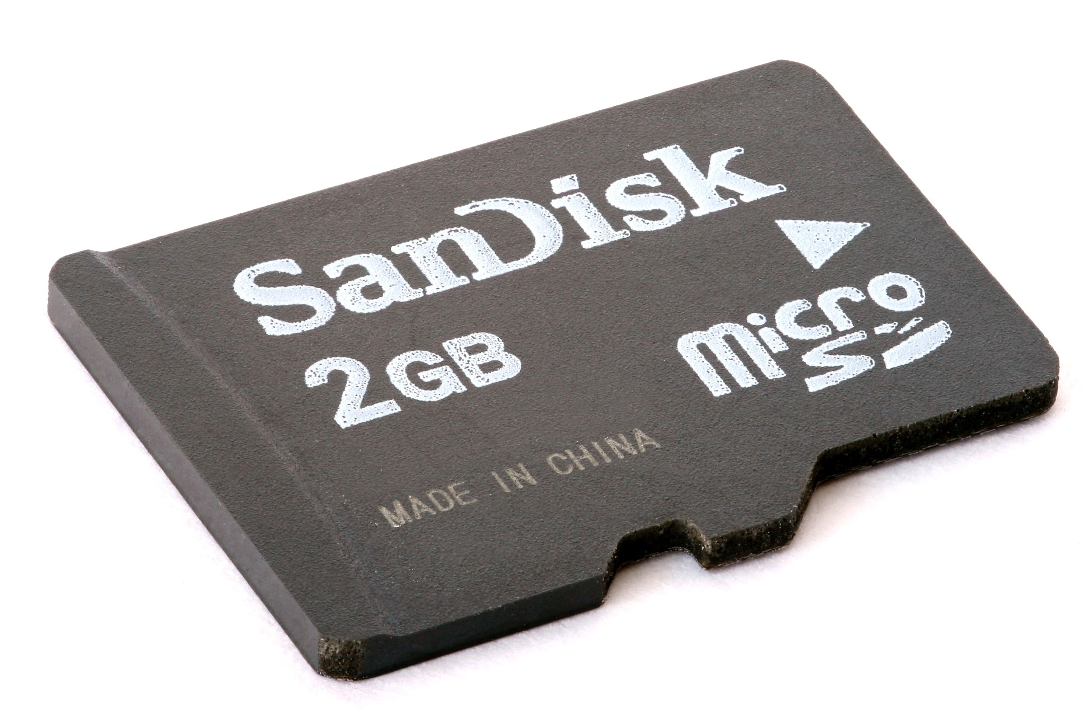

Overview
Arduinos
IonDB
Flash Memory
- An inexpensive, extensible, computing device with limited resources.
- Capable of taking in input through an array of accessories, interfacing with it, and producing output
- A high-performance implementation of a map data structure that can run in the Arduino environment
- Currently has an interface which can use several different implementations with different tradeoffs
- Becoming increasingly popular
- Used in many small devices, including Arduinos
- Has asymmetric read and write performance
- Algorithms can adapted to exploit this property of flash memory
Notes:
There scope of this project is largely defined by 3 domains – Arduinos are… IonDB is… Flash Memory…

Slide 3
Research Objective:
Assess the performance of the linear hash on the Arduino platform

Slide 4
Motivations
The linear hash data structure has near-optimal performance for the basic hash table operations
The linear hash maintains its performance while using little main memory
Currently there is no implementation of a linear hash data structure for the Arduino platform

Slide 5
The Linear Hash

Slide 6
Terminology
Bucket
Stores a set number of records
Storage units in 2D linked-list structure
Overflow Bucket
When a new record maps to a full bucket, an overflow bucket is created
Load
The number of records in the table divided by the table’s current capacity
Split
Create new bucket and redistribute records in bucket pointed to by the split pointer
Notes:
Before we explore the implementation details, we need to become familiar with the some termis
Linear hashes have buckets
Linear hashes have overflow buckets
Linear hashes are always operating at some load
Split operations are performed periodicaly to maintain equal record distribution amongst buckets

Slide 7
Diagram
Records per bucket = 4
Capacity = 4 * 4 = 16
Load = 14 / 16 = 87.5%
Split pointer = Bucket 0
Notes:
Here is a diagram visualizing the structure of the linear hash
The dimension of the linked list shown running horizontally is all of the indexed buckets
The overflow buckets extend vertically downward.
Capcity excludes overflow buckets
Split pointer at bucket 0

Slide 8
Properties
Constant Time Operations
Insert, update, get, and delete run in O(1)
Cost of splits remains relatively constant
Linear Memory Usage
Size of table grows linearly in proportion to the number of records
Average Bucket Load Relatively Constant
Periodic splitting of buckets
Hash function used makes a difference
Configurable
Different parameter values can be used in different environments
Notes:
This setup leads to some desirable properties…

Slide 9

Insertion Example
Linear Hash Table
start_size = 4;
split_pointer = bucket 0;
split_threshold = .80
h0(k) = k mod start_size
h1(k) = k mod (2 * start_size)
Suppose we had a linear hash table with the following characteristics:
Initial size = 4 buckets
2 records per bucket
Next bucket to split = 0
Split performed when load > 80%
Records with id 2, 3, 4, 5, and 8 have been inserted
Current load = (records / buckets * records_per_bucket) = 62.5%
Notes:
With these concepts in mind, consider a brief example…

Slide 10
Insertion Example
Linear Hash Table
start_size = 4;
split_pointer = bucket 0;
split_threshold = .80
h0(k) = k mod start_size
h1(k) = k mod (2 * start_size)
State after inserting 16
h0(16) = 16 mod 4 = 0
Bucket 0 is full so an overflow bucket is created
Load = 6 / 8 = 75%
Notes:
First we are going to insert record 16 into the table
We use the bucket assignment function h0 pictured in the panel on the right to determine which bucket to put it in
Bucket 0 is full so we create an overflow bucket

Slide 11
Insertion Example
Linear Hash Table
start_size = 4;
split_pointer = bucket 0;
split_threshold = .80
h0(k) = k mod start_size
h1(k) = k mod (2 * start_size)
State after inserting 9
h0(9) = 9 mod 4 = 1
Load = 7 / 8 = 87.5%
Since 87.5% is above the split threshold, a split is performed
Notes:
Insert 9
First we apply the bucket assignment function
Bucket 1 not empty so no overflow created
The load is now above the split threshold so a split is performed on the bucket pointed to by the split pointer which is bucket 0

Slide 12
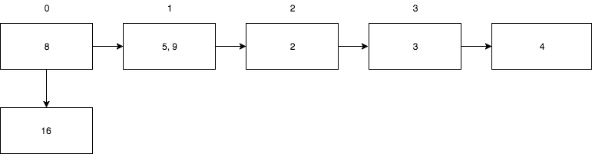
Split Example
Linear Hash Table
start_size = 4;
split_pointer = bucket 1;
split_threshold = .80
h0(k) = k mod start_size
h1(k) = k mod (2 * start_size)
Add a new bucket with an index of n where n is the number of buckets before inserting
For each record in the bucket to split:
b0 = h0(record.key)
b1 = h1(record.key)
If (b0 != b1):
Delete record from bucket b0
Insert record into bucket b1
Increment split pointer
4
Notes:
The split is conducted as follows
First we create a new indexed bucket
Then we apply the following algorithm to the bucket being split
Note that the result of h1 will always be the index of the latest bucket created

Slide 13
Implementation for the
Arduino Environment

Slide 14
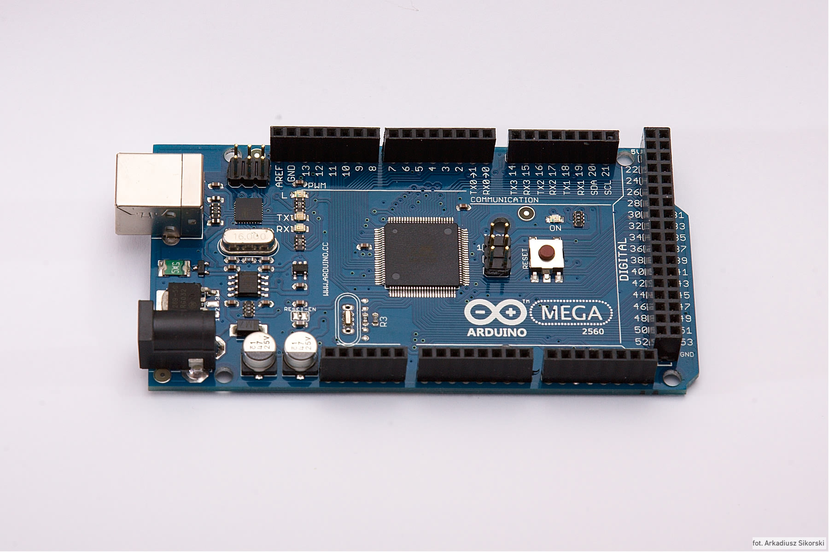
Specifications
Uses flash memory for programs
Relatively high storage capacity from micro SD card (a 32 GB Lexar MicroSD card was used during testing)
8KB of RAM
4KB of local storage on device not used
ATmega2560

Slide 15
Strategies Used
Swap-on-Delete
When deleting a record, pluck the last record in the last bucket for this index and use it to fill the hole in the list.
Consequences:
Increased insert performance as empty location always known
3 additional disk accesses performed for every delete (read swap bucket, update swap bucket, write swap record)
Reversed Linked-List
When creating an overflow bucket, instead of updating the tail bucket in the list, the new overflow bucket points to previous head.
Consequences:
Eliminates additional write during insert (which are more expensive than reads on flash)

Slide 16
Strategies Used
Eager Deletions During Swap
In the IonDB standard, all records with the specified key are deleted. If the swap record retrieved has this key, it is deleted immediately.
Consequences:
Reduces the amount of disk accesses during deletes
This gain is proportional to the amount of records with the same key in the table
Bucket Caching
During operations where all records in a bucket are checked against some condition, the entirety of the bucket and its record is read into main memory.
Consequences:
Reduces amount of disk accesses by a factor of the amount of records per bucket on average
Requires the cache be updated when datafile is mutated

Slide 17
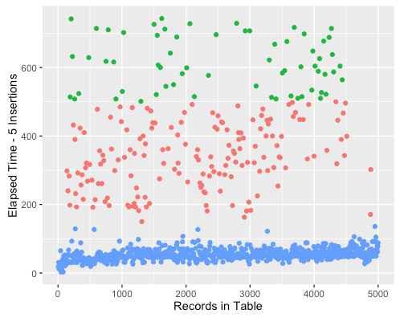
Time for Inserts vs Records in Table
INSERT Operation
Insert time remains constant as linear hash grows
Groupings demonstrate the triggering splitting (highest time grouping) and creation of overflow (mid level grouping)
Group where time is consistently very low for inserts is when inserting into a bucket that is not full

Slide 18
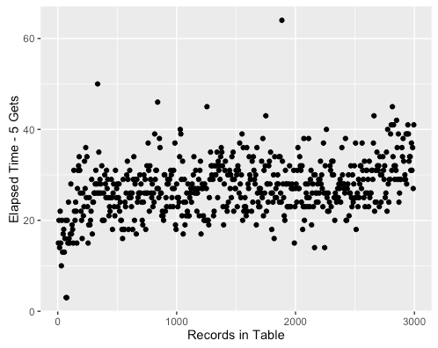
GET Operation
Time for Gets vs Records in Table
Constant average retrieval time
Some variance due to randomly generated values, some buckets will have more overflow buckets than others
May require scan of linked list of overflow buckets

Slide 19
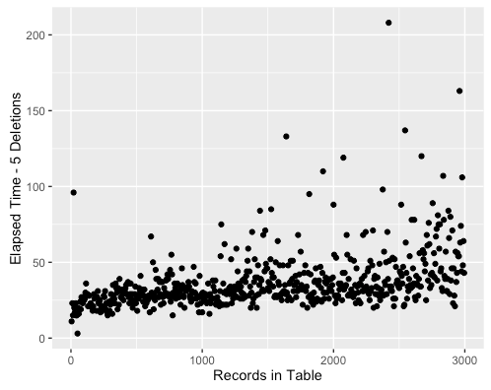
Time for Deletes vs Records in Table
DELETE Operation
Average delete time remains constant
Some variance again due to randomly generated values, some buckets will have more overflow buckets than others
In IonDB standard, performance of delete proportional to the amount of records that share keys

Slide 20
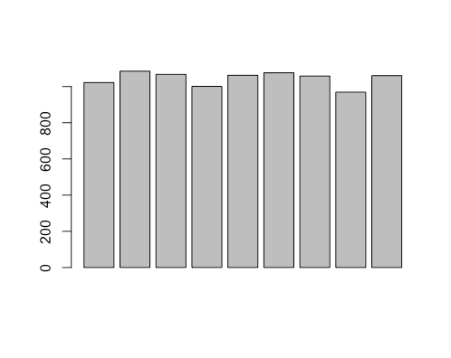
Record Distribution
Record distribution remains relatively equal
Polynomial string hashing was used on keys before bucket assignment to reduce collisions
Record Counts in Bucket Groups
Record Count in Group
Groups of 50
Consecutive Buckets

Slide 21
Performance Comparisons

Slide 22
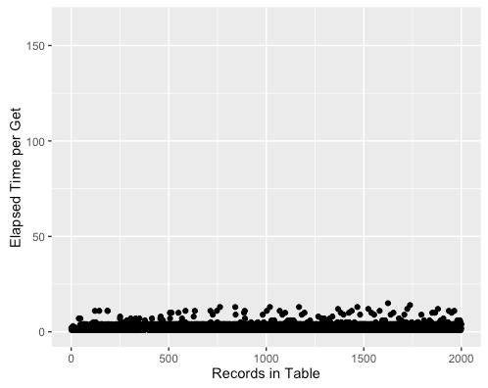
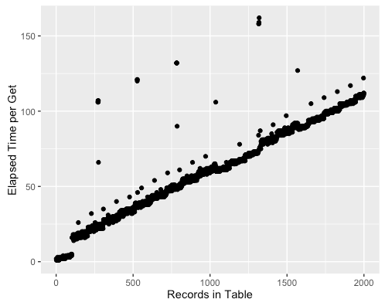
Linear Hash vs. Flat File - Arduino
Linear hash mean get time = 2.356 ms
Flat file mean get time = 60.577 ms
Notes:
Gap when ff falls out of caching

Slide 23
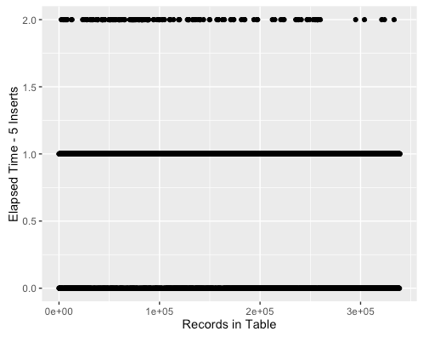
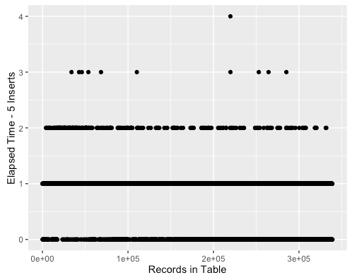
Linear Hash vs. B+ Tree - PC
Linear hash mean insert time = 0.148 ms
B+ tree mean insert time = 0.160 ms
Notes:
The constant coefficients that affect the b+ tree are small enough that we cannot visualize the logarithmic curve at this scale

Slide 24
Conclusion:
The linear hash data structure maintains its constant-time operations on the Arduino platform
Swap-on-delete outperforms tombstoning for delete operations when conforming to the IonDB-standard
The specific implementation of the linear hash used outperforms a B+ tree data structure on disk

Slide 25
A special thank you to
Dr. Ramon Lawrence and Eric Huang for their continuous support and guidance!

